Slide 1
Understand the role of the supervisor in ensuring compliance with food safety legislation
PowerPoint presentation
Unit 306: Monitoring and supervision of food safety

Slide 2
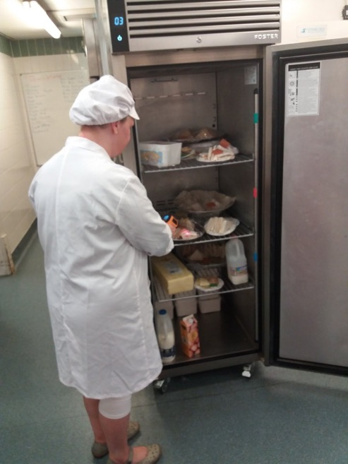
State the ways in which legislation is enforced
Enforcement measures:
Hygiene orders
Fines and penalties.

Slide 3
Legislation
Controlling/reducing outbreaks of food poisoning
Registration of premises/vehicles
Content and labelling of food
Preventing manufacture and sale of food
Food imports
Prevention of food contamination and equipment contamination
Training of food handlers
Provision of clean water, sanitary and washing facilities.

Slide 4
Role of the food safety enforcement authority
Offer advice and guidance on all food safety matters
Advise and deliver training on legislation and compliance
Investigate complaints
Ensure food offered for sale is fit for purpose
Monitor food operations and identify possible sources of contamination
Observe the effectiveness of food management systems and records
Deal with food poisoning outbreaks or other food related problems
Deal with non-compliance of legislation.

Slide 5
Enforcement measures
Hygiene Improvement Notice
Hygiene Prohibition Notice
Hygiene Prohibition Order
Fines and penalties.
Notes:
Photo source – food.gov.uk

Slide 6
Enforcement measures
Hygiene Improvement Notice
Used when an enforcement officer believes a business does not comply with the regulations.
Identifies what actions need to be taken and a time limit to complete them.

Slide 7
Enforcement measures
Hygiene Prohibition Notice
Used when an enforcement officer believes a business does not comply with the regulations and there is an immediate risk to health from the business.
A business issued with a Hygiene Prohibition Notice in the UK would need to apply to a court to have it revoked once compliance has been achieved.

Slide 8
Enforcement measures
Hygiene Prohibition Order
Used when an enforcement officer believes an individual does not comply with the regulations. It is issued by a court and would prevent an individual working in a food business.

Slide 9
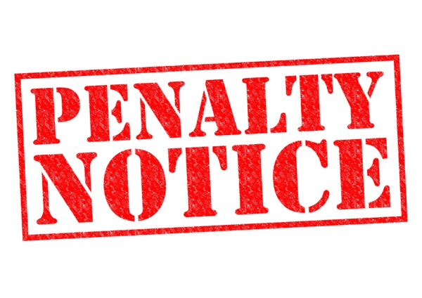
Enforcement measures
Fines and penalties
For serious offences, enforcement officers can act through the courts where fines and imprisonment can be imposed.

Slide 10
Any questions?

