Slide 1
Understand the application and monitoring of food safety practices
PowerPoint presentation
Unit 306: Monitoring and supervision of food safety

Slide 2
The importance of temperature control in a professional kitchen
To prevent or reduce to an acceptable level bacterial multiplication
To prevent outbreaks of food poisoning
To meet due diligence criteria
Environmental health agency requirements
To keep food safe
To comply with legislation
To control wastage.

Slide 3
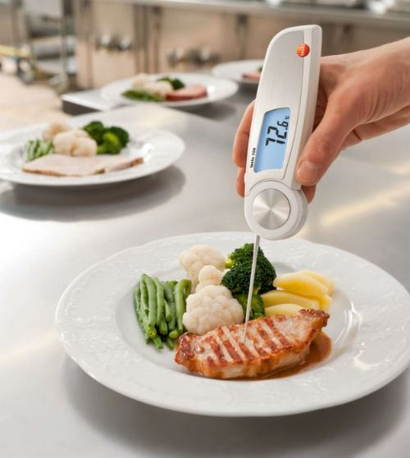
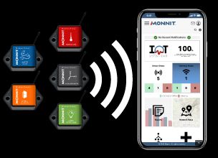
Methods used to control safe temperatures of food
Monitoring temperatures:
manual checks
visual checks
automated recording systems
Notes:
Photo source - https://www.google.com/url?sa=i&source=images&cd=&cad=rja&uact=8&ved=0ahUKEwj8oZDjh6vnAhX6TBUIHeeVAPoQMwhfKAgwCA&url=https%3A%2F%2Fwww.confessionsoftheprofessions.com%2Ftemperature-monitoring-food-industry-infographic%2F&psig=AOvVaw1l_HxeELx0PdC9TII2HLNW&ust=1580464653577521&ictx=3&uact=3
Photo Source 2 - https://www.google.com/url?sa=i&source=images&cd=&cad=rja&uact=8&ved=0ahUKEwj8oZDjh6vnAhX6TBUIHeeVAPoQMwiXASgdMB0&url=https%3A%2F%2Fwww.monnit.com%2Fsolutions%2Ffood-temperature-monitoring&psig=AOvVaw1l_HxeELx0PdC9TII2HLNW&ust=1580464653577521&ictx=3&uact=3

Slide 4
Methods used to control safe temperatures of food
Calibrated and sanitised temperature probes
Calibrated – to ensure accuracy of readings and identify faulty equipment
Sanitised – to prevent cross contamination.
Notes:
Photo source - https://www.google.com/url?sa=i&source=images&cd=&cad=rja&uact=8&ved=0ahUKEwi1j4S4iKvnAhUFuHEKHZ26C1QQMwh1KBMwEw&url=https%3A%2F%2Fbuythermopro.com%2Fguides%2Fhow-to-clean-meat-thermometer%2F&psig=AOvVaw2r7L_2L8UokweTl0fDPiIr&ust=1580464831631427&ictx=3&uact=3

Slide 5
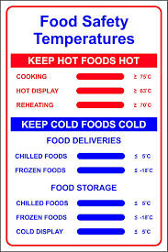
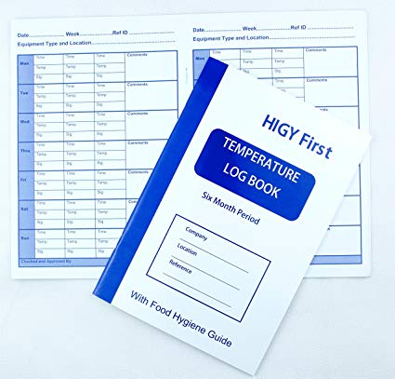
Methods used to control safe temperatures of food
Recording of temperatures:
on delivery
cold storage
cooking
hot holding
Reheating.
Notes:
Photo source 1 - https://www.google.com/url?sa=i&source=images&cd=&cad=rja&uact=8&ved=0ahUKEwiEpengiKvnAhUGmBQKHQNPCskQMwhXKAQwBA&url=https%3A%2F%2Fwww.amazon.co.uk%2FTemperature-recording-appliance-temperatures-Months%2Fdp%2FB00K0GLWLA&psig=AOvVaw2Yj3y6QdFzgw_J7BOvwlFH&ust=1580464917130577&ictx=3&uact=3
Photo source 2 - https://www.google.com/url?sa=i&source=images&cd=&cad=rja&uact=8&ved=0ahUKEwiEpengiKvnAhUGmBQKHQNPCskQMwhTKAIwAg&url=https%3A%2F%2Fwww.amazon.co.uk%2FTemperature-recording-appliance-temperatures-Months%2Fdp%2FB00K0GLWLA&psig=AOvVaw2Yj3y6QdFzgw_J7BOvwlFH&ust=1580464917130577&ictx=3&uact=3

Slide 6
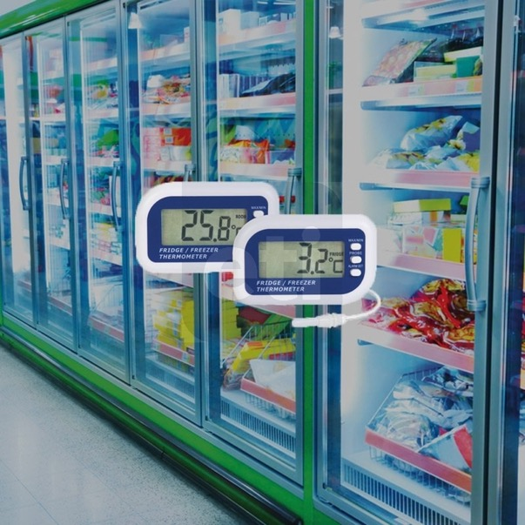
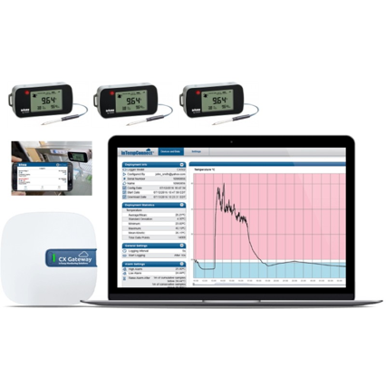
Methods used to control safe temperatures of food
Use of cold storage equipment
Visual displays and or automatic recording systems for:
refrigeration – closed cabinets
freezers
cold refrigerated open displays.
Notes:
Source 1 - https://www.google.com/url?sa=i&source=images&cd=&cad=rja&uact=8&ved=0ahUKEwjPisrJiavnAhWeSEEAHWlwD9MQMwiTAig_MD8&url=https%3A%2F%2Fthermometer.co.uk%2Ffridge-freezer-thermometers%2F1098-fridge-or-freezer-thermometer-with-internal-sensor-max-min-function.html&psig=AOvVaw3RHwC3sKbweRJVqnaBFGJP&ust=1580465136888502&ictx=3&uact=3
Source 2 - https://www.google.com/url?sa=i&source=images&cd=&cad=rja&uact=8&ved=0ahUKEwjPisrJiavnAhWeSEEAHWlwD9MQMwjtASguMC4&url=https%3A%2F%2Fwww.tempcon.co.uk%2Fshop%2Ffood-fridge-temp-monitoring-system&psig=AOvVaw3RHwC3sKbweRJVqnaBFGJP&ust=1580465136888502&ictx=3&uact=3

Slide 7
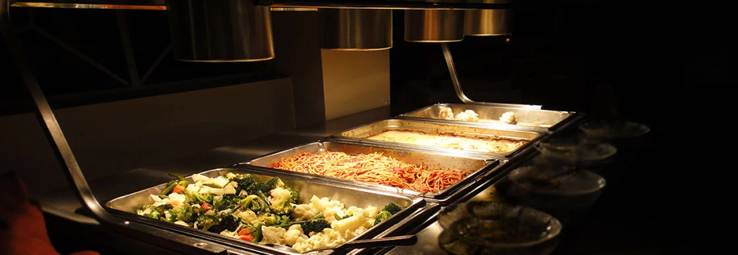
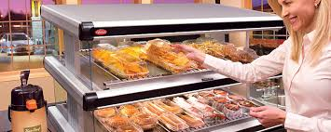
Methods used to control safe temperatures of food
Use of hot holding equipment
Visual displays
Manual recording:
hot cabinets
serving areas
open hot displays.
Notes:
Photo source 1 - https://www.google.com/url?sa=i&source=images&cd=&cad=rja&uact=8&ved=0ahUKEwjFpfHDiqvnAhWUtXEKHWomCl0QMwiWASgdMB0&url=https%3A%2F%2Fwww.webstaurantstore.com%2Fguide%2F536%2Fheat-lamp-strip-warmer-buying-guide.html&psig=AOvVaw3Ip8zmnjnSYT5BdA6OVQ_N&ust=1580465393420240&ictx=3&uact=3
Photo source 2 - https://www.google.com/url?sa=i&source=images&cd=&cad=rja&uact=8&ved=0ahUKEwjFpfHDiqvnAhWUtXEKHWomCl0QMwhzKBIwEg&url=https%3A%2F%2Fwww.hatcocorp.com%2Fen%2Fequipment%2Fmerchandisers%2Fmerchandising-warmers&psig=AOvVaw3Ip8zmnjnSYT5BdA6OVQ_N&ust=1580465393420240&ictx=3&uact=3

Slide 8
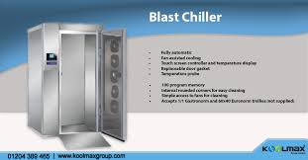
Methods used to control safe temperatures of food
Blast chillers/freezers
visual displays
manual or automated recording
following manufacturers instructions (blast chillers).
Notes:
Photo source 1 - https://www.google.com/url?sa=i&source=images&cd=&cad=rja&uact=8&ved=0ahUKEwjhkLaRi6vnAhVcXRUIHSfRAfgQMwhPKAMwAw&url=https%3A%2F%2Fwww.koolmaxgroup.com%2Fblog%2Fwhy-blast-chillers-are-high-in-demand%2F&psig=AOvVaw2hnwUALGWtZf52O2THV063&ust=1580465556038182&ictx=3&uact=3

Slide 9
Methods used to control safe temperatures of food
Temperature management systems: Computerised/automated systems
Each piece of equipment linked to internal computer system
Audio alarms when temperature goes outside set limits
Linked to internet.
Notes:
Source Photo 1 - https://www.google.com/url?sa=i&source=images&cd=&cad=rja&uact=8&ved=0ahUKEwiS_qT8i6vnAhW7VRUIHerjAZQQMwhWKAowCg&url=https%3A%2F%2Fwww.tempcon.co.uk%2Fshop%2Ffood-fridge-temp-monitoring-system&psig=AOvVaw2UZEk-PbmVMYwDNHaY7DbP&ust=1580465780114685&ictx=3&uact=3

Slide 10
Methods used to control safe temperatures of food
Use of appropriate temperature-controlled vehicles for transporting food
Refrigeration/dry goods only
Freezer only
Refrigeration/freezer split
Dry goods
Cooking/hot holding.

Slide 11
Methods used to control contamination and cross contamination
Control of hazardous substances
Containers should be checked for:
damage
correct labelling
separate storage areas
care when handling/transporting
care when being used following manufacturers instructions
care when dispensing product – automated/manual system
care when disposing.

Slide 12
Methods used to control contamination and cross contamination
Effective cleaning procedures:
Policy
Training
Schedules (after use, daily, weekly, monthly, annual tasks).
Manual cleaning systems and equipment:
Automated cleaning equipment
Use of hot water/steam
Use of appropriate chemicals.

Slide 13
Methods used to control contamination and cross contamination
Regular monitoring
Cleaning schedule check sheets (specific for each area/department)
Audits
Notes:
Photo source - https://www.google.com/url?sa=i&source=images&cd=&cad=rja&uact=8&ved=0ahUKEwir07TdjKvnAhUYTxUIHc33D2YQMwhaKAcwBw&url=https%3A%2F%2Fthe-haccp-app.com%2Ffree-cleaning-schedule%2F&psig=AOvVaw2F4dGuC6jTPXBX2PSRQ_aU&ust=1580465983840194&ictx=3&uact=3

Slide 14
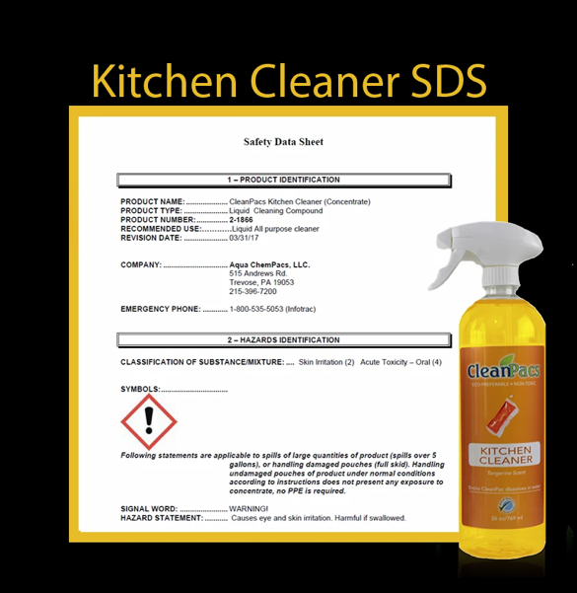
Methods used to control contamination and cross contamination
Correct use of cleaning products:
Following manufacturers instructions
Training
Posters/data sheets.

Slide 15
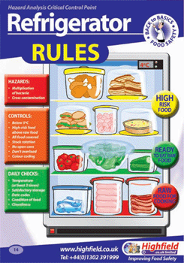
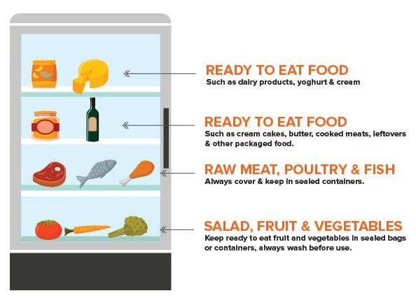
Methods used to control contamination and cross- contamination
Separation of low and high-risk foods:
Correct storage rules adhered to
Separate fridges/freezers.
Notes:
Photo source - https://www.google.com/url?sa=i&source=images&cd=&cad=rja&uact=8&ved=0ahUKEwjsyMPrjavnAhVl8uAKHSWmD4cQMwhRKAEwAQ&url=https%3A%2F%2Fwww.highspeedtraining.co.uk%2Fhub%2Ffridge-shelves-storing-food%2F&psig=AOvVaw3JpDh0j4QkQ-XAJ2sF-2Ck&ust=1580466281854024&ictx=3&uact=3
https://www.google.com/url?sa=i&url=https%3A%2F%2Fwww.pinterest.co.uk%2Fpin%2F64880050859307001%2F&psig=AOvVaw12ClRjY7SvT8r-vP6sg1sr&ust=1582266836926000&source=images&cd=vfe&ved=2ahUKEwjGxae3wd_nAhUBHBoKHbStB80Qr4kDegUIARDtAg Note Highfield image needs to be re drawn

Slide 16
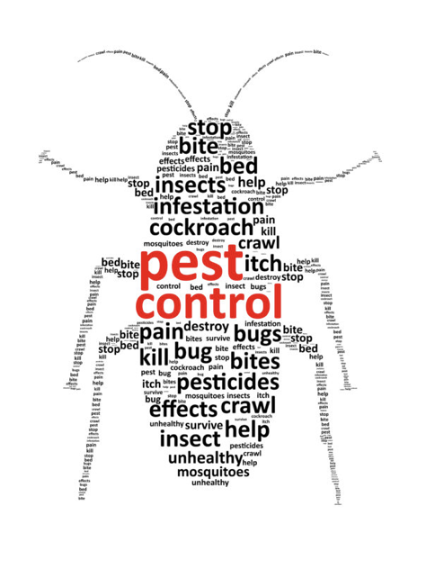
Methods used to control contamination and cross contamination
Pest control
Pest control contractor
Staff awareness and training
Good housekeeping/cleaning
Audit/inspections.
Notes:
Phot source - https://www.google.com/url?sa=i&source=images&cd=&cad=rja&uact=8&ved=0ahUKEwilx8GajqvnAhWv3eAKHUcZBHMQMwhIKAMwAw&url=https%3A%2F%2Fwww.hydrarinse.com%2Ffood-safety-health-pest-control-blog%2F&psig=AOvVaw0JBTwS2LUQ1BQiRr03tAIB&ust=1580466380393820&ictx=3&uact=3

Slide 17
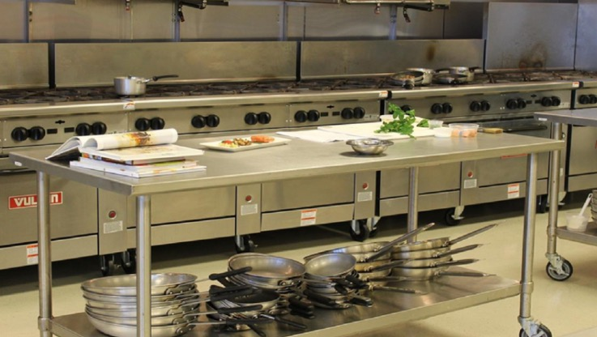
Methods used to control contamination and cross contamination
Suitable work surfaces:
must be easily cleaned and disinfected
well maintained to prevent build up of food or chemical residues
provided with recommended cleaning instructions
easily moved to clean behind.
Notes:
Photo source - https://www.google.com/url?sa=i&source=images&cd=&cad=rja&uact=8&ved=0ahUKEwj2xOrqjqvnAhVFDmMBHVf8CbYQMwiAASgDMAM&url=https%3A%2F%2Fpos.toasttab.com%2Fblog%2Frestaurant-equipment&psig=AOvVaw3Ir-81ZSGYqC2w_4lOwxhP&ust=1580466548847806&ictx=3&uact=3

Slide 18
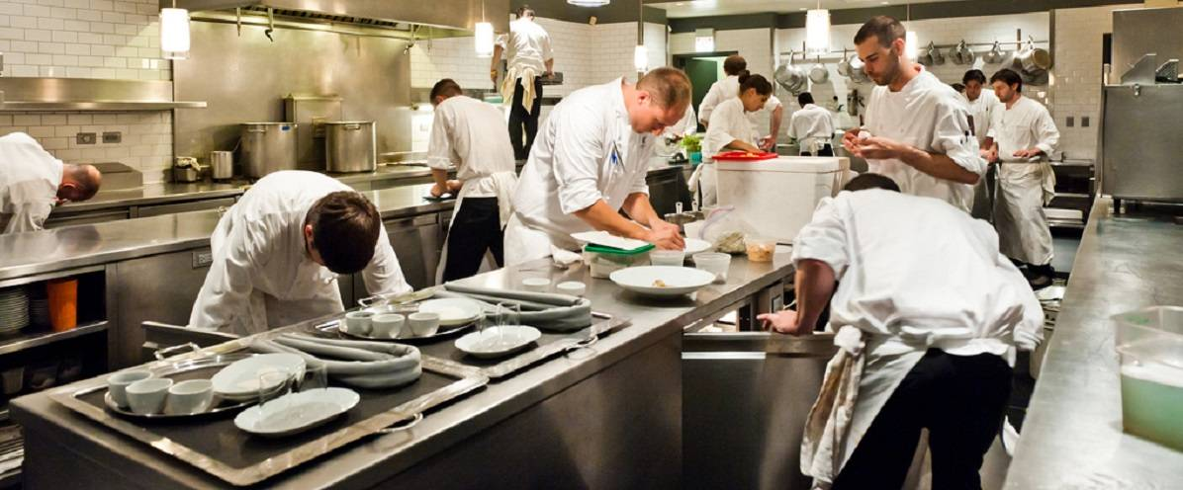
Methods used to control contamination and cross contamination
Discuss the hazards in the kitchen below:
Notes:
Photo source - https://www.google.com/url?sa=i&source=images&cd=&cad=rja&uact=8&ved=0ahUKEwj2xOrqjqvnAhVFDmMBHVf8CbYQMwiIASgHMAc&url=https%3A%2F%2Fwww.247cateringsupplies.co.uk%2Fthekitchenthink%2Ftop-5-pieces-of-cooking-equipment-every-commercial-kitchen-should-own%2F&psig=AOvVaw3Ir-81ZSGYqC2w_4lOwxhP&ust=1580466548847806&ictx=3&uact=3

Slide 19
Explain methods used to control contamination and cross-contamination
Suitable equipment
Manufactured to International/EU CE standards
Instructions provided for operating, cleaning and maintenance.
Notes:
Photo source - https://www.google.com/url?sa=i&source=images&cd=&cad=rja&uact=8&ved=0ahUKEwj2xOrqjqvnAhVFDmMBHVf8CbYQMwiIASgHMAc&url=https%3A%2F%2Fwww.247cateringsupplies.co.uk%2Fthekitchenthink%2Ftop-5-pieces-of-cooking-equipment-every-commercial-kitchen-should-own%2F&psig=AOvVaw3Ir-81ZSGYqC2w_4lOwxhP&ust=1580466548847806&ictx=3&uact=3

Slide 20
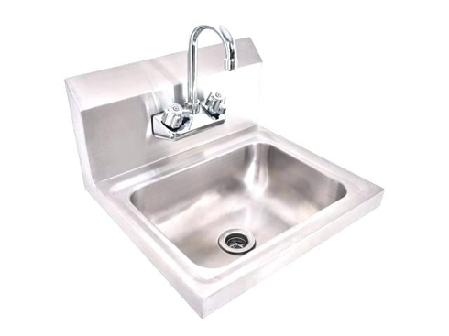
Methods used to control contamination and cross- contamination
Personal hygiene procedures: Handwashing, correct use of protective clothing.
Supply of dedicated wash hand basins and hand drying facilities
Supply of protective clothing and laundry
Audit to ensure staff adhere to personal hygiene and dress responsibilities.
Notes:
Source - https://www.google.com/url?sa=i&source=images&cd=&cad=rja&uact=8&ved=0ahUKEwjpl92oj6vnAhWGy4UKHdJ2AAIQMwiFAigUMBQ&url=http%3A%2F%2Facquaperlavita.org%2Fcommercial-kitchen-hand-wash-sink%2F&psig=AOvVaw3jkpks7XY7AJ-s1CFXTYgx&ust=1580466678699083&ictx=3&uact=3

Slide 21
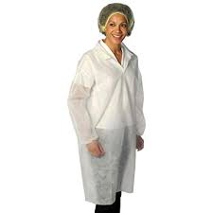
Methods used to control contamination and cross- contamination
Visitor hygiene policy:
Protective clothing available for visitors if entering food preparation /high risk areas
Visitors made aware of responsibilities on arrival.
Notes:
Phot source = https://www.google.com/url?sa=i&source=images&cd=&cad=rja&uact=8&ved=0ahUKEwjX-JnVkKvnAhUTWsAKHUHrA9IQMwhSKAYwBg&url=https%3A%2F%2Fwww.amazon.co.uk%2FVISITOR-Hi-Vis-High-Viz-Visibility-Waistcoat%2Fdp%2FB017UNGCD8&psig=AOvVaw2xJi9xVVH2m2S1bjmfZ_4U&ust=1580467040264872&ictx=3&uact=3
Source 2 https://www.google.com/url?sa=i&source=images&cd=&cad=rja&uact=8&ved=0ahUKEwjX-JnVkKvnAhUTWsAKHUHrA9IQMwhGKAAwAA&url=https%3A%2F%2Fwww.amazon.co.uk%2FDisposable-Lab-Coat-Visitors%2Fdp%2FB00JJRUT56&psig=AOvVaw2xJi9xVVH2m2S1bjmfZ_4U&ust=1580467040264872&ictx=3&uact=3

Slide 22
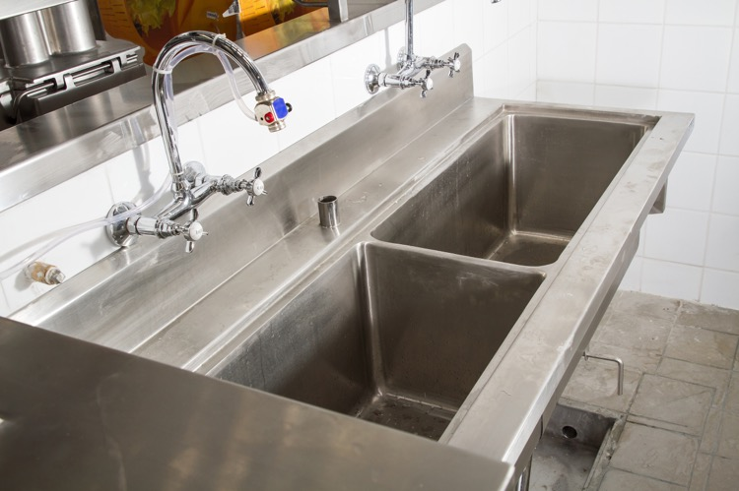
Methods used to control contamination and cross- contamination
Use of separate sinks for food/washing food equipment/hand washing to prevent cross contamination and use of sterilising sinks.
Notes:
Phot source - https://www.google.com/url?sa=i&source=images&cd=&cad=rja&uact=8&ved=0ahUKEwjktoGVkavnAhW_QxUIHY2nBZoQMwjXAigPMA8&url=https%3A%2F%2Fwww.shutterstock.com%2Fsearch%2Frestaurant%2Bkitchen%2Bsink&psig=AOvVaw2amxu3E1ZhDiGGL6_dMpoE&ust=1580467174225698&ictx=3&uact=3
https://www.google.com/url?sa=i&source=images&cd=&cad=rja&uact=8&ved=0ahUKEwjktoGVkavnAhW_QxUIHY2nBZoQMwjNAigLMAs&url=https%3A%2F%2Fwww.247cateringsupplies.co.uk%2Fcommercial-kitchen-equipment%2Fcatering-fabrications%2Fcatering-sinks&psig=AOvVaw2amxu3E1ZhDiGGL6_dMpoE&ust=1580467174225698&ictx=3&uact=3

Slide 23
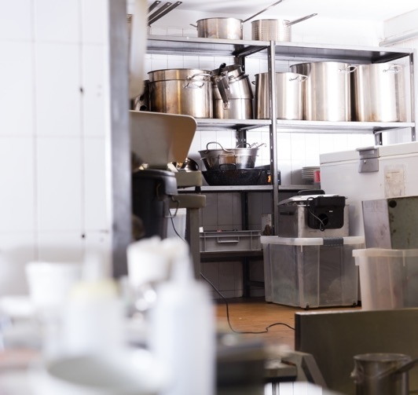
Methods used to control contamination and cross- contamination
Correct storage of equipment:
To ensure stored safely and hygienically
Notes:
Phot source - https://www.google.com/url?sa=i&source=images&cd=&cad=rja&uact=8&ved=0ahUKEwivnaGWkqvnAhXBiVwKHe2AACsQMwi-AigXMBc&url=https%3A%2F%2Fwww.shutterstock.com%2Fimage-photo%2Frack-inox-professional-kitchen-equipment-6977386&psig=AOvVaw2Hf7RplxTSiyOlfjoaVfdo&ust=1580467445351142&ictx=3&uact=3

Slide 24
Methods used to control contamination and cross- contamination
Internal/external waste/food disposal procedures:
Correct use of bins
Use of waste disposal contractor
Recycling policy – to reduce waste.
Notes:
Source - https://www.google.com/url?sa=i&source=images&cd=&cad=rja&uact=8&ved=0ahUKEwiOsPTYkqvnAhUvxYUKHfBbDU8QMwjgAigpMCk&url=https%3A%2F%2Fwww.foodstarsuk.com%2Fcommercial-kitchens-for-rent%2Fstarter-guide-food-safety-storage-waste%2F&psig=AOvVaw3mqP9Hob06Jer3rT_1iDDh&ust=1580467585453445&ictx=3&uact=3

Slide 25
Any questions?

