Slide 1
Understand the application and monitoring of food safety practices
PowerPoint presentation
Unit 306: Monitoring and supervision of food safety

Slide 2
Measures taken to ensure safe cleaning and disinfection
Ensuring equipment is disconnected from power before cleaning
Clean as you go
Applying the six stages of cleaning
Applying safe cleaning procedures from delivery of food to service point
Correct clearing of areas for cleaning - to avoid chemical contamination, over-spray.

Slide 3
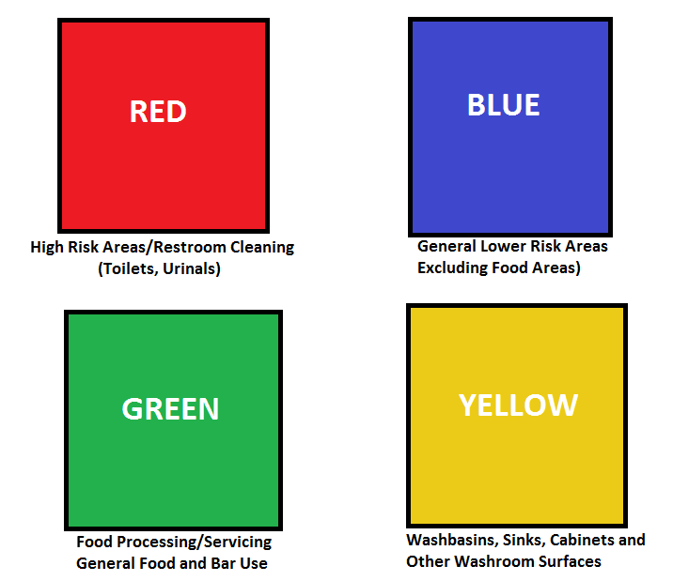
Measures taken to ensure safe cleaning and disinfection
correct dilution of chemicals
correct equipment (single-use cloths)
procedures to control hazardous substances.

Slide 4
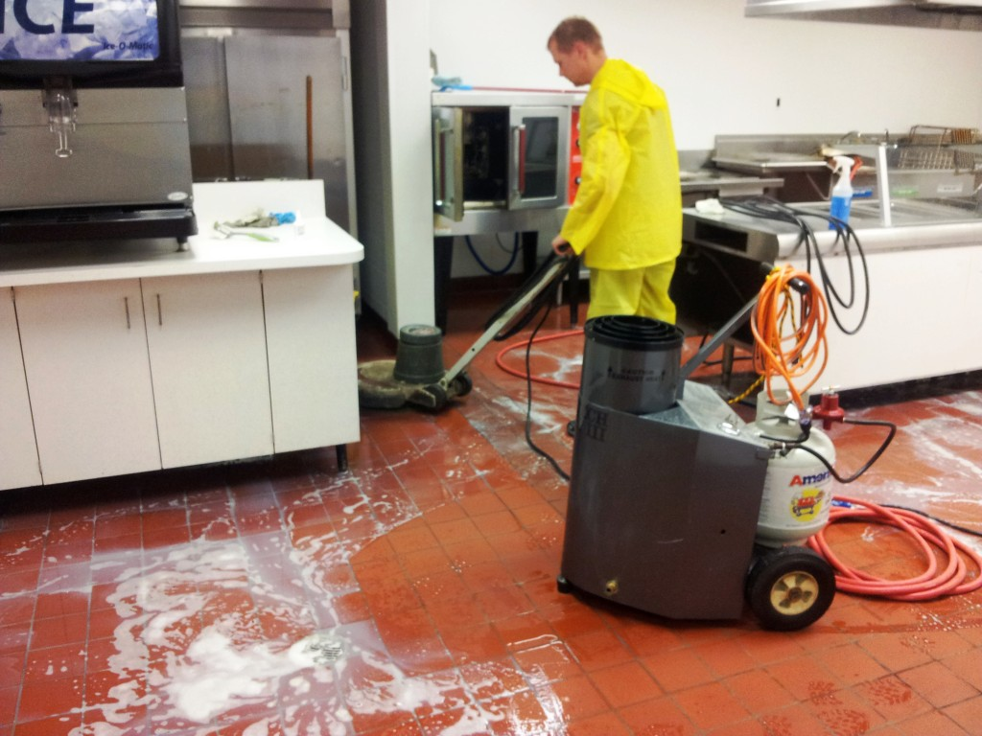
Measures taken to ensure safe cleaning and disinfection
Ensure equipment is disconnected from power before cleaning
Care should be taken to ensure plugs and electrical components are not wet.
Notes:
Source - https://www.google.com/url?sa=i&source=images&cd=&cad=rja&uact=8&ved=0ahUKEwiV4_qYk6vnAhUSCxoKHb7jCs4QMwjNASgVMBU&url=https%3A%2F%2Fwww.at-ekopalvelut.fi%2Fen%2F&psig=AOvVaw2ZPWCaifeSrgZvytVR1d5P&ust=1580467719381237&ictx=3&uact=3

Slide 5
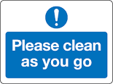
Measures taken to ensure safe cleaning and disinfection
A clean-as-you-go policy is about keeping the work area clean and tidy at all times whilst working. This may include cleaning up spills, wiping down surfaces, removing waste to bins and generally keeping the work area, tools and equipment and person to the required levels of hygiene to produce safe products.

Slide 6
Measures taken to ensure safe cleaning and disinfection
Applying the six stages of cleaning:
Pre-clean: Remove excess food waste by sweeping, wiping or pre-rinsing
Main clean: Loosen surface waste and grease using a detergent
Rinse: Remove loose food waste, grease and detergent
Disinfection: Kill the bacteria with disinfectant or heat
Final rinse: Remove the disinfectant
Drying: Remove all moisture.
Notes:
Points to Remember
With light contamination the pre-clean and main clean can be combined.
Some surfaces do not need to be disinfected after every wash (e.g. floors and walls).
Disinfect any items which come either into direct contact with food (e.g. meat slicers, work surfaces, chopping boards) or with the hands of food handlers (e.g. refrigerator door handles).
When drying, try and let the item air dry, but if this is not possible, then use paper towels or a clean dry cloth.
After use, clean and dry the cleaning equipment.
Store cleaning materials and equipment in separate cupboards or rooms, away from food. Never put cleaning materials into unmarked containers or food containers.
Ensure staff are trained to 'clean as they go' and to clean up any spillages immediately.
Staff must receive training to use chemicals correctly.
Always observe manufacturers instructions (e.g. leave disinfectants on the surface long enough to work properly).

Slide 7
Measures taken to ensure safe cleaning and disinfection
Applying safe cleaning procedures from delivery of food to service point:
Cleaning: This is the removal of visible food debris and grease. It is usually done with hot water and detergent.
Disinfection: This is the reduction of germs to a safe level and is usually done by the use of special chemicals intended for food use, or by heat (hot water at around 82°C in a dishwasher or second sink).
Detergent: A chemical used in cleaning to remove food debris and grease.
Disinfectant: A chemical used for disinfection.
Notes:
Common Terms:
Cleaning: this is the removal of visible food debris and grease. It is usually done with hot water and detergent.
Disinfection: this is the reduction of germs to a safe level and is usually done by the use of special chemicals intended for food use, or by heat (hot water at around 82°C in a dishwasher or second sink).
Detergent: a chemical used in cleaning to remove food debris and grease.
Disinfectant: a chemical used for disinfection.

Slide 8
Measures taken to ensure safe cleaning and disinfection
Correct clearing of areas for cleaning (to avoid chemical contamination or over-spray):
Many different types of hazardous cleaning chemicals are used in the hospitality industry. They include washing-up liquids, dishwasher detergents and rinse- aids, drain-cleaning products, oven cleaners, disinfectants, toilet cleaners, bleach, sanitisers and descalers.
Food handlers and cleaners should follow manufacturer’s instructions and ensure all food is removed or covered from the areas being cleaned .

Slide 9
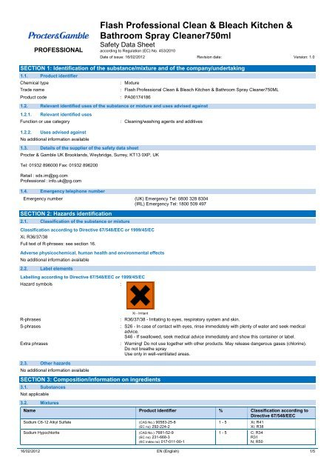
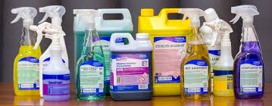
Measures taken to ensure safe cleaning and disinfection
Correct dilution of chemicals
Food handlers and cleaners should be trained to follow manufacturer’s instructions
Posters and safety data sheets should be available for staff to read on the cleaning products or where they are stored.
Notes:
Source - https://www.google.com/url?sa=i&source=images&cd=&cad=rja&uact=8&ved=0ahUKEwijjaullavnAhX9RxUIHWkpA8AQMwhGKAIwAg&url=https%3A%2F%2Fwww.yumpu.com%2Fen%2Fdocument%2Fview%2F21054299%2Fcoshh-safety-data-sheet-futures-supplies-support-services&psig=AOvVaw3Vo3BPxUhlMOli0FVNShWj&ust=1580468282262161&ictx=3&uact=3
Source 2 - https://www.google.com/url?sa=i&source=images&cd=&cad=rja&uact=8&ved=0ahUKEwijjaullavnAhX9RxUIHWkpA8AQMwhqKBMwEw&url=http%3A%2F%2Fwww.zhgplc.com%2F&psig=AOvVaw3Vo3BPxUhlMOli0FVNShWj&ust=1580468282262161&ictx=3&uact=3

Slide 10
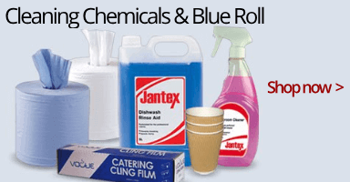
Measures taken to ensure safe cleaning and disinfection
Correct equipment
Single-use cloths should be used wherever possible, and thrown away after each task. This will make sure that any bacteria picked up by the cloth will not be spread. Always use a new or freshly cleaned cloth to wipe work surfaces, equipment or utensils that will be used with ready-to- eat food.
Notes:
Source - https://www.google.com/url?sa=i&source=images&cd=&cad=rja&uact=8&ved=2ahUKEwiqlp2WlqvnAhUJZcAKHUVHDk04ZBAzKCcwJ3oECAEQVQ&url=https%3A%2F%2Fwww.easyequipment.com%2F&psig=AOvVaw3uljfjpyMhK59XXRwJatWP&ust=1580468499872856&ictx=3&uact=3

Slide 11
Measures taken to ensure safe cleaning and disinfection
Procedures to control hazardous substances
Cleaning chemicals should be stored in a separate area away from food and heat sources, in their original container and with a tight lid.
Employees should be taught to:
never mix chemicals
use chemicals only in well ventilated areas.

Slide 12
Procedures for waste disposal
Remove food scraps from the kitchen daily – or more frequently if required.
Arrange regular waste collection. Most food businesses require waste collection at least twice a week.
Do not allow waste containers to overflow. Move overflowing waste to other containers.
Regularly hose down and clean waste containers.
Always use a waste liner for garbage containers. This is a good way to ensure that the waste container is kept as clean as possible and that harmful bacteria do not have time to grow on the inside of the unit itself.

Slide 13
Procedures for waste disposal
Keep lids tightly closed on all waste containers when in use.
Use special containers to dispose of dangerous items like broken glass. Talk to your supervisor or manager if you are unsure of how to dispose of dangerous items.
Never use waste containers to transfer food or ice.
In warm climates, refrigerate food scraps to prevent bacteria growing to harmful levels quickly – but always use a separate refrigerator to one that contains food intended for human consumption.
Finally, always wash your hands after handling waste and waste containers – no exceptions!

Slide 14
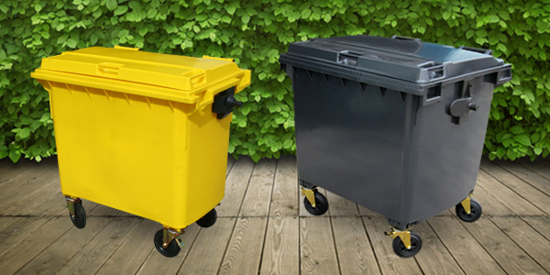
Procedures for waste disposal
No over-night storage
Remove from food preparation areas to prevent the waste being attracted by pests.
Notes:
Source - https://www.google.com/url?sa=i&source=images&cd=&cad=rja&uact=8&ved=0ahUKEwjIub7glqvnAhViRxUIHeblDpgQMwj8ASgEMAQ&url=https%3A%2F%2Fwww.britishbins.co.uk%2F4-wheel-bins%2F&psig=AOvVaw16GhBTaWI0N-QTZcfWdSp4&ust=1580468674934321&ictx=3&uact=3

Slide 15
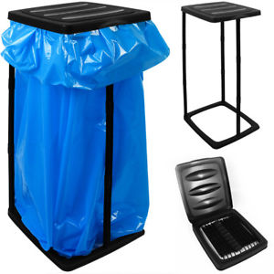
Procedures for waste disposal
Use of bin bags/liners
Always use a waste liner for waste containers. This is a good way to ensure that the waste container is kept as clean as possible and that harmful bacteria do not have time to grow on the inside of the unit itself.
Notes:
Source - https://www.google.com/url?sa=i&source=images&cd=&cad=rja&uact=8&ved=0ahUKEwiX-8H6lqvnAhW-RBUIHW_DB5IQMwiEAigHMAc&url=https%3A%2F%2Fwww.ebay.co.uk%2Fitm%2FBin-Liner-Stand-60L-Rubbish-Waste-Refuse-Bag-Holder-Sack-Kitchen-Collapsible-%2F352471074742&psig=AOvVaw1798uvZwgyVWGvwkam40T0&ust=1580468729329322&ictx=3&uact=3

Slide 16
Procedures for waste disposal
Always clean waste containers regularly with detergent/disinfectant when emptied or on discovery of a waste food spill.
Notes:
Source - https://www.google.com/url?sa=i&source=images&cd=&cad=rja&uact=8&ved=0ahUKEwiX-8H6lqvnAhW-RBUIHW_DB5IQMwjPAigjMCM&url=https%3A%2F%2Fdirect2u.co.uk%2Fblog%2Fwheelie-bins%2Fcommercial-kitchen-bins%2F&psig=AOvVaw1798uvZwgyVWGvwkam40T0&ust=1580468729329322&ictx=3&uact=3

Slide 17
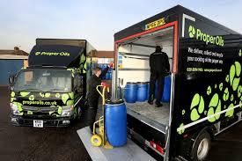
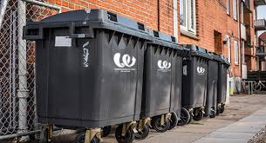
Procedures for waste disposal
Easy access for collection
Ensure easy access for waste collection vehicles to prevent unnecessary distances to be moved with the potential of spillages.
Notes:
Source - https://www.google.com/url?sa=i&source=images&cd=&cad=rja&uact=8&ved=2ahUKEwjJwMnIl6vnAhUpUhUIHXAQAVE4yAEQMygyMDJ6BAgBEG4&url=https%3A%2F%2Fwasteconcern.com%2F&psig=AOvVaw0NqaD3kdm1WbD4y92O-8GW&ust=1580468841481443&ictx=3&uact=3
https://www.google.com/url?sa=i&source=images&cd=&cad=rja&uact=8&ved=0ahUKEwijiv-vl6vnAhXvRxUIHVDTClkQMwiUAihGMEY&url=https%3A%2F%2Fwww.properoils.co.uk%2Fwhat-happens-used-cooking-oil-recycling%2F&psig=AOvVaw0NqaD3kdm1WbD4y92O-8GW&ust=1580468841481443&ictx=3&uact=3

Slide 18
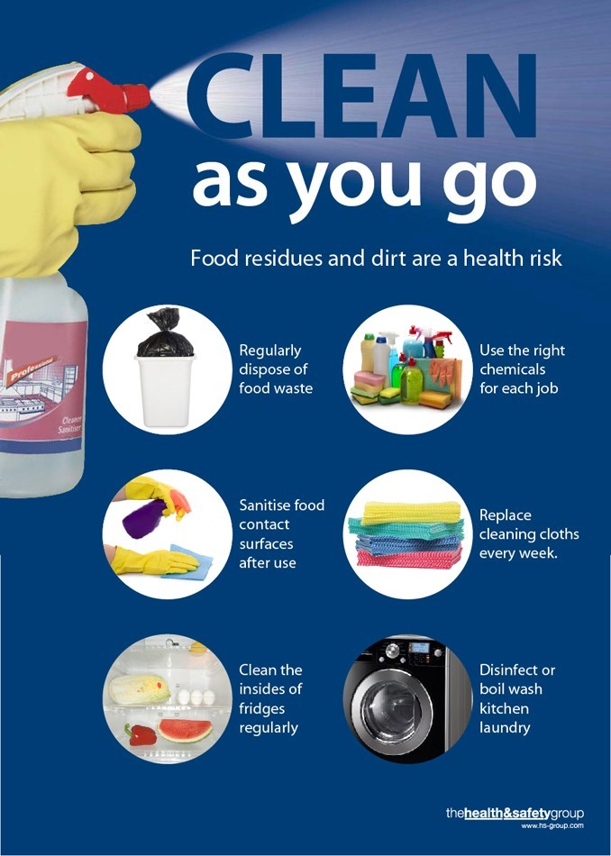
Explain procedures for waste disposal
Clean-as-you-go
A clean-as-you-go policy should be in place, monitored and enforced by the supervisor.
Notes:
Source - https://www.google.com/url?sa=i&source=images&cd=&cad=rja&uact=8&ved=0ahUKEwjEuIOfmKvnAhWx4IUKHbwLClUQMwhPKAAwAA&url=https%3A%2F%2Fwww.healthandsafetygroup.com%2Fshop%2Fclean-as-you-go-hygiene-posted&psig=AOvVaw0-mldJZ-uOhlLOPr52yWMg&ust=1580469074364956&ictx=3&uact=3

Slide 19
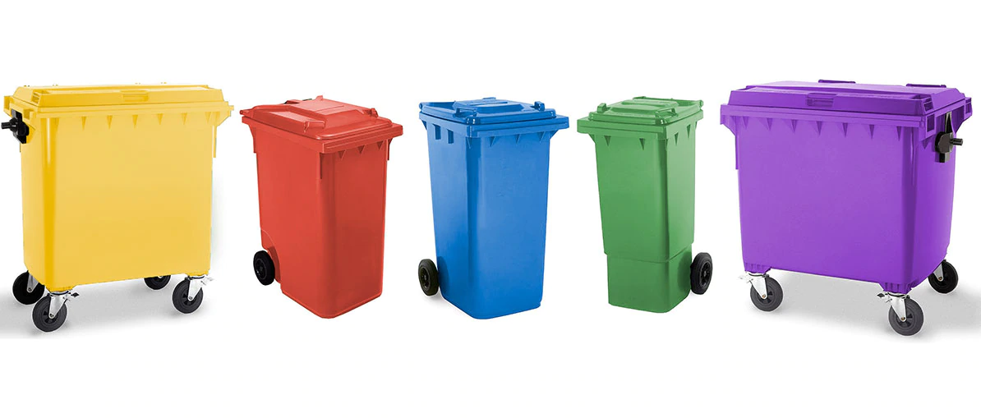
Procedures for waste disposal
Separating food, general waste and recycling policy:
Monitoring and reducing waste
Recycle/reuse containers where required
Providing suitable containers for separating waste.
Notes:
Source - https://www.google.com/url?sa=i&source=images&cd=&cad=rja&uact=8&ved=0ahUKEwi9tsC_mKvnAhUOhRoKHYcvC7wQMwiDAig6MDo&url=https%3A%2F%2Fsohocommercial.com%2F&psig=AOvVaw2XHb4M7Iok0-VC5tVwu9hI&ust=1580469142368804&ictx=3&uact=3

Slide 20
Procedures for waste disposal
External lidded waste storage
External bins should be lidded and locked to prevent pest access and other non authorised users deposing of their waste.

Slide 21
Procedures for waste disposal
Separate storage of recyclables:
Items suitable for recycling (card, glass, metal, etc.) should have their own recycle bins and be in line with local authority guidelines.

Slide 22
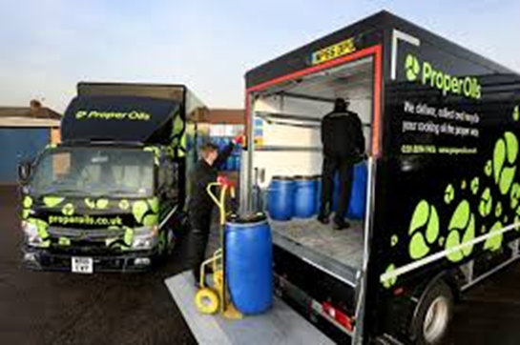
Explain procedures for waste disposal
Waste collection of food waste: Liquid food waste, oil, grease traps
Use a specialist waste company to dispose of specialist waste products of high value e.g. waste cooking oil.

Slide 23
Any questions?

