Slide 1
Understand the application and monitoring of food safety practices
PowerPoint presentation
Unit 306: Monitoring and supervision of food safety

Slide 2
The importance of good personal hygiene standards
Prevents food poisoning
Reduces the risks associated with food safety
Prevents the transmission of pathogenic bacteria
Prevents physical hazards from an individual getting into the food chain
Prevents convalescent and healthy carriers contaminating food
Prevents infecting co-workers
Promotes a safe working environment
Promotes an organisations reputation.

Slide 3
The importance of good personal hygiene standards
Prevents food poisoning
Food handlers have a legal and moral responsibility to ensure the food they prepare, cook and serve is free from contamination and safe to eat.
Notes:
Source - https://www.google.com/url?sa=i&source=images&cd=&cad=rja&uact=8&ved=0ahUKEwiQoKCbmavnAhUJHxoKHcT_CJ4QMwioASgpMCk&url=http%3A%2F%2Fdutable.com%2F2019%2F02%2F27%2Fresponsibilities-of-food-handler-solutions-to-poor-food-hygiene-practice%2F&psig=AOvVaw2DCuZH5BzBgaLFNSVdJD-G&ust=1580469334740876&ictx=3&uact=3

Slide 4
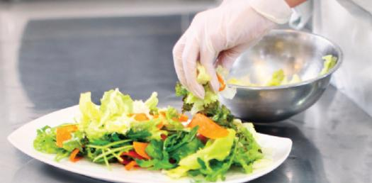
The importance of good personal hygiene standards
Reduces the risks associated with food safety:
All food handlers should be aware of the potential hazards in the kitchen including bacterial, physical, chemical and allergenic contamination.
Food handlers unknowingly could be carriers of bacteria that could cross contaminate food and other food handlers.
Notes:
Source - https://media.proprofs.com/images/QM/user_images/2415354/1552022884.jpg

Slide 5
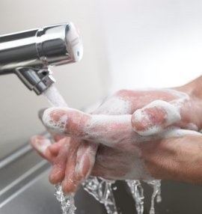
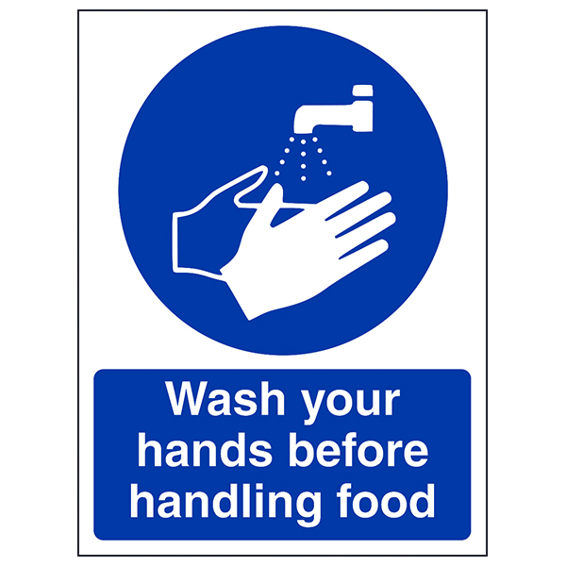
The importance of good personal hygiene standards
Prevents the transmission of pathogenic bacteria
Contamination from septic cuts, hands, hair, the nose and mouth – food handlers should take measures such as hand washing to reduce the risk of contamination.
Notes:
Source
https://www.google.com/url?sa=i&source=images&cd=&cad=rja&uact=8&ved=0ahUKEwjNtLD4mavnAhVNQBoKHULnCYoQMwhUKAIwAg&url=https%3A%2F%2Finfo.debgroup.com%2Fblog%2Fbid%2F226858%2Fhand-hygiene-and-food-safety&psig=AOvVaw3SV_Gtytg_DJMsCs9agpRQ&ust=1580469530105820&ictx=3&uact=3
https://www.google.com/url?sa=i&source=images&cd=&cad=rja&uact=8&ved=0ahUKEwjNtLD4mavnAhVNQBoKHULnCYoQMwhPKAAwAA&url=https%3A%2F%2Fwww.safetysigns4less.co.uk%2FSafety-Signs%2FFood-HygieneCatering-Signs%2FFood-Hygiene-Production-Signs%2FWash-Your-Hands-Before-Handling-Food-Portrait&psig=AOvVaw3SV_Gtytg_DJMsCs9agpRQ&ust=1580469530105820&ictx=3&uact=3

Slide 6
The importance of good personal hygiene standards
Prevents physical hazards from an individual getting into the food chain.
Food handlers should:
remove or cover items of jewellery, piercings, false nails etc in case they are lost during food preparation
wear hair nets, beard snoods to ensure hair is kept covered
ensure spots, cuts and boils are covered with a waterproof blue plaster.

Slide 7
The importance of good personal hygiene standards
Prevents convalescent and healthy carriers contaminating food
Carriers could be healthy or convalescent food handlers who harbour, and may transmit, harmful disease and pathogenic bacteria without showing signs of the illness.
Notes:
Source - https://www.google.com/url?sa=i&source=images&cd=&cad=rja&uact=8&ved=0ahUKEwjNtLD4mavnAhVNQBoKHULnCYoQMwiuASgnMCc&url=https%3A%2F%2Fdsdweb.co.uk%2Flevel-2-diploma-in-care%2Fhealth-safety-and-well-being-in-care-settings%2Fexplain-own-roles-and-responsibilities-as-an-employee-and-those-of-the-employer-in-the-prevention-and-control-of-infection%2F&psig=AOvVaw3SV_Gtytg_DJMsCs9agpRQ&ust=1580469530105820&ictx=3&uact=3

Slide 8
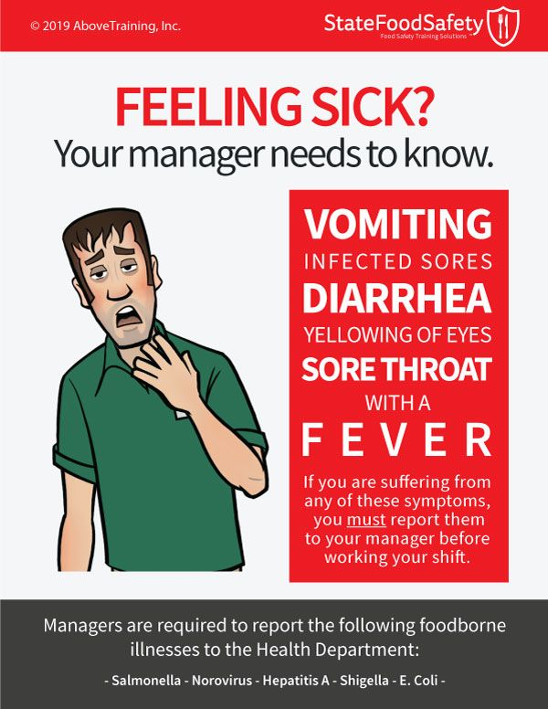
The importance of good personal hygiene standards
Prevents infecting co-workers
Understanding their personal responsibility to report illness and sickness that may affect food handling and preparation operations.
Notes:
Source https://www.google.com/url?sa=i&source=images&cd=&cad=rja&uact=8&ved=0ahUKEwiBhJXbmqvnAhUkSBUIHQJRBDoQMwhTKAIwAg&url=https%3A%2F%2Fwww.statefoodsafety.com%2FResources%2FResources%2Ffeeling-sick&psig=AOvVaw0g-F_osGORIedoAu2fK3N0&ust=1580469737365206&ictx=3&uact=3

Slide 9
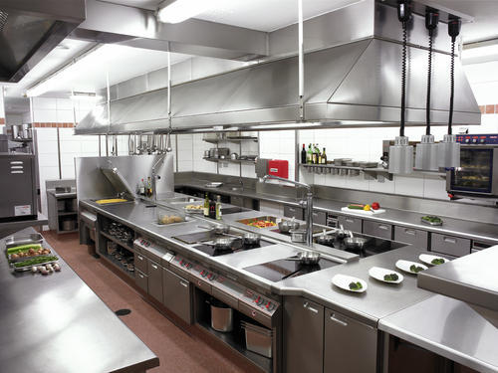
The importance of good personal hygiene standards
Promotes a safe working environment
Supervisors should ensure staff follow good personal standards as part of the safe working environment. Providing the hand washing and staff washing facilities, first aid boxes, protective clothing and laundry service will promote a safe working environment.
Notes:
Source: https://www.google.com/url?sa=i&url=https%3A%2F%2Fallservicesinone.co.uk%2Fcleaning%2Fcommercial-kitchen-cleaning%2F&psig=AOvVaw0nZhxxG6Bx5BbWtwZWMfjp&ust=1582265532382000&source=images&cd=vfe&ved=2ahUKEwjsxKDJvN_nAhWS1uAKHU5-DawQr4kDegUIARCBAQ

Slide 10
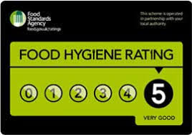
Explain the importance of good personal hygiene standards
Promotes an organisation’s reputation
High standards of personal hygiene and appearance play an important part of creating a good public image especially where diners can observe the food preparation areas e.g. Chef’s table.
Notes:
Source – food.gov.uk

Slide 11
Requirements relating to the design of food premises and equipment
Food premises design should:
allow for good food hygiene practices, including separation of high- risk and ready-to-eat foods
ensure safe food storage and preparation
be easily cleaned
ensure surfaces are smooth, impervious, impact resistant, non-tainting and non-corrosive
have adequate lighting
have adequate ventilation

Slide 12
Requirements relating to the design of food premises and equipment
have adequate refrigeration
be pest proofed
have adequate hand washing facilities
have potable water
have adequate drainage
have adequate services
have suitable staff facilities to promote good personal hygiene practices.

Slide 13
Requirements relating to the design of food premises and equipment
Food equipment should:
be easily taken apart
be in a good state of repair
be installed to allow adequate cleaning of surrounding areas
be easily cleaned
be impervious, non-tainting, resistant to corrosion,
be fit for purpose for commercial use
have suitable work surfaces – smooth.

Slide 14
Any questions?

