Slide 1
Understand how to implement food safety management procedures
PowerPoint presentation
Unit 306: Monitoring and supervision of food safety

Slide 2
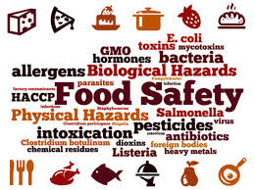
Hazards
Describe how microbial, chemical, physical and allergenic hazards pose a risk to food safety.
Notes:
Source - https://www.google.com/url?sa=i&source=images&cd=&cad=rja&uact=8&ved=0ahUKEwjvgN2DoKvnAhVCr3EKHcq3C7MQMwhTKAIwAg&url=https%3A%2F%2Fwww.foodsafetynews.com%2F2019%2F08%2Ffao-says-food-safety-focus-must-be-on-prevention%2F&psig=AOvVaw2uK1ca1K5NU0_IU-F_m0sm&ust=1580471164539316&ictx=3&uact=3

Slide 3
Microbial
Cause foodborne illnesses
Pathogenic bacteria (e.g. bacteria, viruses, moulds, yeasts) grow and multiply given the right conditions (salmonella, campylobacter, e-coli)
Contaminate other foods
Cause food wastage.
Notes:
Source - https://www.google.com/url?sa=i&source=images&cd=&cad=rja&uact=8&ved=0ahUKEwjM2qqwoKvnAhVeQxUIHQItAkMQMwhPKAAwAA&url=https%3A%2F%2Fwww.eufic.org%2Fen%2Ffood-safety%2Fcategory%2Fmicrobiological&psig=AOvVaw1f9SpJMrNwl3OIT8b83naS&ust=1580471258065209&ictx=3&uact=3

Slide 4
Bacteria
Bacteria are the most common form of microbial contamination.
Sources include:
raw food/food waste
people
equipment
air and dust
soil
pests
water
viruses
moulds
yeasts

Slide 5
Chemical
Cause food poisoning
Contaminate foods
Over treated with pesticides
Cleaning chemicals incorrectly used in the kitchen
Perfumes and aftershave from food handlers
Chemical reaction between metals and acidic foods
Pose a risk to staff safety
Misuse of cleaning materials and chemicals.

Slide 6
Physical
Contaminate foods
Increase risks of choking
Increase risk of hurting guests
Sources:
people
packaging materials
machinery/equipment
premises
pests
environment
raw materials.

Slide 7
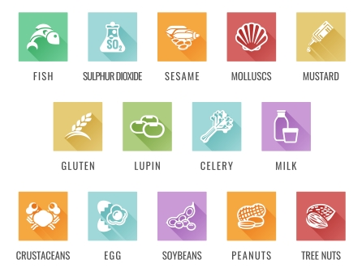
Allergenic
Contaminate foods
Increase the risks associated with allergens and anaphylactic shock
Food handlers should have an awareness and knowledge of:
the 14 foods associated with allergenic reactions
common symptoms of allergenic reactions
food labelling and advise for customers.
Notes:
Source Food Standards Agency – www.eatwell.gov.uk
https://www.google.com/search?rlz=1C1EJFA_enGB779GB780&biw=1536&bih=750&tbm=isch&sxsrf=ACYBGNQsbU3ZLzoRnDE9B6UrTIvySmEaYA%3A1580384957658&sa=1&ei=vcIyXs3fJ-yi1fAP3ri2gA4&q=14+allergen+hazards++food+standards+agency&oq=14+allergen+hazards++food+standards+agency&gs_l=img.3...29770.35363..35734...0.0..0.111.1657.21j2......0....1..gws-wiz-img.......35i39.0funZcfAH0c&ved=0ahUKEwiNsongoKvnAhVsURUIHV6cDeAQ4dUDCAc&uact=5#

Slide 8
Any questions?

