Slide 1
Check quality of ingredients
PowerPoint presentation
Unit 307 Produce and present advanced starters using standardised recipes

Slide 2
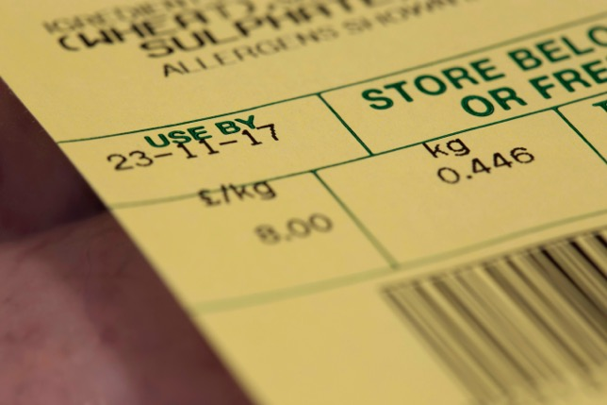
Check the quality of ingredients
The main four quality checks for ingredients are:
Visual
Aroma
Texture
Use by and best buy dates.

Slide 3
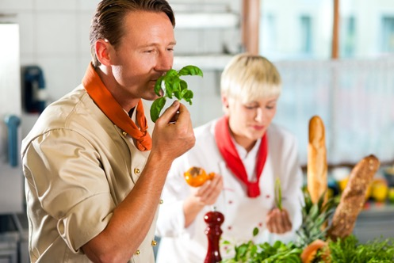
Four main quality checks
Visual
checks made by looking over the ingredients, checking for imperfections and anomalies
size and packaging, broken or damaged
wrong specification
colour.
Aroma
actual smell of ingredients usually applies to fresh produce
ingredients tainted by other produce
stored next to strong smelling items e.g. garlic, spices, etc.

Slide 4
Quality checks continued
Texture:
Physically touching the ingredients
Is the size correct?
Checking for deuteriation and decomposition
Check temperatures
Use by and best buy dates:
Check for out of date items
Log the dates for future use
Develop a FIFO first in first out system.

Slide 5
Ingredients
Ingredients | Appropriate checks
Fresh stock/convenience stock | Use by date, correct mixing of convenience
Meat | Suitable cuts, packaging
Fish and Shellfish | Fresh, frozen or dried
Vegetables | Correct ingredients, seasonal
Pulses Grains | Rehydration required, use by dates
Seaweed | Rehydration required, use by dates
Noodles Pasta | Fresh or dried, applicable shapes and sizes
Bread | Type required, use by dates

Slide 6
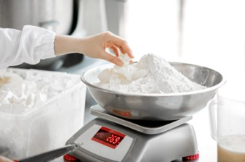
Determine correct quantity of ingredients
Adapt standardised recipe: Working through a standard recipe and making adjustments, e.g. healthier, vegetarian to vegan.
Increasing yield amount: Taking a standard recipe and developing for more covers, e.g. 4 portions to 40 portions.
Adjusting ingredients: Replacing ingredients e.g. seasonal. Adding or removing to ensure end result works.
Use weighing scales and measuring equipment: Fine tuning ingredients which have been changed, most recipes do not just multiply out.

Slide 7
Any questions?

