Slide 1
Sauces, chutneys and relishes
PowerPoint presentation
Unit 307: Produce and present advanced starters using standardised recipes

Slide 2
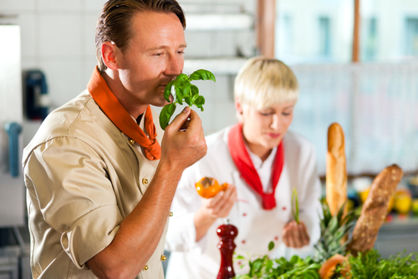
Check quality of ingredients
Visual
Aroma
Use by and best before dates

Slide 3
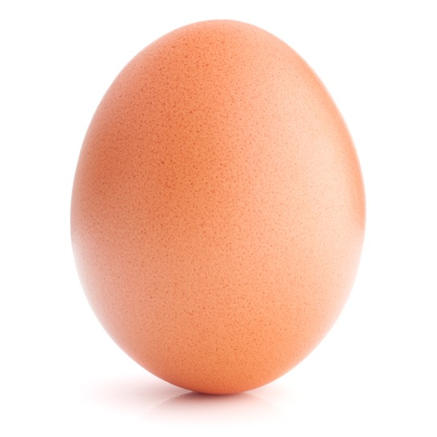
Prepare dressings, sauces, chutneys and relishes to accompany starters: Ingredients
Eggs
Vinegar
Vegetable oils
Mayonnaise
Balsamic vinegar
Mustards
Fish sauce
Hot sauce

Slide 4
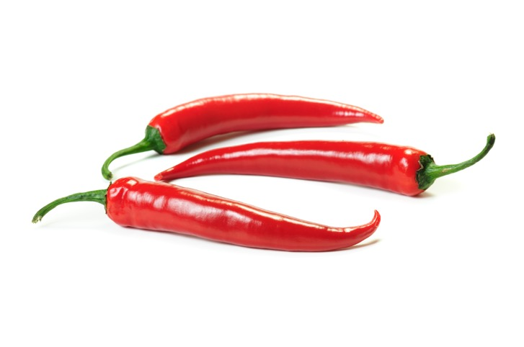
Ingredients (continued)
Spices
Sugar
Fruits
Herbs
Chillies
Vegetables
Cheese
Buttermilk
Ginger
Soy sauce

Slide 5
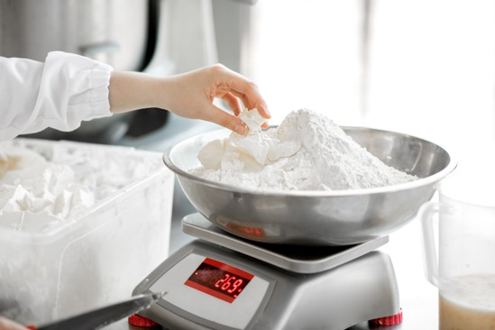
Quantities
Adapt standardised recipe
Increasing yield amount
Adjusting ingredients
Use weighing scales and measuring equipment

Slide 6
Quality checks
Quality | Checks completed
Visual | Colour, size, proportions, athletically pleasing
Aroma | Ingredients smell, check for overcooking, burnt smell
Use by and best before dates | Always check label correctly Use F.I.F.O system

Slide 7
Ingredient uses
Ingredients | Uses
Eggs Vinegar Vegetable oils | Emulsion sauces, dressings and added ingredients
Buttermilk Ginger Soy sauce Chillies Vegetables Cheese | Specific ingredients to add to standard recipes, sometimes in very small qualities but important for specific flavours
Mayonnaise Balsamic vinegar Mustards | Derivitives of mayonnaise e.g. Marie Rose Basamic and mustard as an ingredient or for dressings

Slide 8
Ingredient uses (continued)
Ingredients | Uses
Sugar Fruits spices | Chutneys and relishes
Herbs Fish sauce Hot sauce | Enhance and garnish Ingredients to add to oriental sauces

Slide 9
Quantities
Quantity | Checks
Adapt standardised recipe | Upgrading to a larger or smaller amount
Increasing yield amount Adjusting ingredients | Smaller portions don’t always match to larger so development may be required
Use weighing scales and measuring equipment | Accurate measurements of both dry and wet ingredients

Slide 10
Any questions?

