Slide 1
Monitor the safe use of equipment used when making dressings, sauces, chutneys and relishes
PowerPoint presentation
Unit 307: Produce and present advanced starters using standardised recipes

Slide 2
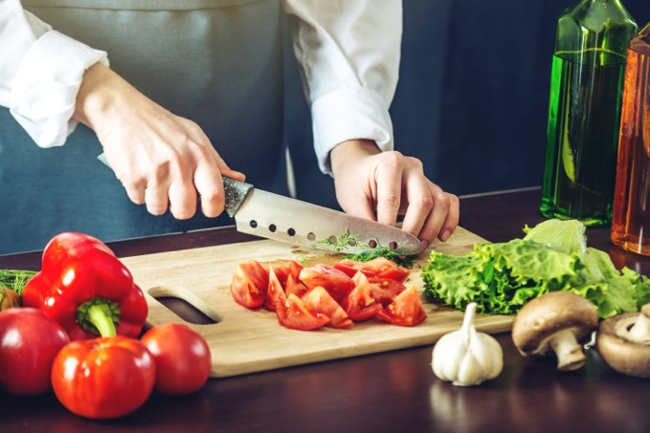
Kitchen equipment
Temperature probe
Blender
Chopping boards
Food processor
Mandolin
Measuring jug
Mixers
Blast chillers and blast freezers
Hobs
Ovens
Steamers

Slide 3
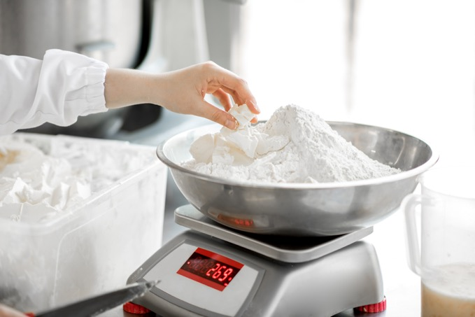
Preparation methods
Weighing/measuring
Cutting
Deseeding
Blending
Pureeing
Grating
Emulsifying
Mixing
Infusing

Slide 4
Equipment
Equipment | Uses
Temperature probe | Ensure and record correct temperatures
Chopping boards | Colour coded system in line with centre standard
Food processor /Blender | Chopping, liquidizing and blending items
Mandolin | For uniform slicing

Slide 5
Equipment (continued)
Equipment | Uses
Measuring jug | For measuring liquids sometimes liquid is weighed for accuracy
Mixers | For bulk mixing, handheld or machine
Blast chillers and blast freezers | To chill down items as soon as possible in line with centre’s procedures
Hobs | For cooking and warming

Slide 6
Preparation methods
Preparation methods | Recipe items
Weighing /measuring | Accurate measuring is important
Cutting | Should be even to help with cooking usually chutneys
Deseeding | All seeds should be removed during preparation as too small
Pureeing | To incorporate a puree, e.g. fresh tomato, garlic, spinach to concentrate flavor or give colour e.g. tricolor pasta
Grating | Grater used for specific items e.g. horseradish
Emulsifying | Mixing egg yolks with oil or butter e.g. Mayonnaise or Hollandaise sauces and derivatives
Mixing | Brining together of ingredients
Infusing | Adding ingredients to gain flavor but removing before serving e.g. herbs

Slide 7
Any questions?

