Slide 1
Cook a range of dressings, sauces, chutneys and relishes using different methods of cookery
PowerPoint presentation
Unit 307: Produce and present advanced starters using standardised recipes

Slide 2
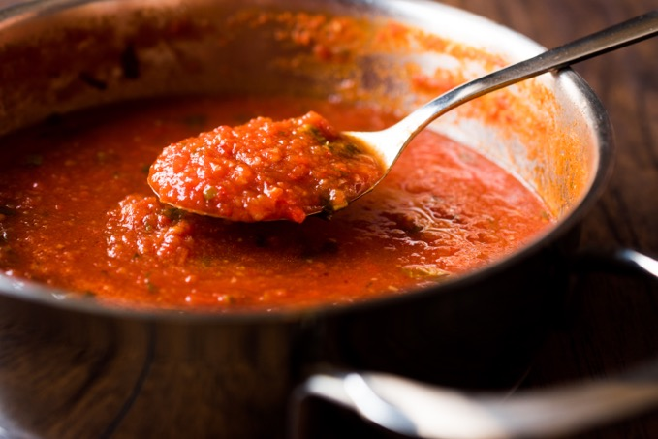
Prepare dressings, sauces, chutneys and relishes to accompany starters
Cook a range of dressings, sauces, chutneys and relishes using different methods of cookery
Cooking examples:
Boiling
Simmering
Steaming

Slide 3
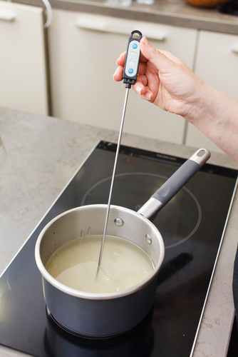
Quality checks
Apply quality checks during the making of dressings, sauces, chutneys and relishes:
Correct temperature
Timing
Texture
Correct degree of cooking
Seasoning

Slide 4
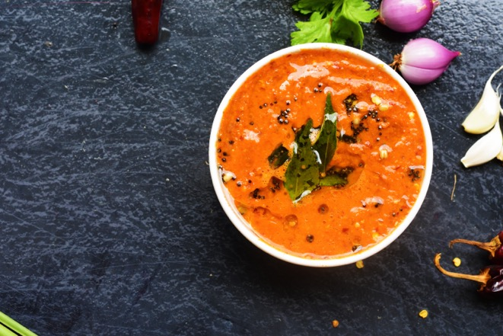
Prepare dressings, sauces, chutneys and relishes to accompany starters
Use a range of dressings, sauces, chutneys and relishes for finishing of starters. Ensure:
correct consistency
flavour balance
garnishing
dressing
storage
chilling.

Slide 5
Cooking methods
Cooking method | Uses
Boiling | Commodities and items boiled at a temperature of 100 degrees celsius
Simmering | Commodities and items poached at a temperature 71–82 degrees celsius
Steaming | Cooked via steam, could be in a pressure steamer, atmospheric steamer or an oriental basket style steamer over boiling water

Slide 6
Sauces
Sauces hot and cold | Uses
Mayonnaise | Derivatives of mayonnaise could include tartar, Marie Rose
Hollandaise | This has various derivatives including maltaise with blood orange juice, Bearnaise is also made in a similar way but with a different reduction
Remoulade sauce | This is a mayonnaise derivative into tartar and the addition of anchovy essence
Pesto | Classic made from Basil, garlic, pine nuts and olive oil
Compound butters | These are served as a dressing and could include beurre noisette, nut brown butter and beurre noir black butter

Slide 7
Quality checks
Quality checks | Reasons
Correct Temperature | Follow standard recipe
Timing | Follow standard recipe with check made
Texture | Check the texture is appropriate to the dish
Correct degree of cooking | Some items can be served medium (pink) or be fully cooked through
Seasoning | Ensure seasoning takes place throughout the process taking care not to over season

Slide 8
Finishing methods
Finishing | Reasons
Correct consistency | Size and portion in relation to the main part of the dish
Flavour balance | Must enhance the dish and not overpower the main items, all must marry together
Garnishing | Suitable garnishes for the standard recipe
Dressing | Not overpowered with dressing, this should take place as near as possible to service
Storage | Depending on the actual sauce chutney or relish, could be bottled or into jars or vacuum packed for longer life
Chilling | All items must be chilled in line with the centre’s procedures

Slide 9
Any questions?

