Slide 1
Cook a range of dressings, sauces, chutneys and relishes using different methods of cookery
PowerPoint presentation
Unit 307: Produce and present advanced starters using standardised recipes

Slide 2
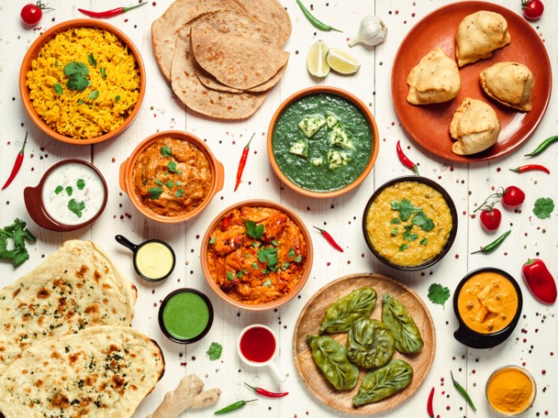
Prepare dressings, sauces, chutneys and relishes to accompany starters
Cook a range of dressings, sauces, chutneys and relishes using different methods of cookery.
Cooking methods:
Grilling
Roasting

Slide 3
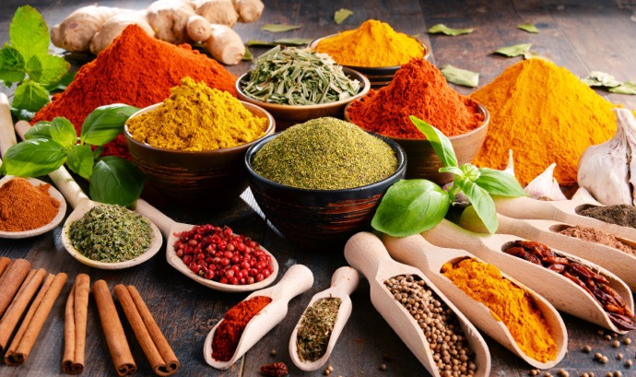
Prepare dressings, sauces, chutneys and relishes to accompany starters
Apply quality checks during the making of dressings, sauces, chutneys and relishes
Quality checks:
Correct temperature
Timing
Texture
Correct degree of cooking
Seasoning

Slide 4
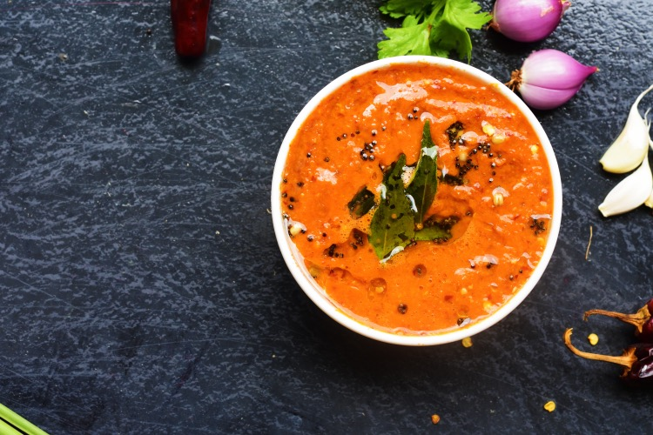
Prepare dressings, sauces, chutneys and relishes to accompany starters
Use a range of dressings, sauces, chutneys and relishes for finishing of starters.
Finishing can be for:
correct consistency
flavour balance
garnishing
dressing
storage
chilling

Slide 5
Cooking methods
Cooking method | How
Grilling | A form of cooking that involves dry heat applied to the surface of food, commonly from above, below or from the side
Roasting | A cooking method that uses dry heat where hot air covers the food, cooking it evenly on all sides with temperatures of at least 150 °C (300 °F)

Slide 6
Relishes
Relishes | Centre specification
Beetroot relish | Discuss the standard centre recipe
Tomato relish | Discuss the standard centre recipe
Cucumber relish | Discuss the standard centre recipe
Regional relishes | Discuss the standard centre recipe

Slide 7
Quality checks
Quality checks | Reasons
Correct Temperature | Follow standard recipe
Timing | Follow standard recipe with check made
Texture | Check the texture is appropriate to the dish
Correct degree of cooking | Some items can be served medium (pink) or be fully cooked through
Seasoning | Ensure seasoning takes place throughout the process taking care not to over season

Slide 8
Finishing methods
Finishing | Reasons
Correct consistency | Size and portion in relation to the main part of the dish
Flavour balance | Must enhance the dish and not overpower the main items, all must marry together
Garnishing | Suitable garnishes for the standard recipe
Dressing | Not overpowered with dressing, this should take place as near as possible to service
Storage | Depending on the actual sauce chutney or relish, could be bottled or into jars or vacuum packed for longer life
Chilling | All items must be chilled in line with the centre’s procedures

Slide 9
Any questions?

