Slide 1
Review and recap
PowerPoint presentation
Unit 307: Produce and present advanced starters using standardised recipes

Slide 2
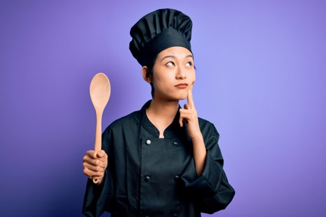
Recap and review
Discuss any outstanding work.
Learners to complete a 3-hour practical session using developed standardised recipe covering areas for development.
Catch up on missed or incomplete work for the following areas:
Prepare, cook and serve hot soups and advanced hot starters
Prepare, cook and serve cold soups and advanced cold starters
Prepare dressings, sauces, chutneys and relishes to accompany starters.

Slide 3
Any questions?

