Slide 1
Monitor the safe use of equipment used when making hot soups and hot starters
PowerPoint presentation
Unit 307 Produce and present advanced starters using standardised recipes

Slide 2
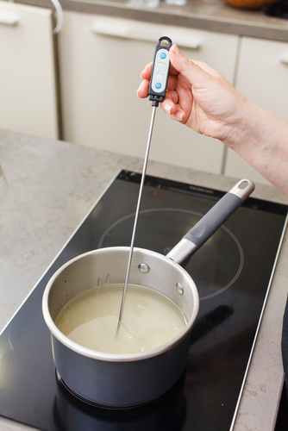
Monitor the safe use of equipment used when making hot soups and hot starters
Equipment:
Temperature probe
Blender
Food processor
Frying pans
Mandolin

Slide 3
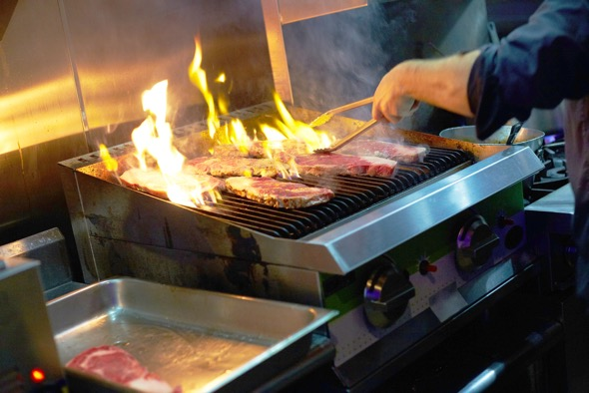
Monitor the safe use of equipment used when making hot soups and hot starters
Mixers
Blast chillers and blast freezers
Cold holding equipment
Fryers and griddles
Grills
Hobs

Slide 4
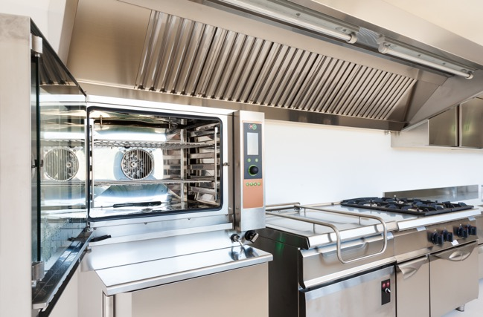
Monitor the safe use of equipment used when making hot soups and hot starters
Hot holding equipment
Ovens
Steamers
Soup kettle

Slide 5
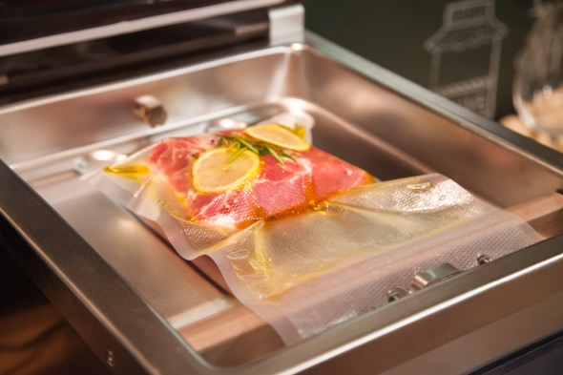
Prepare a range of hot soups and hot starters using correct preparation methods
Blending
Clarification mix
Clarifying butter
Filleting
Purging
Sous vide water bath

Slide 6
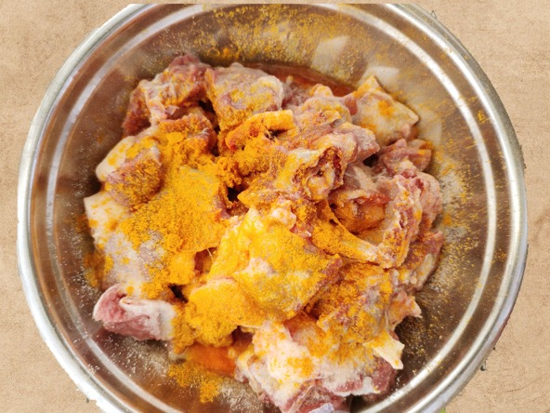
Preparation methods (continued)
Tenderising
Thermomix
Marinating

Slide 7
Equipment
Equipment | Uses
Temperature probe | To take and record safe temperatures, requires calibration
Blender | For blending ingredients
Food processor | For chopping, pureeing and grinding
Frying pans | For cooking various items
Mandolin | Fine slicing, julienne and giuffre vegetable cuts
Mixers | Handheld and bulk mixing
Blast chillers and blast freezers | To reduce the temperature to a safe level as soon as possible

Slide 8
Equipment
Equipment | Uses
Cold holding equipment | Display and fridges for cold starters
Fryers and griddles | For cooking ingredients for hot and cold starters
Grills and hobs | For cooking ingredients for hot and cold starters
Ovens/hot holding equipment | For cooking and hot holding
Steamers | Atmospheric and pressure steamers
Soup kettle | Holding prepared and cooked soups

Slide 9
Preparation methods
Preparation methods | Menu examples
Blending | Mixing items together in a set order
Clarification mix | For use in consommés
Clarifying butter | For cooking, layering and topping of terrines and pate’s
Filleting | Usually for fish preparing

Slide 10
Preparation methods (continued)
Preparation methods | Menu examples
Tenderising | To help make meat cuts more tender, can be done with meat hammer or various specialist tools
Purging | Rinsing seafood e.g.mussels to remove impurities
Sous vide water bath | Cooking slowly in a temperature-controlled bath of water at set temperatures which can be very low
Thermomix | A blending and mixing machine which can be used cold but also has a heating element for some cooking e.g. hollandaise sauce
Marinating | To mix with a variety of items to help impart flavor and to tenderise e.g. cajun

Slide 11
Any questions?

