Slide 1
Prepare a range of hot soups and hot starters using correct preparation methods
PowerPoint presentation
Unit 307: Produce and present advanced starters using standardised recipes

Slide 2
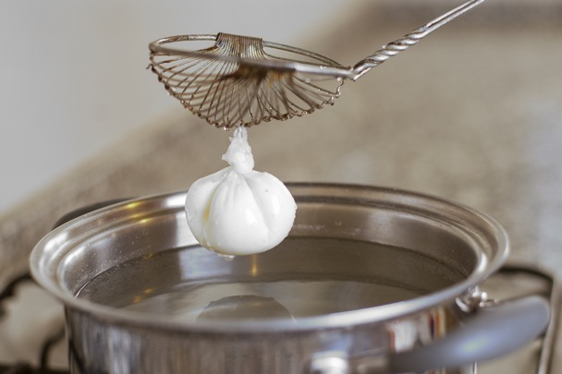
Cook a range of hot soups and hot starters
Cooking methods:
Boiling
Poaching
Steaming
Simmering

Slide 3
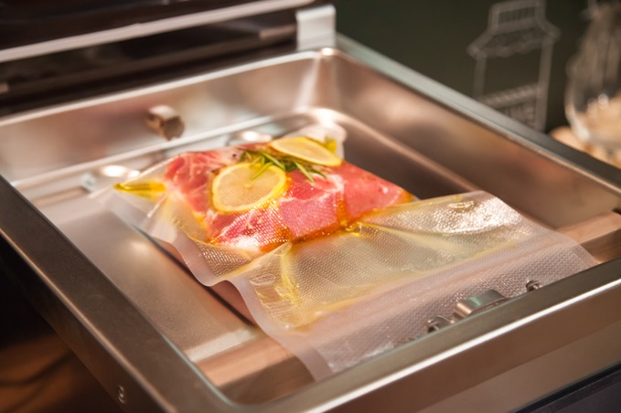
Blending
Clarification mix
Clarifying butter
Filleting
Purging
Sous vide water bath
Tenderising
Thermomix
Marinating

Slide 4
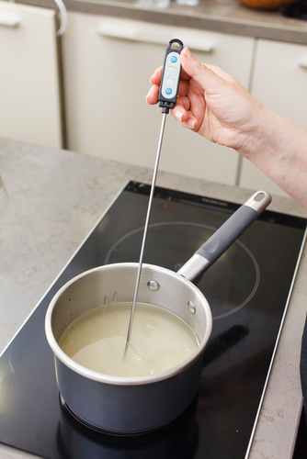
Apply quality checks during the cooking of hot soups and advanced starters
Correct temperature
Timing
Texture
Correct degree of cooking
Seasoning
Evaporation
Liquid levels

Slide 5
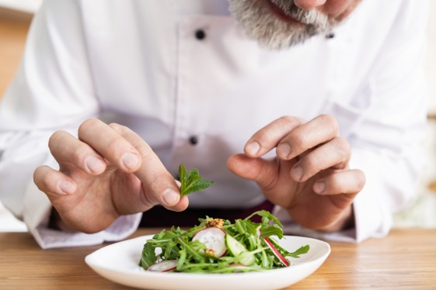
Finish a range of hot soups and advanced hot starters using appropriate finishing methods
Garnishing
Saucing
Glazing
Gratinating
Flambéing
Passed
Serving
Plating
Correct temperature

Slide 6
Cook a range of hot soups and hot starters
Cooking method | Menu item
Boiling | Commodities and items boiled at a temperature of 100 decree celsius.
Poaching | Commodities and items poached at a temperature 71–82 degrees celsius.
Steaming | Cooked via steam. could be in a pressure steamer, atmospheric steamer or an oriental basket style steamer over boiling water .
Simmering | Just off boiling around 95 degrees Celsius.

Slide 7
Apply quality checks during the cooking of hot soups and advanced starters
Quality check | How
Correct Temperature | Follow standard recipe, record temperature following temperature probing
Timing | Follow standard recipe with check made
Texture | Check the texture is appropriate to the dish
Correct degree of cooking | Some items can be served medium (pink)
Seasoning | Ensure seasoning takes place throughout the process taking care not to over season
Evaporation | This can happen when the temperature is too high
Liquid levels | Keep liquid levels up

Slide 8
Finish a range of hot soups and advanced hot starters using appropriate finishing methods
Finishing | Menu example
Garnishing | Suitable garnish to enhance the dish as per dish specification
Saucing | Coated or served separate as per dish specifications
Glazing | Hot dishes can be glazed with the addition of a liaison (egg yolks and cream) or cold items can be glazed with a savory jelly
Gratinating | Usually glazed with cheese or breadcrumbs or both
Flambéing | To flame with alcohol, sometimes in front of the customer
Passed | To pass through a conical strainer or chinois

Slide 9
Finish a range of hot soups and advanced hot starters using appropriate finishing methods (continued)
Finishing | Menu example
Strained | To remove all items so a liquid is left
Pureed | To make a fine ingredient to add to a dish e.g. carrot, tomato
Un passed | The dish contains all items usually a soup e.g. broth, garnish must be small e.g. paysanne
Clarified | This refers to a stock which had been cleared e.g. consommé
Serving | Serving specification in standard recipe
Plating | Which crockery or serving dish is to be used to enhance the dish
Correct temperature | Checking and recording temperatures for both hot and cold dishes

Slide 10
Any questions?

