Slide 1
Prepare a range of hot soups and hot starters
PowerPoint presentation
Unit 307 Produce and present advanced starters using standardised recipes

Slide 2
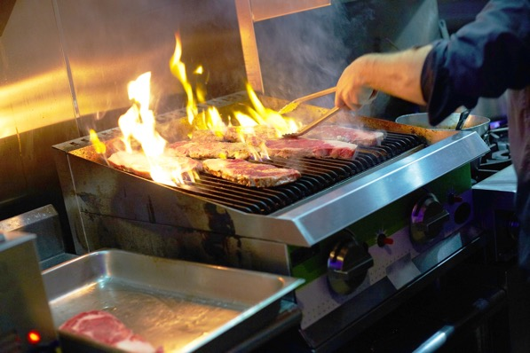
Cook a range of hot soups and hot starters
Cooking methods
Baking
Roasting
Grilling

Slide 3
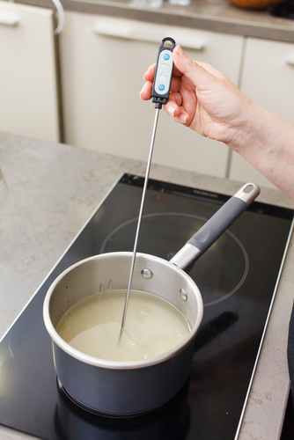
Quality checks
Correct temperature
Timing
Texture
Correct degree of cooking
Seasoning

Slide 4
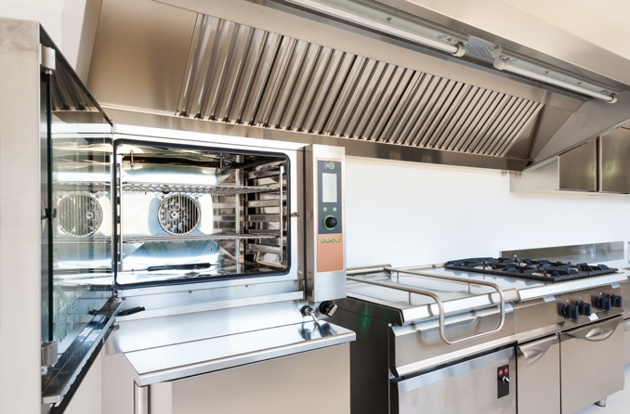
Use equipment safely
Use equipment safely during the cooking of hot soups and advanced starters from the following groups:
Baking
Roasting
Grilling

Slide 5
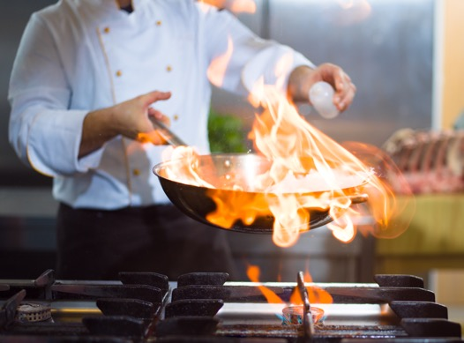
Finish a range of hot soups and advanced hot starters using appropriate finishing methods
Garnishing
Saucing
Glazing
Gratinating
Flambéing
Passed

Slide 6
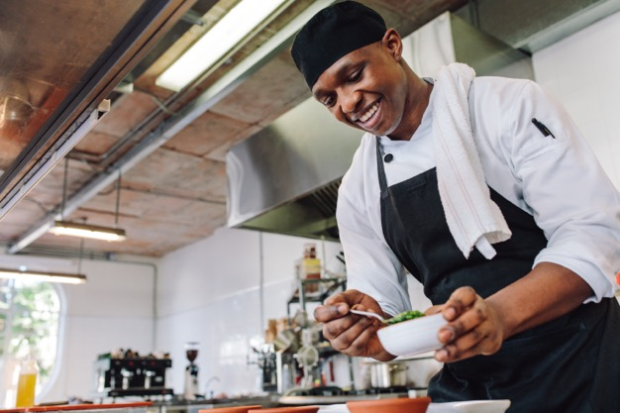
Finish a range of hot soups and advanced hot starters using appropriate finishing methods
Strained
Pureed
Un-passed
Clarified
Serving
Plating
Correct temperature

Slide 7
Cook a range of hot soups and hot starters
Cookery method | Menu item
Baking | A method of preparing food that uses dry heat, normally in an oven, but can also be done in hot ashes, or on hot stones.
Roasting | A cooking method that uses dry heat where hot air covers the food, cooking it evenly on all sides with temperatures of at least 150 °C (300 °F)
Grilling | A form of cooking that involves dry heat applied to the surface of food, commonly from above, below or from the side.

Slide 8
Apply quality checks during the cooking of hot soups and advanced starters
Quality check | How
Correct Temperature | Follow standard recipe
Timing | Follow standard recipe with check made
Texture | Check the texture is appropriate to the dish
Correct degree of cooking | Some items can be served medium (pink)
Seasoning | Ensure seasoning takes place throughout the process taking care not to over season

Slide 9
Finish a range of hot soups and advanced hot starters using appropriate finishing methods
Finishing | Menu example
Garnishing | Suitable garnish to enhance the dish
Saucing | Coated or served separate as per dish specifications
Glazing | Hot dishes can be glazed with the addition of a liaison (egg yolks and cream) of cold items can be glazed with a savory jelly
Gratinating | Usually glazed with cheese or breadcrumbs
Flambéing | To flame with alcohol, sometimes in front of the customer
Passed | To pass through a conical strainer or chinois

Slide 10
Finish a range of hot soups and advanced hot starters using appropriate finishing methods (continued)
Finishing | Menu example
Strained | To remove all items so a liquid is left
Pureed | To make a fine ingredient to add to a dish e.g. carrot, tomato
Un passed | The dish contains all items usually a soup e.g. broth
Clarified | This refers to a stock which had been cleared e.g. consommé
Serving | Serving specification in standard recipe
Plating | Which crockery or serving dish is to be used to enhance the dish
Correct temperature | Checking and recording temperatures for both hot and cold dishes

Slide 11
Any questions?

