Slide 1
Monitor the safe use of equipment used when making hot soups and hot starters
PowerPoint presentation
Unit 307 Produce and present advanced starters using standardised recipes

Slide 2
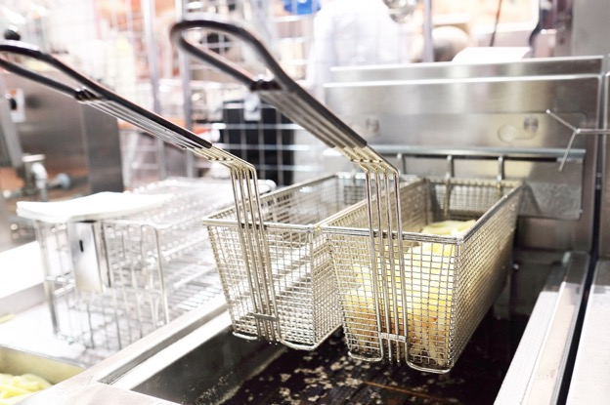
Cooking methods for hot soups and hot starters
Shallow frying
Deep frying
Combination cookery

Slide 3
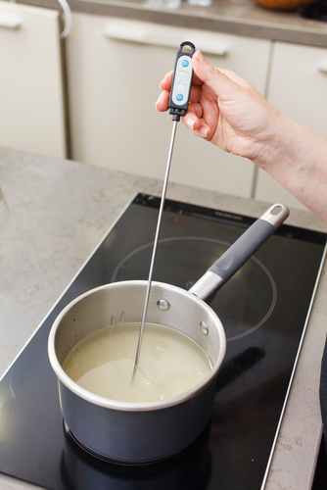
Quality checks
Correct temperature
Timing
Texture
Correct degree of cooking
Seasoning

Slide 4
Monitor the safe use of equipment used when making hot soups and hot starters
Discuss the following equipment and how these will support the development, preparation, cooking and storage. Standard recording documents to be completed and filed for the following:
Shallow frying
Deep frying
Combination cookery

Slide 5
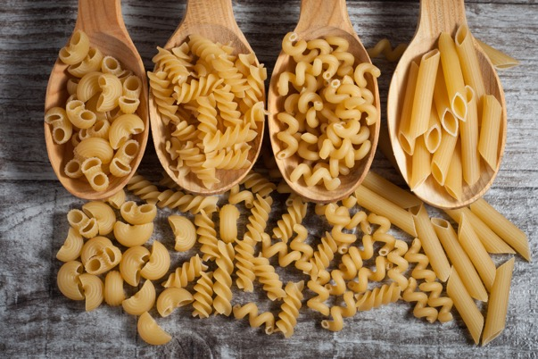
Use equipment safely during the cooking of hot soups and advanced starters
Use equipment safely during the cooking of hot soups and advanced starters from the following groups:
Fresh or convenience stock
Noodles, pasta and bread

Slide 6
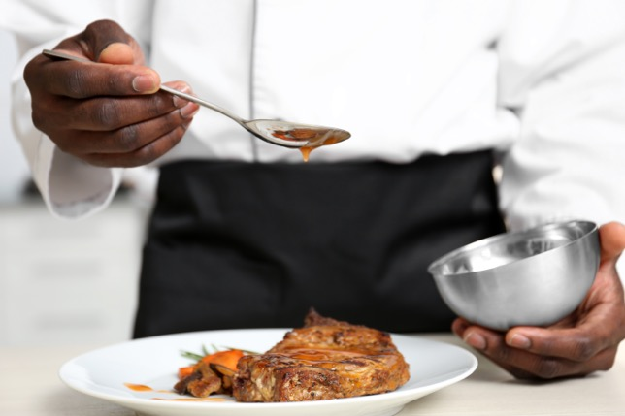
Finishing methods
Garnishing
Saucing
Glazing
Gratinating
Flambéing
Passed

Slide 7
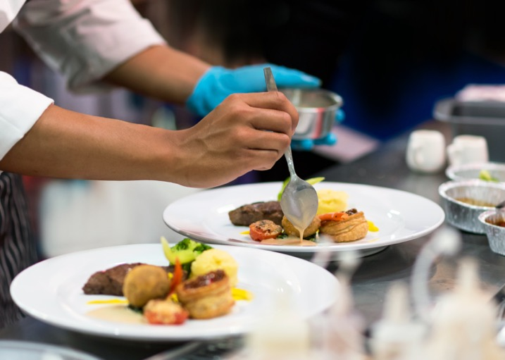
Finishing methods (continued)
Strained
Pureed
Un-passed
Clarified
Serving
Plating
Correct temperature

Slide 8
Cooking methods
Cookery method | Menu item
Shallow frying | An oil-based cooking technique. It is typically used to prepare portion-sized cuts of meat and fish, and patties such as fritters.
Deep frying | A process where food is completely submerged in hot oil at temperatures typically between 350 °F (177 °C) and 375 °F (191 °C) ensure the oil is hot enough and the food is not immersed in the oil for too long, oil penetration will be confined to the outer surface.
Combination | A mixture of cookery method e.g. roasting and steaming

Slide 9
Apply quality checks during the cooking of hot soups and advanced starters
Quality check | How
Correct Temperature | Follow standard recipe
Timing | Follow standard recipe with check made
Texture | Check the texture is appropriate to the dish
Correct degree of cooking | Some items can be served medium (pink)
Seasoning | Ensure seasoning takes place throughout the process taking care not to over season

Slide 10
Finishing methods
Finishing | Menu example
Garnishing | Suitable garnish to enhance the dish
Saucing | Coated or served separate as per dish specifications
Glazing | Hot dishes can be glazed with the addition of a liaison (egg yolks and cream) of cold items can be glazed with a savory jelly
Gratinating | Usually glazed with cheese or breadcrumbs
Flambéing | To flame with alcohol, sometimes in front of the customer
Passed | To pass through a conical strainer or chinois

Slide 11
Finishing methods (continued)
Finishing | Menu example
Strained | To remove all items so a liquid is left
Pureed | To make a fine ingredient to add to a dish e.g. carrot, tomato
Un-passed | The dish contains all items usually a soup e.g. broth
Clarified | This refers to a stock which had been cleared e.g. consommé
Serving | Serving specification in standard recipe
Plating | Which crockery or serving dish is to be used to enhance the dish
Correct temperature | Checking and recording temperatures for both hot and cold dishes

Slide 12
Any questions?

