Slide 1
Preparing, cooking and finishing methods
PowerPoint presentation
Unit 307: Produce and present advanced starters using standardised recipes

Slide 2
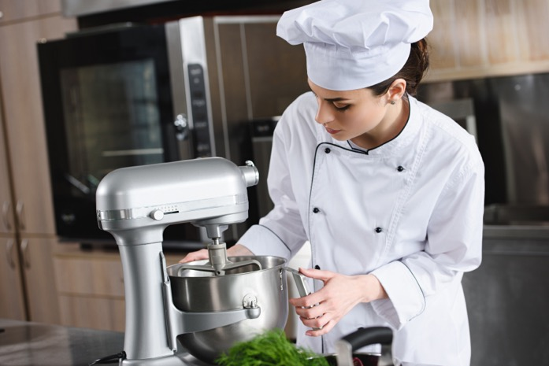
Kitchen equipment
Temperature probe
Blender
Food processor
Frying pans
Mandolin
Mixers
Blast chillers and blast freezers
Cold holding equipment

Slide 3
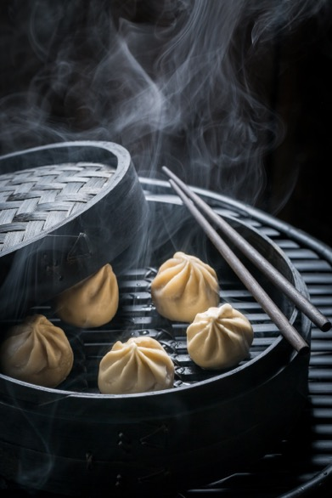
Kitchen equipment (continued)
Fryers and griddles
Grills
Hobs
Hot holding equipment
Ovens
Steamers

Slide 4
Cooking methods
Baking – in an oven
Combination – using more than one method
Poaching – cooking in water
Boiling – cooking at 100 degrees celsius
Simmering – cooking at just under boiling point
Steaming – cooking over water e.g. through mesh
Grilling – cooking under a heat source from the top or side
Bain marie – keeping food warm in a water bath.

Slide 5
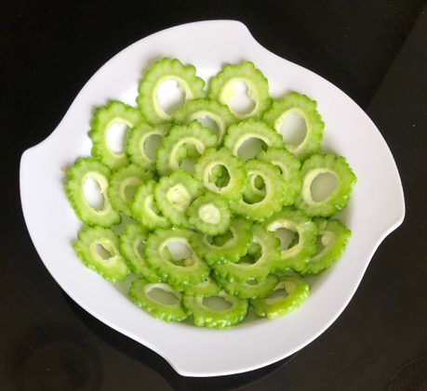
Be able to prepare, cook and serve cold soups and advanced cold starters and mezze
Adapt standard recipes, increase yield amounts for more covers and adjust ingredients to ensure quality is maintained.
Use a range of preparation and cooking methods for the following:
Fresh and convenience stock
Textured vegetable proteins
Vegetables

Slide 6
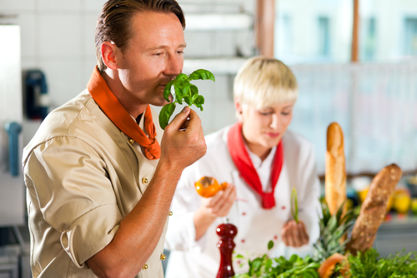
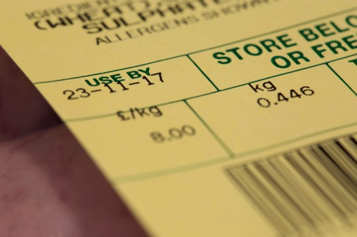
Check quality of ingredients
Visual
Aroma
Texture
Use by and best before dates.

Slide 7
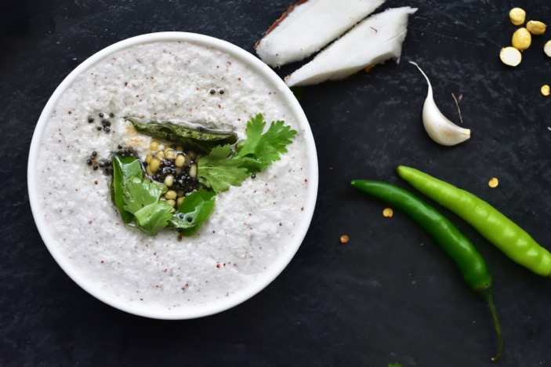
Finishing methods
Garnishing
Saucing
Dressing
Gratinating
Flambéing
Passed

Slide 8
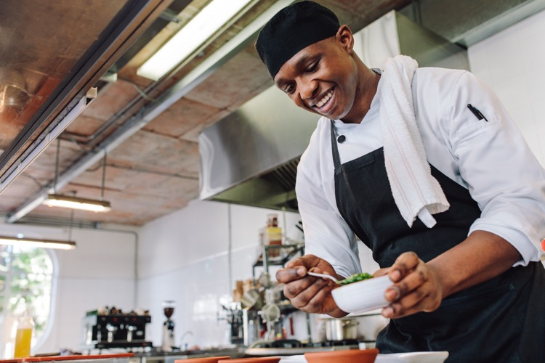
Finishing methods (continued)
Strained
Pureed
Un-passed
Clarified
Serving
Plating
Chilling

Slide 9
Use a range of kitchen equipment
Equipment used | Menu item
Temperature probe | To take and record safe temperatures, requires calibration
Blender Food processor Mandolin | For chopping, pureeing and grinding Fine slicing, julienne and Giuffre vegetable cuts
Frying pans Fryers and griddles Grills | For cooking various items
Mixers | Handheld and bulk mixing
Blast chillers and blast freezers Cold holding equipment | To reduce the temperature to a safe level as soon as possible Display and fridge's for cold starters
Hobs Hot holding equipment Ovens Steamers | For cooking ingredients for hot and cold starters Atmospheric and pressure steamers

Slide 10
Use a variety of ingredients
Ingredients | Examples
Fresh and convenience stock | Stock made from fresh ingredients, powdered, gels and frozen.
Textured vegetable proteins | Soya items, soft and hard types Tofu
Vegetables | All range of vegetables as per the standard recipe

Slide 11
Apply a range of finishing methods when serving dishes
Finishing | Application
Garnishing | Suitable garnish to enhance the dish
Saucing Dressing | Coated or served separate as per dish specifications
Glazing/ gratinating | Hot dishes can be glazed with the addition of a liaison (egg yolks and cream) of cold items can be glazed with a savory jelly Usually glazed with cheese or breadcrumbs
Flambéing | To flame with alcohol, sometimes in front of the customer
Passed Strained Pureed Un passed | To remove all items so a liquid is left To make a fine ingredient to add to a dish e.g. carrot, tomato The dish contains all items usually a soup e.g. broth
Clarified | This refers to a stock which had been cleared e.g. consommé
Serving Plating | Which crockery or serving dish is to be used to enhance the dish
Chilling | Checking and recording temperatures for both hot and cold dishes

Slide 12
Any questions?

