Slide 1
Prepare a range of cold soups, mezze and advanced cold starters using correct preparation methods
PowerPoint presentation
Unit 307: Produce and present advanced starters using standardised recipes

Slide 2
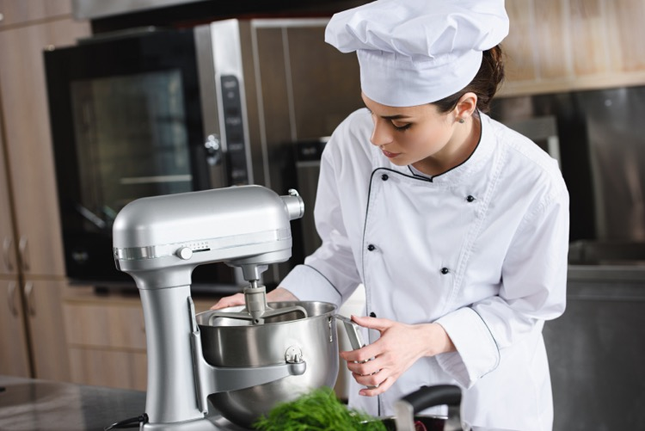
Kitchen equipment
Temperature probe
Blender
Food processor
Frying pans
Mandolin
Mixers
Blast chillers and blast freezers
Cold holding equipment

Slide 3
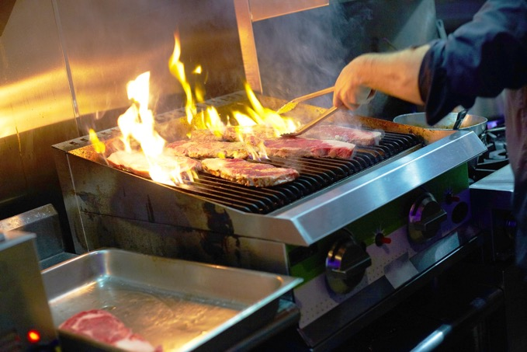
Kitchen equipment (continued)
Fryers and griddles
Grills
Hobs
Hot holding equipment
Ovens
Steamers

Slide 4
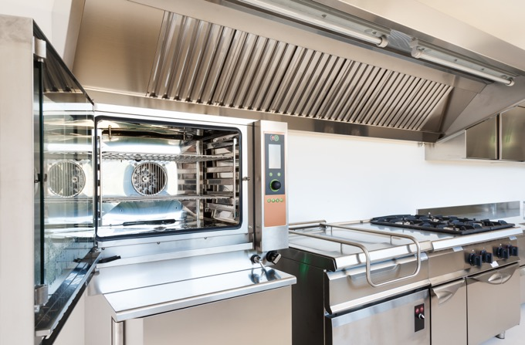
Be able to prepare, cook and serve cold soups and advanced cold starters and Mezze
Use a variety of cookery methods:
Baking
Combination cooking

Slide 5
Be able to prepare, cook and serve cold soups and advanced cold starters and mezze
Adapt standard recipes, increase yield amounts for more covers and adjust ingredients to ensure quality is maintained.
Use a range of preparation and cooking methods for the following :
Grains
Noodles
Rice

Slide 6
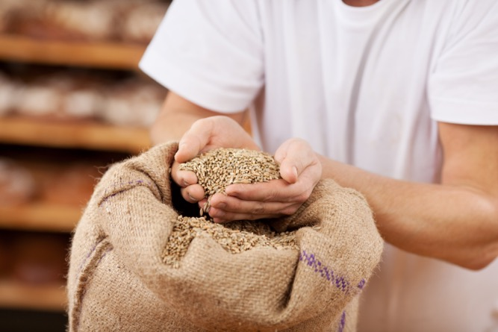
Quality checks
Visual
Aroma
Texture
Use by and best before dates

Slide 7
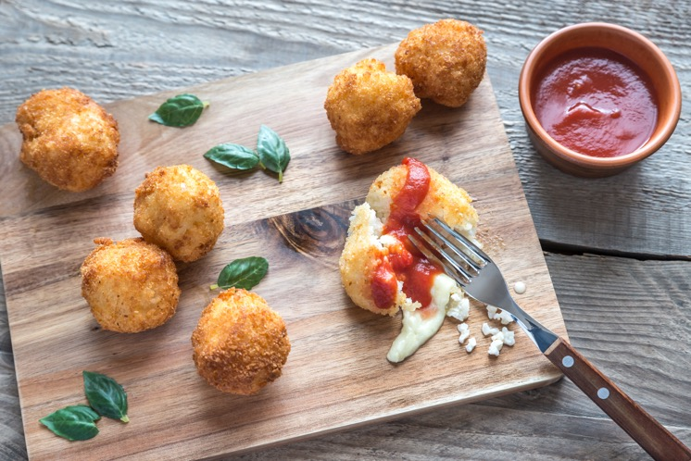
Finishing methods
Garnishing
Saucing
Dressing
Gratinating
Flambéing
Passed

Slide 8
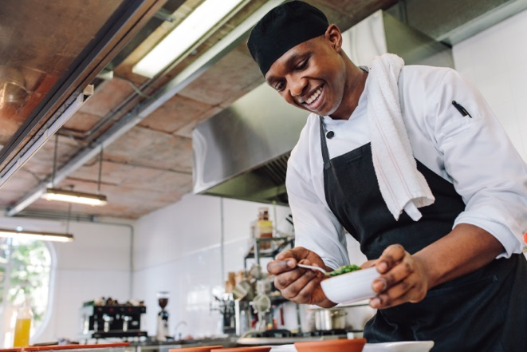
Finishing methods (continued)
Strained
Pureed
Un-passed
Clarified
Serving
Plating
Chilling

Slide 9
Use a variety of ingredients
Ingredients | Menu items
Grains | Barley, spelt, whole wheat, quinoa, maize
Noodles | Raman, Rice cellophane, Wonton, Soba, Egg
Rice | Long grain, arborio rice, wild rice, Jasmin rice, red cargo sushi rice, basmati rice

Slide 10
Any questions?

