Slide 1
Cook a range of cold soups, mezze and advanced cold starters using different methods of cookery
PowerPoint presentation
Unit 307: Produce and present advanced starters using standardised recipes

Slide 2
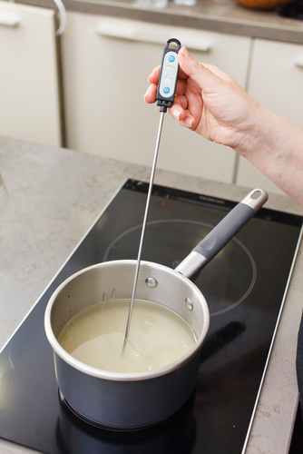
Monitor the safe use of equipment
Temperature probe
Blender
Food processor
Frying pans
Mandolin
Mixers
Blast chillers and blast freezers
Cold holding equipment

Slide 3
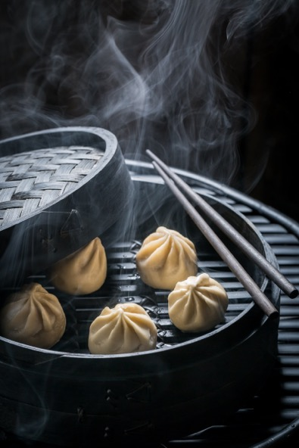
Kitchen equipment (continued)
Fryers and griddles
Grills
Hobs
Hot holding equipment
Ovens
Steamers

Slide 4
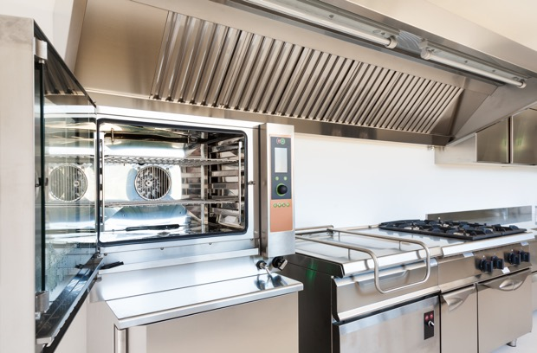
Be able to prepare, cook and serve cold soups and advanced cold starters and mezze
Use a variety of cookery methods:
Baking
Combination cooking

Slide 5
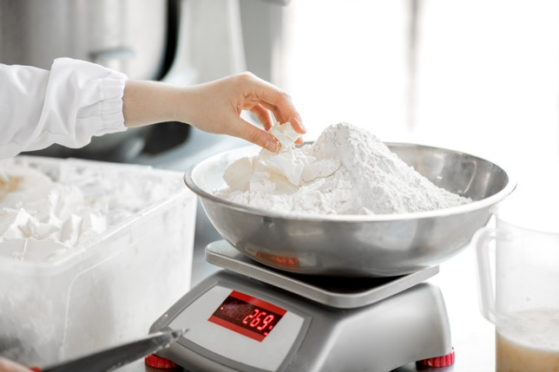
Be able to prepare, cook and serve cold soups and advanced cold starters and mezze
Adapt standard recipes, increase yield amounts for more covers and adjust ingredients to ensure quality is maintained.
Use a range of preparation and cooking methods for the following
Dairy products
Pasta
Pastry

Slide 6
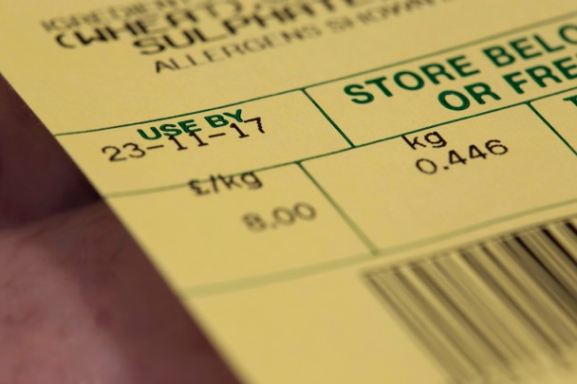
Quality checks for ingredients
Visual
Aroma
Texture
Use by and best before dates

Slide 7
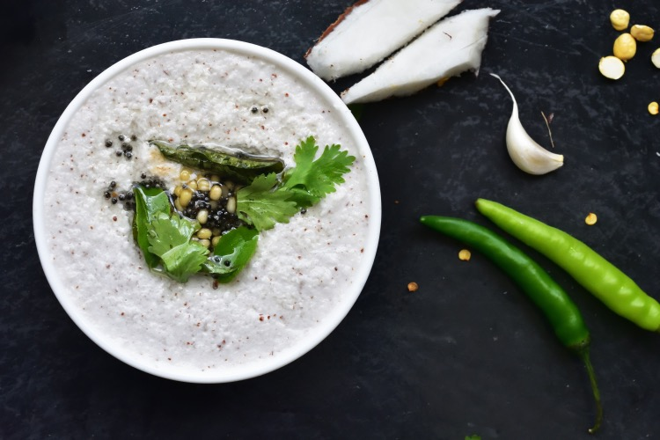
Finishing methods
Garnishing
Saucing
Dressing
Gratinating
Flambéing
Passed

Slide 8
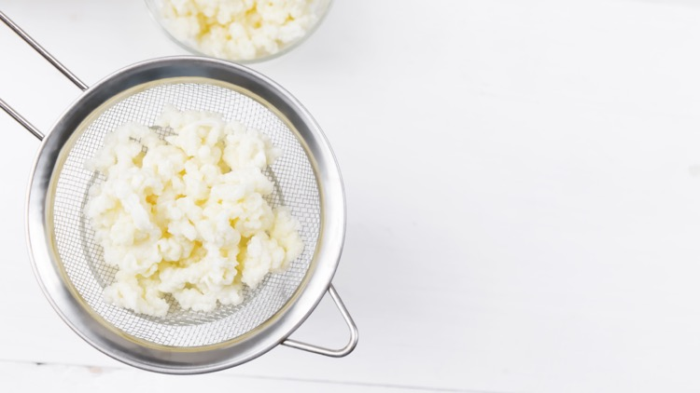
Finishing methods (continued)
Strained
Pureed
Un-passed
Clarified
Serving
Plating
Chilling

Slide 9
Equipment recording
Equipment used
Temperature probe
Blender Food processor Mandolin
Frying pans Fryers and griddles Grills
Mixers
Blast chillers and blast freezers Cold holding equipment
Hobs Hot holding equipment Ovens Steamers

Slide 10
Use a variety of ingredients
Ingredients | Menu items
Dairy products | Creams, (single, whipping, double) butters, yoghurt, crème fraiche, sour cream, etc.
Pasta | Fresh, frozen and dried for a range of shapes and stuffed pasta
Pastry | Savory pastry items could include puff pastry, rough puff pastry, brick paste, hot water paste, short crust pastry, filo paste, spring roll paste

Slide 11
Apply a range of finishing methods when serving dishes
Finishing | Application
Garnishing | Suitable garnish to enhance the dish
Saucing Dressing | Coated or served separate as per dish specifications
Gratinating/glazing | Hot dishes can be glazed with the addition of a liaison (egg yolks and cream) of cold items can be glazed with a savory jelly, chaud froid style (usually glazed with cheese or breadcrumbs)
Flambéing | To flame with alcohol, sometimes in front of the customer
Passed, strained, pureed un-passed | To make a fine ingredient to add to a dish e.g. carrot, tomato
 | The dish contains all items usually a soup e.g. broth
Clarified | This refers to a stock which had been cleared e.g. consommé
Chilling | Checking and recording temperatures for both hot and cold dishes

Slide 12
Any questions?

