Slide 1
Cook a range of cold soups, mezze and advanced cold starters using different methods of cookery
PowerPoint presentation
Unit 307: Produce and present advanced starters using standardised recipes

Slide 2
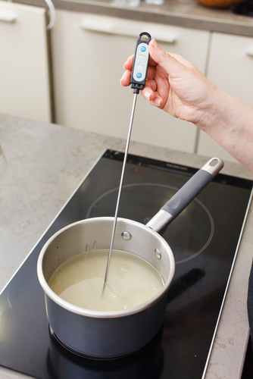
Kitchen equipment
Temperature probe
Blender
Food processor
Frying pans
Mandolin
Mixers
Blast chillers and blast freezers
Cold holding equipment

Slide 3
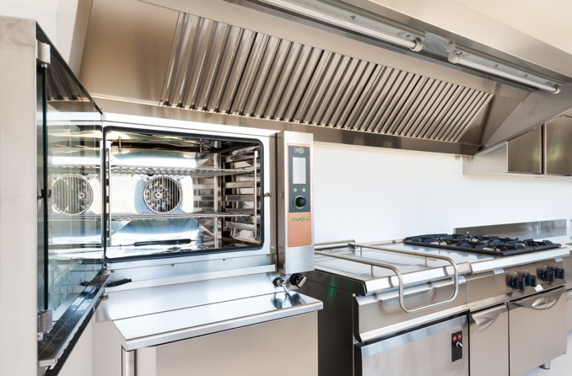
Kitchen equipment (continued)
Fryers and griddles
Grills
Hobs
Hot holding equipment
Ovens
Steamers

Slide 4
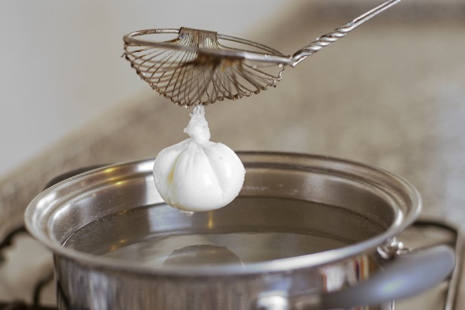
Cooking methods
Poaching – cooking in water
Boiling – at 100 degrees celsius
Simmering – at jus under boiling point
Steaming – over water, e.g. on a mesh

Slide 5
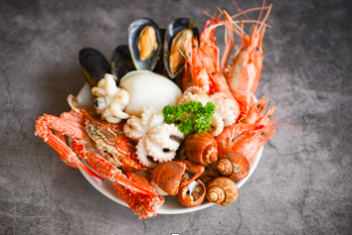
Be able to prepare, cook and serve cold soups and advanced cold starters and mezze
Adapt standard recipes, increase yield amounts for more covers and adjust ingredients to ensure quality is maintained
Use a range of preparation and cooking methods for the following
Cheese
Eggs
Fish
Shellfish

Slide 6
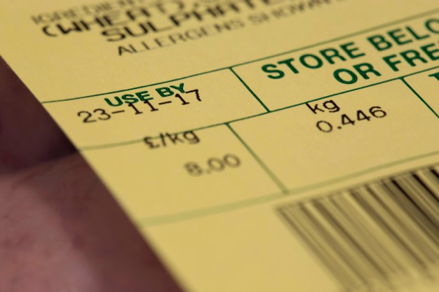
Check quality of ingredients
Visual
Aroma
Texture
Use by and best before dates

Slide 7
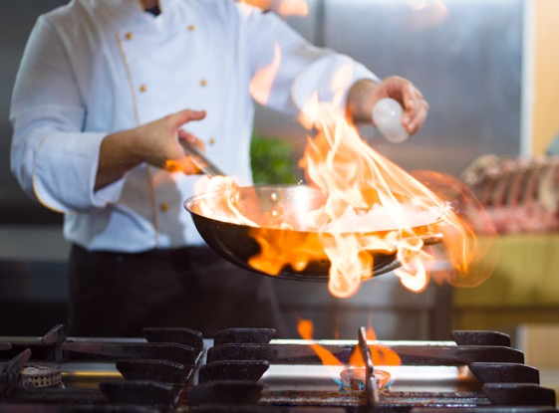
Finishing methods
Garnishing
Saucing
Dressing
Gratinating
Flambéing
Passed

Slide 8
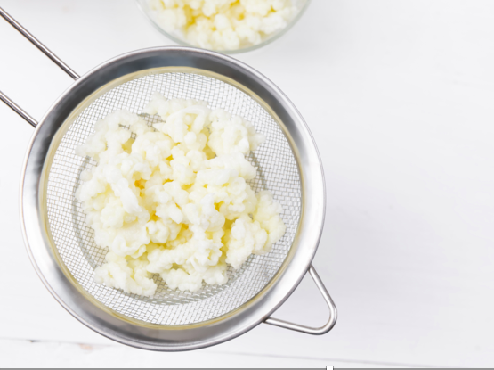
Finishing methods (continued)
Strained
Pureed
Un-passed
Clarified
Serving
Plating
Chilling

Slide 9
Use a variety of ingredients
Ingredients | Uses
Cheese | For service as a course or as an ingredient, e.g. goats cheese, raclette, parmesan, pecorino
Eggs | Hens, duck and quail's eggs are most suitable for starters
Fish | Small fish like sardines and fillets of small fish, other large fish for terrines and mousses
Shellfish | All shellfish including prawns, crab, oysters, abalone, mussels, calamari, octopus

Slide 10
Any questions?

