Slide 1
Prepare advanced vegetarian main course dishes
PowerPoint presentation
Unit 308: Produce and present advanced main course dishes using standardised recipes

Slide 2
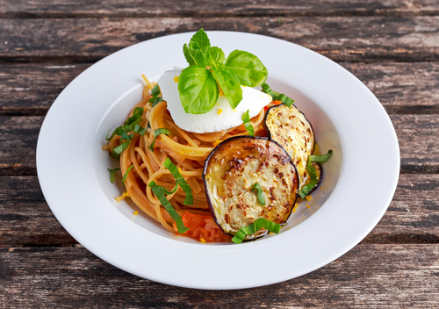
Introduction
In order for a professional chef to create quality vegetable and vegetarian products the must first understand:
the preparation techniques used
the cooking methods employed
When preparing any vegetable it is imperative that the chef understands the technique used to prepare their vegetables so as to meet the quality and dish requirements. The cooking methods employed will effect how the vegetables will react to the onset of heat.

Slide 3
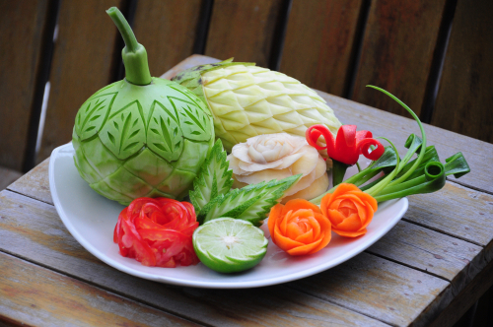
Preparation
Carving – carving is a technique that has been developed over many years and it is believed to originate in the Far East. This technique sometimes uses specialist tools and the end results are normally used as a garnish. A competent carver will employ their imagination to make flowers, birds and other objects to decorate a plate, buffet or table.
Curing – a salt cure does more than just season, It also has a power to transform texture in the process. Salting wedges of savoy cabbage ahead of time lets the seasoning penetrate to the core while also tenderizing the leaves. That way, when the cabbage hits the grill, it'll reach that firm-tender place on the inside before it threatens to totally blacken on the outside.

Slide 4
Preparation
Cutting – the majority of vegetable will need to cut in some form for the vegetarian dish. The different cuts used will depend on the dish being prepared. Precision cuts are used to add colour and structure to menu items. These cuts display the chef’s skill and attention to detail. Precision cuts are used for a variety of vegetables such as celery, leek, carrots, turnips and swedes
Drying – this technique has been used for many years, usually this employed the sun to dry the vegetables, as a preservation method. Now however the technique has been employed to provide the professional chef with more possibilities for garnishing their products. Dehydrator machine are available, but a low temperature oven can also be used. This technique can be used to dry slices of tomatoes and vegetable crisps, creating different textures and powders.

Slide 5
Preparation
Marinating – marinating of vegetables is conducted to impart or enhance the flavour of the vegetables. This can be achieved by using vinegar, lemon juice, oils infused with herbs etc. Marinades are especially transformative for aubergine and courgette, which soaks them up like a sponge, and leafy greens, which easily absorb infused oil.
Peeling – most vegetable require some sort of peeling, however, when prepping potatoes, carrots, parsnips, and other root vegetables, it’s common practice to first wash and then remove the outer layer of skin (peelings) . However, these peelings can be baked or fried into a crunchy garnishes that can add texture to a dish.

Slide 6
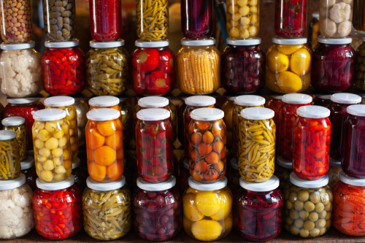
Preparation
Pickling – pickling is a normally used to preserve a vegetable, but it can also provide other flavours, or enhance the natural flavours of the vegetables. The process involves the cooking of the vegetables, in most cases, then immersing then in an acid such as vinegar, the vinegar can be flavoured using many different additions, such as sugar, salt and whole spices
Shaping – shaped vegetables are used in many instances from fondant potatoes to cocotte vegetables to use as a garnish.

Slide 7
Preparation
Soaking – soaking vegetables means that the vegetables absorb some liquid. In some cases, such as with onions, this may actually increase or boost the flavour. However, in other cases, such as with mushrooms, soaking dilutes the flavour of the vegetable. When using pulses there is a requirement to soak prior to preparing and cooking.
Smoking – vegetables absorb smoke much quicker than meat. Gentle, indirect heat and a few handfuls of wood chips are all you need to give firm vegetables like carrots, celery root, and cabbage burnished skin and fragrant, yielding flesh. Potatoes take especially well to this technique, readily drawing in smoke as they soften.

Slide 8
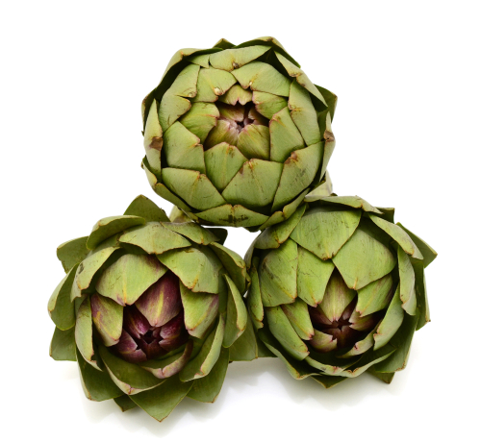
Preparation
Turning – the technique uses a turning knife to shape the vegetable into a barrel shape, an example of this technique is The vegetables should be cut evenly to ensure even cooking.
Using acidulated liquid – some vegetables, such as artichokes and salsify, require preparing and then storing in acidulated water. This prevents the discolouration of the vegetables before the cooking process begins.

Slide 9
Preparation
Vacuum packing – vegetables and flavouring can be vacuum packed, by doing this it compresses the vegetables when into its bag and seals in all the flavours. When it is cooking in the bag, the water molecules inside the vegetable cells are forced to move throughout the vegetable itself, giving it a uniform texture and help to retain its shape.

Slide 10
Any questions?

