Slide 1
Cooking advanced vegetarian main course dishes
PowerPoint presentation
Unit 308: Produce and present advanced main course dishes using standardised recipes

Slide 2
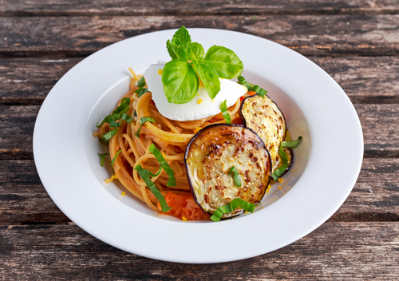
Introduction
It is key that the following procedures are carried out to be able to deliver a quality dish:
Use advance skills to correctly prepare the vegetables and vegetarian dishes.
Apply the correct cooking methods.
Finish dishes according to the dish requirements.
Present and evaluate the dish correctly.
Store the food in the correct manner.
Ensure you apply all health and safety and food safety measures within the kitchen.

Slide 3
Cooking
Baking – similar to roasting. Whole vegetables are used in their skins. Hard vegetable varieties are used, such as parsnips, potatoes and salsify gratin. Baking can be used for stuffed vegetables such as eggplant. Vegetable terrines or custards are baked in moulds. Vegetable gratins may be baked with cream and/or cheese.
Blanching – allows you to partially cook vegetables and cool them quickly so they retain their crunch. This is good for service as vegetables can be blanched and portioned ready to quickly reheat during service, saving time and wastage.

Slide 4
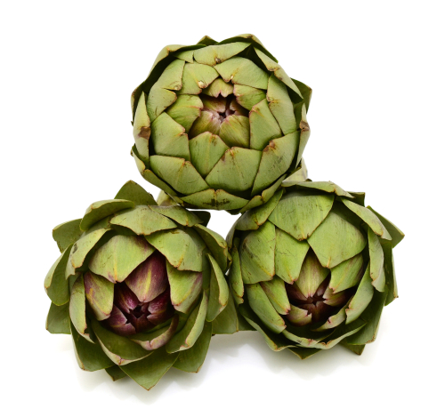
Cooking
Boiling – this is the most common method for cooking vegetables, it is used when cooking vegetables to produce products that are al dente, when making soups and sauces to accompany vegetables. Boiling ids also the most damaging to the vegetables therefore effecting the nutritional values of the end product
Braising – this method employs the use of a liquid, vegetables are usually prepared, fried and then covered in the liquid and braised in an oven. This method can be used on cabbage, onions, leeks and many other vegetables. Red/white braised shallots slowly cooked add flavour and texture.

Slide 5
Cooking
Combination – combination cooking involves both dry- and moist-heat cooking. Braising, stewing and pot-roasting are all combination cooking methods especially with root vegetables, pulses and beans. Dishes might include butter bean and butternut squash ragout with yogurt and hot mint oil; gentle spicing helps to lift the sauce.
Grilling – grilling can include the use of a salamander or employing a BBQ, in both cases there is a restriction on the vegetables that can be used of this high heat short time dry cooking method. These include tomatoes, onions, peppers, asparagus etc. An example is charred grilled cabbage with goat cheese and soused cucumber.

Slide 6
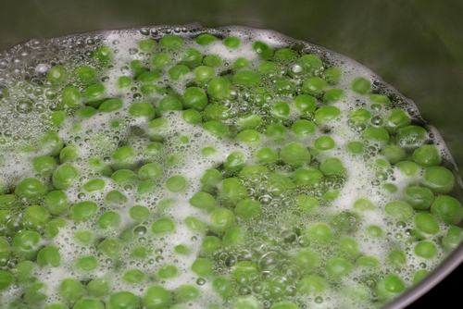
Cooking
Poaching – a delicate way of cooking vegetable by only slightly submerging it in gently simmering water or stock. Using stock allows the vegetable to take on flavours, ideal for carrots, fennel and leeks. Other dishes include shakshouka eggs poached in a sauce of tomatoes, vegetables, spices and herbs.
Simmering – this method is used when using vegetables to make stews and soups, the simmering effect allows the promotion of flavours within a dish.

Slide 7
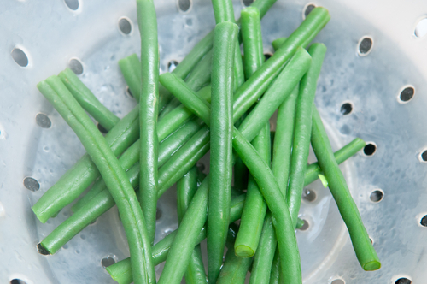
Cooking
Sous vide – during the sous-vide cooking process the water molecules inside the vegetable cells are forced to move throughout the vegetable itself, giving it a uniform texture. The method also ensures that all the flavour is retained, something which can often be an issue when boiling vegetables.
Steaming – steaming is an extremely positive method of cooking, as it is high speed, it supports the retention of the nutrients within the vegetables. Vegetables suitable for steaming include asparagus, samphire, potatoes, salsify amongst others.

Slide 8
Cooking
Stewing – used for tough vegetables such as cabbage, fennel, celery. stewed to soften them, e.g. sauerkraut, ratatouille. Also spicy root and lentil casserole or root vegetable tagine, each bursting with fragrant spices.
Stir-fry – similar to sauté, the stir- frying method of cooking is widely used in Asian cooking and is said to encourage the sealing in of the nutrients as well as the colour of the vegetables. Most vegetables can be stir fried in one form or another, either from fresh or after they have been cooked and refreshed.

Slide 9
Cooking
Shallow frying – mainly used for blanched items such as pre-shaped potatoes and turned vegetables, tossed in butter to provide flavour and gloss.
Deep frying – need to be protected from the cooking medium to keep the moisture inside. Can be blanched in the fat/oil at a lower temperature to pre-cook and prevent oxidisation, then finished at service time in hot fat/oil. Smaller cuts can be cooked and finished directly by deep frying. Can include dishes such as spicy fried cauliflower with a soy and spring onion glaze.

Slide 10
Any questions?

