Slide 1
Finishing advanced vegetarian dishes
PowerPoint presentation
Unit 308: Produce and present advanced main course dishes using standardised recipes

Slide 2
Introduction
A vegan or vegetarian meal can include luscious gourmet dishes to wow the guest. The finishing of a vegetarian main course dish can make the attractive, full of complementary flavours and make it attractive to the guest.
Such dishes to showcase your skills could be vegetarian mushroom risotto with truffle oil, mushroom wellington using puff pastry surrounding a hearty mixture of butternut squash, sweet potato, portobello mushrooms, kale, and faro. Once it is baked until golden brown it can be served with a light tarragon cream sauce. Vegan or vegetarian is not boring in fact it can be an exciting alternative for guest show casing the versatility of non-meat ingredients.

Slide 3
Finishing
Dressing – you can finish a dish just before service with a liquid, usually flavoured dressing or an oil which helps to improve the and complement the flavour and the overall appearance of the dish.
When considering the type of dressing for the dish, use a flavour that complements and combines the flavours of the dishes ingredients.
If the dishes ingredients have strong flavours, use dressings that are robust in flavour. Delicate ingredients require a lighter weight dressing so it does not overpower the dishes ingredients. Dressing could include sweet orange and balsamic dressing.
The weight of the dressing should also be considered. Lighter weight dressing such as a vinaigrette will evenly coat the dishes ingredients. Creamier and heavier dressings provide a deeper and heavier coating.

Slide 4
Finishing
Emulsions – are made from two liquids that do not naturally combine, like oil and vinegar. When an emulsion is created, the two ingredients are blended together to create a unique and luscious final product. Popular dressings like mayonnaise, hollandaise sauce and vinaigrettes are all popular emulsions.
Beurre blanc sauce is a warm butter emulsion that is prepared with a reduction of wine, wine vinegar and shallots. Reduced cream is sometimes added to the reduction as a stabilizer. Diced butter is whisked into the sauce over low heat until it is emulsified into the sauce.
Hollandaise and béarnaise, and their derivatives make up a class of emulsion sauces, prepared by emulsifying melted butter or oil into egg yolks; usually include wine, wine vinegar, or lemon, sometimes as cooked reductions.

Slide 5
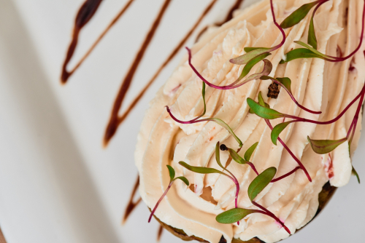
Finishing
Flambéing – is to cover something with alcohol and then set it alight. The only trace of the alcohol that remains is its flavour. Often used with desserts and meat it can be applied to vegetarian dishes for example pan frying a Greek cheese and then finishing off with a brandy, similarly can be used to finish a swiss cheese fondue.
Foams – made by using natural flavours such as fruit or vegetable purees, vegetable stocks, infusions of aromatic herbs, etc are mixed with a neutrally-flavoured gelling or stabilizing agent such as agar-agar, and either whipped with a hand-held immersion blender or extruded through a whipped cream canister equipped with nitrous oxide cartridges. Some famous food-foams are foamed parmesan, foamed mushroom, foamed pumpkin and foamed lemon and parsley.

Slide 6
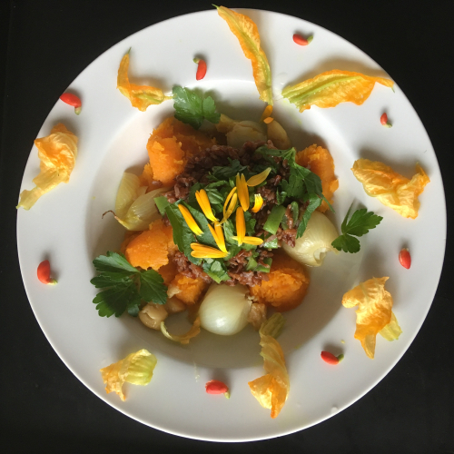
Finishing
Garnishing – a garnish is often best as a simple, colourful ingredient. Use edible garnishes whenever possible. Garnishes are not only for decoration; they can add new flavours and textures to the meal as well. Vary the colour and texture. Pick a colour that contrasts with the colour of the dish, so the garnish is more visible and appealing.

Slide 7
Finishing
Gratinating – this will involve finishing the dish with a covering of breadcrumbs usually combined with a high fat product such as butter, cream, cheese or eggs for the topping, or alternatively covering using a sauce or grated cheese until a crust or crisp surface forms. It provides textures and colour to the finished dish.

Slide 8
Finishing
Saucing – the type of sauce being used will depend on the type of dish being used.
Correct seasoning – very important when cooking and finishing to ensure that dish has been correctly seasoned. Fish due to the nature of their flesh contain minimal natural fats which help to improve flavour so it is important to ensure that dishes are seasoned correctly to bring out the natural flavourings of the dish.

Slide 9
Any questions?

