Slide 1
Preparing hot sauce
PowerPoint presentation
Unit 308: Produce and present advanced main course dishes using standardised recipes

Slide 2
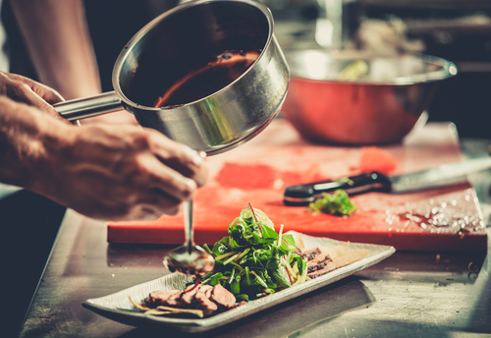
Introduction
The production of quality sauces will be achieved through using the correct procedures and using only quality ingredients.
Production methods will vary according to the sauce that is being made.
The chef will need to chose which technique to employ to meet the dish specification, remembering the effect these techniques have on the end product.

Slide 3
Preparation
Making roux – rouxs are very effective and heat-stable thicken sauce. A roux is made by cooking a mixture of 50% of flour and 50% fat. Then liquid (stock, milk, etc.) is slowly combined to make the sauce
There are generally three colour variations on a roux, white, blond, and brown. A white roux has the aroma of freshly-baked bread and is used in a white sauce. A blond roux has the aroma of freshly popped popcorn, a toasted flavour and is used to thicken sauces that are golden in colour. A brown roux has deep nutty flavour and is used to thicken dark and richly flavoured sauces
When making a roux, use a heavy pan and a wooden/plastic spoon or spatula. Whisking a roux in a pan, especially an aluminium pan will turn the roux grey.

Slide 4
Preparation
Passing – is the preparation process of passing an ingredient through a mesh bottom sieve to remove lumps and any unwanted pieces of the ingredient to make a smooth sauce or stock. The use of a muslin cloth when passing a stock or jus-lie is essential to remove excess sediment, this would be repeated a number of times to ensure a clear finish.
Straining – similar to passing used to remove large any unwanted pieces of the ingredient, for example straining a chicken stock to remove bones and vegetables prior to using in a sauce.

Slide 5
Preparation
Skimming – when using stock bases for sauces, you will need to skim the liquid. This will remove scum, fat or other impurities from the surface of a liquid while it is cooking. A slotted spoon is generally used to remove solid impurities, while an unslotted spoon or ladle would be used to remove liquids such as fat.
Peeling – certain ingredients will need to be peeled before use in stocks and sauces. This may include root vegetables, onions or peel fat of meat bones.
Blending – is the process of mixing or preparing ingredients together usually using a food processor or electric hand blender so that they lose their individual characteristics and become smooth and uniform, for example blending tomatoes together to be used in a tomato-based sauce.

Slide 6
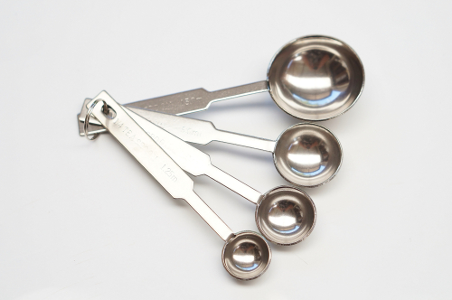
Preparation
Cutting – the majority of ingredients used in sauces such vegetable, meats, poultry will need to cut in some form for the sauce. The different cuts used will depend on the dish being prepared. Precision cuts are used to add colour and structure to sauce such as finely dicing shallots to be used in a emulsion based sauce. These cuts display the chef’s skill and attention to detail.
Weighing/measuring – it is important that ingredients used in sauces are correctly weighed and measured. This is key to ensuring that not too much of any certain ingredient is added and thus the flavour of the ingredient does not overpower another ingredient and the overall flavour of the sauce. Always follow the recipe to ensure accurate and consistent results when making sauces.

Slide 7
Any questions?

