Slide 1
Cooking hot sauces
PowerPoint presentation
Unit 308: Produce and present advanced main course dishes using standardised recipes

Slide 2
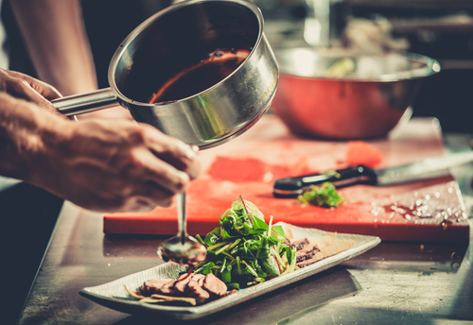
Introduction
The secret to an outstanding dish is often in the sauce, it literally brings a dish together.
Sauces are essentially liquids of various thicknesses that are flavoured or seasoned to enhance the flavour of a dish.
Sauces can be sweet, sour, spicy, or savoury and may be added to the food to become part of a main dish or used as an accompaniment to the food being prepared.
Sauces add a variety of features to foods, such as complementing or enhancing flavours, adding an attractive appearance, and/or providing additional texture.

Slide 3
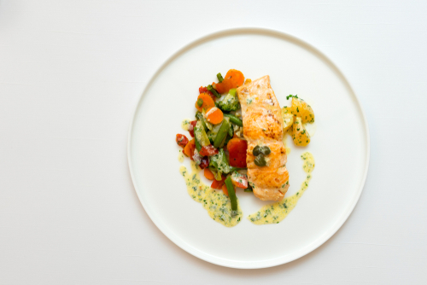
Cooking
Beurre blanc – beurre blanc is a simple butter-based emulsified sauce that's great with fish or seafood. It is a hot emulsified butter sauce made with a reduction of vinegar and/or white wine and shallots. Cream is then added to enrich the sauce. It also aids in the emulsification, causing the wine mixture and butter to combine more easily, which means the sauce will come together quickly. The cold butter is then whisked in off the heat to prevent separation.

Slide 4
Cooking
Cream thickened – cream sauce recipe is similar to a typical white sauce or bechamel but is richer in taste. It is also quite versatile by adding white wine, or sprinkling in some parmesan.
The best way to thicken a cream sauce is reduction. Cooking the sauce while regularly stirring to prevent it from burning.
Another way to thicken a cream sauce is the addition of egg yolk. Bring the cream to a simmer, slowly add some to the egg yolk while whisking to temper the yolk, then add the mixture back to the simmering cream and stir until thickened. This will give you a velvety cream sauce.

Slide 5
Cooking
Emulsified – an emulsified sauce is made by combining two immiscible liquids, or liquids that don’t normally combine, often with a binding or emulsifying ingredient. Warm emulsified egg sauces like hollandaise and béarnaise are similar to cold emulsified egg sauces like mayonnaise except for the use of butter instead of oil.
Hollandaise or a béarnaise sauces are made by creating a sabayon, where egg yolks and flavourings are gently warmed until the egg yolks thicken to a “ribbon-consistency.” Melted whole or clarified butter is slowly whisked into the sabayon to form the sauce. In a hollandaise, the flavourings might be just some lemon juice or a reduction of vinegar flavoured with shallots and peppercorns. Whereas, béarnaise sauce uses a tarragon-flavoured vinegar reduction.
Temperature control is critical when making and holding a warm emulsified sauce.

Slide 6
Cooking
Gravy-based – espagnole and demi-glace are classical French sauces and are one of the mother sauces. Espagnole or simply “brown sauce”, is a rich sauce made with a brown stock, roasted mirepoix with tomato (usually tomato paste) and thickened with a brown roux. Tomato is added mainly to darken the colour of the sauce and not for flavour.
The classic demi-glace is made with equal parts espagnole and a brown stock simmered together and then reduced by half or to a nappé consistency. It is often finished with small amount Madeira or sherry.
Jus-lié is made by thickening a brown stock with corn-starch or arrowroot or by reduction of the stock. A jus-lié depends on the richness of the brown stock where a demi-glace is enriched by the butter in a roux.

Slide 7
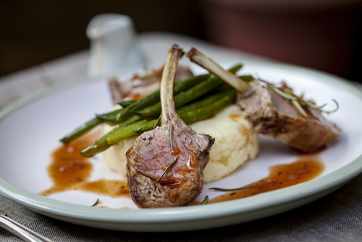
Cooking
Examples of sauces made from espagnole:
Red wine reduction
Robert sauce
Charcutière sauce
Lyonnaise sauce
Chasseur sauce
Bercy sauce
Mushroom sauce
Madeira sauce
Port wine sauce

Slide 8
Cooking
Reductions – a reduction is the result of boiling or cooking down a liquid until it reduces to the consistency of a sauce. As the liquid evaporates, the liquid becomes denser and thickens. The liquid can be just about anything but is usually a wine or a stock that has been used to deglaze a pan where meat, chicken or fish have just been cooked.
Sauces include:
Red wine reduction
Port and orange reduction
Balsamic reduction.

Slide 9
Cooking
Roux-based – rouxs are very effective and heat-stable thicken sauce. Roux is a versatile thickening agent and used in three of the five mother sauces.
Béchamel – is a roux whisked with milk or other dairy to make a white sauce.
Velouté – is a light roux whisked with chicken, turkey, fish or any other clear stock. The resulting sauce takes on the flavor of the stock.
Espagnole – is made of brown beef or veal stock, tomato puree, and browned mirepoix, all thickened with a very dark brown roux.
Beurre Manié is an uncooked roux. It is made by kneading equal amounts of softened butter and flour. The small bit of the paste are then whisked into a hot liquid to achieve desire thickness.

Slide 10
Cooking
Velouté derivatives – velouté is much like a béchamel, made with a little darker blond roux and a white stock of veal, chicken, fish or vegetable instead of milk and finished with cream. The sauce commonly serves as a base for sauces and should be the consistency of cream.
Bercy sauce – made by adding white wine, shallots, and garlic.
Poulette sauce – made by adding freshly sliced mushrooms, parsley, and lemon to a chicken velouté.
Allmande sauce – made from velouté sauce with the addition of mushrooms, peppercorn, lemon juice and thickened with a liaison instead of a roux.
Supreme sauce – made by adding heavy cream to a chicken veloute
Cardinal sauce – made from a fish fumet with fish velouté
Normandy sauce – made by flavouring a fish velouté with chopped mushrooms and then thickening it with a mixture of egg yolks and heavy cream called a liaison.

Slide 11
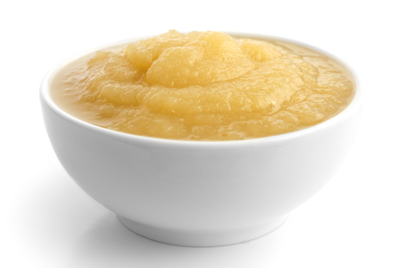
Cooking
Miscellaneous sauces
Tomato sauce – is one of the mother sauce, this sauce resembles the traditional tomato sauce that is used on pasta and pizza, but it's got much more flavour.
Bread sauce – is the perfect accompaniment to a classic roast chicken or turkey
Tomato coulis – is a smooth purée of raw or cooked tomatoes strained of seeds and peel.
Apple sauce – is a tangy, yet sweet flavour sauce and works well with rich roasts such as pork, turkey or goose.

Slide 12
Any questions?

