Slide 1
Finishing hot sauces
PowerPoint presentation
Unit 308: Produce and present advanced main course dishes using standardised recipes

Slide 2
Introduction
Sauces add flavour, texture, moistness, viscosity, and eye appeal to a dish. They help pull together the various elements of a plate and make it whole. Sauces add contrasting or complimentary flavours and colours to a plate thereby keeping the dish interesting and appealing throughout the dining experience.
All finished hot sauces should have the following quality characteristics:
smooth
glossy
a light texture
a definitive flavour.
When finishing any hot sauces only quality ingredients, correcting finishing methods should be used and care should be taken not to over-season.

Slide 3
Finishing
Adjust flavour, temperature and consistency – a sauce should have a consistency that is light yet thick enough to coat the back of a spoon. Chefs use the French term nappé, meaning to top or coat with sauce, to describe the proper consistency.
If the consistency of a sauce is too thin or the flavour too weak, adjust it by gently simmering the sauce to reduce, thicken and concentrate the flavours.
Other alternatives include adding a thickening agent, cream, a swirl of butter, or a liaison of egg yolk and cream. If the sauce is too thick add water, stock, or other liquid to adjust consistency.
Emulsified sauces must be held warm, no warmer than 63˚C and allowed to cool to no more than 30˚C.

Slide 4
Finishing
Adjust consistency
Too thin – if the consistency of a sauce is too thin or too weak it can be adjusted by reducing the sauce on the stove. Other alternatives include adding more thickening agent, cream, a swirl of butter, or a liaison of egg yolk and cream.
Too thick – if it is too thick it can be thinned with a little water, stock or other liquid. Be careful to taste and adjust seasoning. Thinning with water will dilute the flavour so it is normally not recommended except in the case where it may be too intense. Sauces that sit in a hot plate or bain-maire will evaporate over time becoming too thick or salty; in this situation it may be appropriate to adjust with water.

Slide 5
Finishing
Garnishing – a finished sauce might be garnished with a key element of the sauce, for example a lemon sauce may be garnished with blanched julienne of lemon, alternatively a sauce can be similarly garnished with finely chopped herbs.
Liaison – is a mixture of egg yolks and heavy cream that is used to enrich a r sauce at the end of the cooking process; usually one part yolk to three parts double cream. This process enriches and gives the final sauce a silky texture, a liaison also has some thickening power.

Slide 6
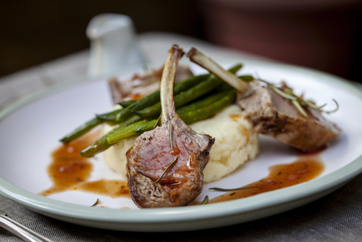
Finishing
Monte au beurre – or “beurre monté” is a French term used to describe the process of adding or whisking in whole, cold butter into a sauce at the end of the cooking process. This process, which is usually done off the heat, adds shine, flavour and richness to the sauce.
Reduction – by reducing the sauce over heat it will intensify the flavour of the sauce, it is important that as you reduce the sauce the liquid will reduce so it important to consider this when considering the portion required. Over reducing a sauce can result in a sauce that has a bitter flavour.

Slide 7
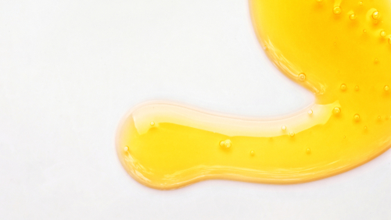
Finishing
Sabayon – emulsion based sauce that it finished under a hot grill for colour and texture; for example a lemon sabayon would go well with grilled asparagus or a champagne and tarragon sabayon served with seared scallops.
Seasoning – a properly seasoned sauce can be can be the difference between delicious and dull. Proper seasoning is a fundamental culinary technique. Sauce are best seasoned prior to serving, seasoning too early in the cooking process can reduce the effect the seasoning has within the sauce.

Slide 8
Any questions?

