Slide 1
Preparing advanced side dishes
PowerPoint presentation
Unit 308: Produce and present advanced main course dishes using standardised recipes

Slide 2
Introduction
A side dish is essentially any food served as an accompaniment to a main course, beyond this basic definition, the exact nature of a side dish can vary widely from country to country, restaurant to restaurant, ranging from simple steamed vegetables to elaborate rice and grain dishes.
Side dishes are a great way to add flavours and textures to the dish. In addition to diversifying the flavours of a meal, side dishes also sometimes perform the function of soaking up sauces and gravies.
Restaurants often offer a choice of side dishes when a main course is ordered, and the available sides usually conform to the restaurant’s prevailing type of cuisine.

Slide 3
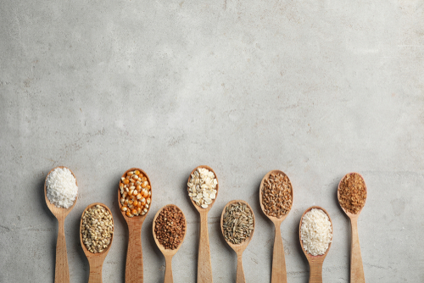
Introduction: Sides
Rice
Wild rice
Risotto
Fried rice
Pilau
Sticky rice
Grains
Quinoa
Buckwheat
Barley
Farinaceous
Orzo
Gnocchi
Noodles
Vegetables
Grilled
Fermented
Pureed
Gratinated
Stuffed
Potatoes
Gratin
Pommes Anna
Fondant
Rosti
Spiced

Slide 4
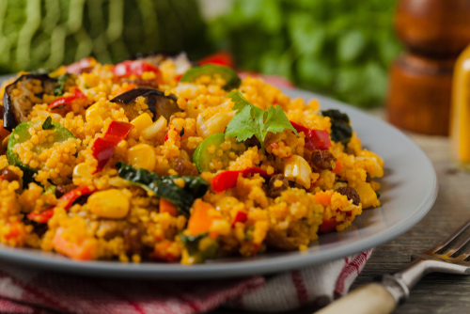
Types of sides
Korean seasoned spinach
Mexican and Spanish-style rice
Spicy pickled cabbage
Glazed carrots with pickled ginger
Roasted garlic and caramelized onion potato galette
Root vegetable gratin
Grilled romaine hearts with hollandaise sauce
Parisian potatoes with crispy pancetta
Pearled barley pilaf with spiced oils
Sweet potato ravioli
Pasta and cheese bake with wild herbs
Moroccan couscous
Mac and cheese with truffle oil

Slide 5
Preparation
Clarifying butter – whole butter is approximately 15% water and milk solids. Clarifying butter removes the water and milk solids leaving only the butterfat. As the butter melts, the solids (butterfat) rise to the top and water sinks to the bottom and you are left with a clear, golden-yellow fat with a higher smoking point than regular butter.
Cutting – the majority of ingredients used in sauces such vegetable will need to cut in some form. The different cuts used will depend on the dish being prepared. Precision cuts are used to add colour and structure to the side dish. These cuts display the chef’s skill and attention to detail.
Deseeding – means to remove all the seeds from it such as tomatoes, chillies or aubergines. Seeds are bitter and can get stuck in the guest’s teeth, so it is sometime good to remove them.

Slide 6
Preparation
Coating – there are many ways to add simple flavours and textures to side dishes especially with vegetables, this can be achieved by coating the vegetables. Any vegetable large enough to coat in batter is suitable for deep frying. For example aubergine, onions, peppers, mushrooms, courgette, cauliflower, carrots, green beans, sweet potatoes or okra. A simple batter consisting of egg and lightly seasoned flour or breadcrumbs won't detract from the natural flavour of the vegetables. Alternatively batters and coatings:
Batter based using yeast or beer
Tempera batter
Coating with seasoned flour
Coating with herb and spice seasoned flour (Southern fried style coating)
Coating in breadcrumbs - dipping vegetables in seasoned flour, then beaten egg and finally in breadcrumbs (this is often known as pane).

Slide 7
Preparation
Grating – many vegetables can be grated to make sides dishes like fritters or rostis such as courgette, carrot, potato and sweet potato
Peeling – certain ingredients will need to be peeled before use in the side dish this may include root vegetables, onions and potatoes.
Weighing/measuring – It is important that ingredients used in side dishes are correctly weighed and measured. This is key to ensuring that not too much of any certain ingredient is added and thus the flavour of the ingredient does not overpower another ingredient and the overall flavour of the dish. Always follow the recipe to ensure accurate and consistent results when making side dishes.

Slide 8
Any questions?

