Slide 1
Cooking advanced side dishes
PowerPoint presentation
Unit 308: Produce and present advanced main course dishes using standardised recipes

Slide 2
Cooking
Blanching – to briefly cook from 30 seconds up to two minutes. This method is used for tomato to loosen the skin for peeling. It is also used for tender leafy greens and spinach.
Boiling – the vegetables, pasta, grains and rices are submerged in a large quantity of rapidly boiling water that is highly salted and then cooked for a proscribed amount of time. They can then drained and plunged into an ice water bath to stop the cooking process or served immediately.
Vegetables, pasta and rices can be cooked to al dente, which means “to the tooth”. This is used to describe ingredients that are tender but still firm to the bite. This term is used to describe the correct degree of doneness for vegetables, pasta, rice and grains and other foods.

Slide 3
Cooking
Braising/stewing – combination cooking methods, braising and stewing, begin by searing or sweating the ingredients in fats and then adding liquids. Braises are simple preparations of leeks or celery, heartier items of braised cabbage or sauerkraut, or complex ones including ratatouille and Moroccan vegetable tagine.
Pilaf, or pilau, is braised rice, or other grains, that begin by sweating aromatic vegetables, including onions, carrots, celery, and garlic, in fat. The rice is added to the fat and parched, or toasted, to develop colour and flavour. The liquid and seasonings are added, and the dish is covered and cooked, either on the stovetop or in an oven.
Baking – main side dishes can be baked to add colour, texture and flavour to the dishes, pastas can be combined with sauce and served as an accompaniment to a main course.

Slide 4
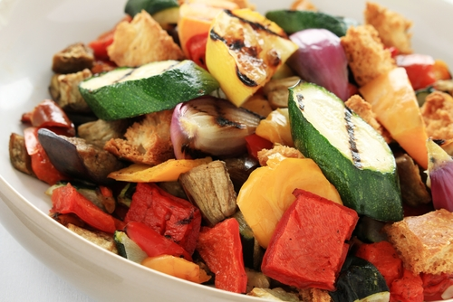
Cooking
Poaching – is a low-heat cooking method, from 82–88˚C, in aromatic liquids including court bouillon, stock, broth, coconut milk, juice, butter or oil. This method is used for root vegetables with stable pigment colours including carrots, parsnips, rutabagas and turnips. Other vegetables including fennel, onions, artichokes and leeks also can be cooked in this style.
Roasting – roasting brings out the natural sweetness in vegetables by concentrating the flavours and caramelizing the natural sugars in them. Almost any vegetable, including artichokes, beans, cauliflower, and winter squash are good for roasting.

Slide 5
Cooking
Shallow and deep frying – frying vegetables produces a crisp texture with a caramelized taste. It uses more fats or oils in the cooking process than sautéing and is divided into two categories; shallow fried and deep fried.
Vegetables cooked using these methods are often coated with breading or are batter dipped to create fritters, tempura. The product may be pre-cooked or par-cooked before being finished by frying.
Proper oil temperature is important to evenly cook the product, and provide a crisp texture and a golden colour. Too much heat will overcook the coating while leaving the vegetables cold or raw. Too little heat and the product will be soggy and oily. For most frying methods, a temperature of 160–180˚C is ideal.

Slide 6
Cooking
Shallow and deep frying – vegetables can be sliced or julienne before breading to produce onion rings or eggplant fries. Croquettes can be prepared with cooked and diced vegetables and other ingredients bound with a sauce which are then shaped and breaded. Or in the case of potatoes and other root vegetables, they can be blanched and fried in various shapes or sliced and fried crisp to create chips.
Batters prepared with yeast, beer or other liquid can also be used for deep frying. Japanese tempura uses a light batter to coat the foods before frying giving the finished product a very pale colour yet light and crisp texture. Vegetables and other ingredients can also be combined with the batter and dropped from a scoop to produce fritters.

Slide 7
Cooking
Simmering – some vegetables, pulse and rice's require a gentler moist heat cooking process. Potatoes, when cooked by moist heat methods, should be simmered and not boiled, because boiling will break down and disintegrate the potatoes leaving some of it behind in the cooking liquids.
Sous vide (water bath) – cooking by the sous vide method is done in a vacuum package with an immersion circulator or hot water bath at 88ºC. The vegetables are trimmed, lightly seasoned, oiled and sealed. The cooking temperature and method are similar to poaching. The advantage of vacuum packaging is that it locks in all the flavours of the vegetables. The process can be used for any type of vegetables.

Slide 8
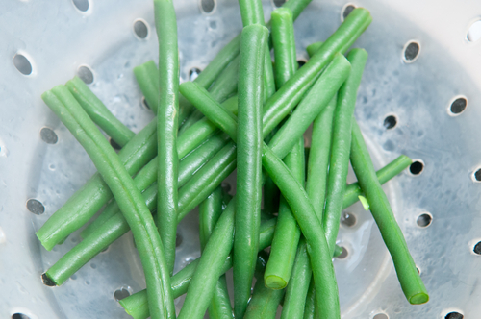
Cooking
Steaming – steaming is a cooking method that employs hot steam to conduct the heat to the food, without disturbing it in a boiling liquid, leaving us with tender, moist dish. Vegetables, pasta, grains and rice’s can all be steamed.
By steaming vegetables, their colour, texture, flavour, and nutritional content are better retained. Steaming also is one of the easiest ways to prepare vegetables and can be cooked in minutes.

Slide 9
Cooking
Grilling – grilling vegetables provides a rustic compliment to menus. A variety of vegetables do well on the grill, but some stand outs include asparagus, corn, aubergine, courgette, mushrooms, peppers, onions, tomatoes.
The vegetables are often sliced, seasoned, and tossed or brushed with oil before grilling. Marinades or vinaigrettes can also be incorporated either before or after cooking.
Stir-fry – when stir-frying, small pieces of food are cooked in a small quantity of oil over high heat for a brief period of time, stirring constantly, favours can be added. This can be applied to cooked rices, grains and pasta and raw vegetables.

Slide 10
Any questions?

