Slide 1
Finish advanced main course dishes
PowerPoint presentation
Unit 308: Produce and present advanced main course dishes using standardised recipes

Slide 2
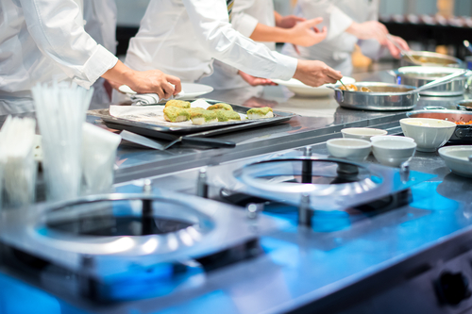
Introduction
Finishing and presentation is the final step that showcases a chefs creations. Side dishes contribute to the overall appearance by providing variety in taste, colour, shapes, and textures. Each element should be there for a reason, adding dimensions of flavour, texture, and colour that is in harmony with the finished side dish.
Side dishes such as pasta, risotto, grains, and legumes, which are delicate items that, once prepared and plated, must be served immediately to retain their fresh appeal.

Slide 3
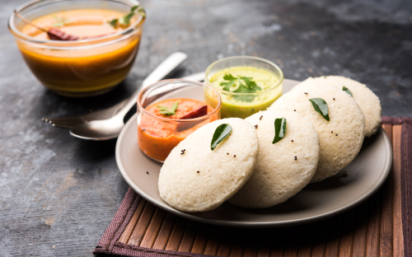
Finishing
Garnishing – garnishes provide colour and a finished touch to the side dish. Choose items that are appropriate to the dish and that echo some of the ingredients. They should be functional, not merely a sprig of rosemary or a wedge of lemon, but incorporated as part of the dish concept.
A finished side dish might be garnished with finely chopped herbs to bring out the colour of the dishes, or crunchy deep fried vegetables such as onions which could add colour, texture and taste to the final side dish.

Slide 4
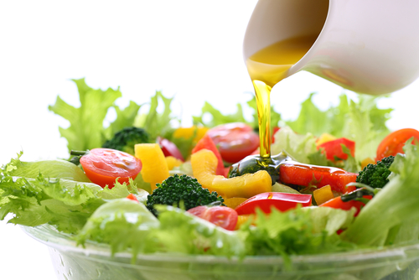
Finishing
Dressing – you can finish a dish just before service with a liquid, usually flavoured dressing or an oil which helps to improve the and complement the flavour and the overall appearance of the dish.
When considering the type of dressing for the dish, use a flavour that complements and combines the flavours of the dish’s ingredients.
Saucing – you may wish to finish a pasta or vegetable side dish with an appropriate sauce, however, should ensure that the ratio of sauce to ingredients are matched.

Slide 5
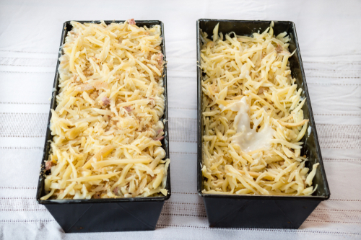
Finishing
Gratinated – this will involve finishing the dish with a covering of breadcrumbs usually combined with a high fat product such as butter, cream, cheese or eggs for the topping, or alternatively covering using a sauce or grated cheese until a crust or crisp surface forms. It provides textures and colour to the finished dish.
Sautéed aromatic vegetables including onions, garlic, or leeks are a good side dish. Place in a buttered casserole and top with bread crumbs and/or hard grating cheese (gruyere, parmesan, and/or romano). Bake in an oven and finish by browning under a grill. Finish with balsamic vinegar.

Slide 6
Any questions?

