Slide 1
Checking Ingredients for advanced main course dishes
PowerPoint presentation
Unit 308: Produce and present advanced main course dishes using standardised recipes

Slide 2
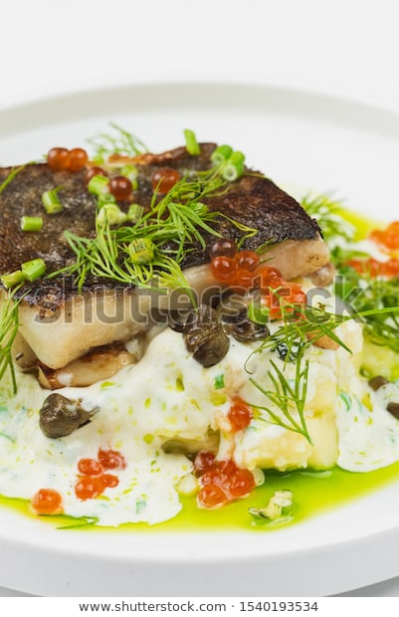
Introduction
In order for any chef to provide a quality menu they must have a good understanding of the quality points associated with their ingredients.
The chef must understand the different ingredients, have a sound knowledge of their suppliers and the supply chain. They must also understand that a good mix of different ingredients types enables a chef to provide a varied and distinctive menu.
Chefs must make the time and effort to get to know their suppliers and endeavour to use their knowledge to ensure they get the best ingredients.

Slide 3
Ingredients
Fresh stock – any fresh stock whether vegetable or veal, brown or white, all stocks share four common indicators of quality:
Body – created when the collagen in the connective tissue of the bones dissolves and converts to gelatine during the cooking process. Vegetable stocks have less body than protein-based stocks.
Flavour – is developed in a brown stock by caramelizing the bones and vegetables before adding them to the water. Deglaze the roasting pan and add the liquor to the stock for additional flavour. All stocks acquire flavour from the mirepoix and bouquet garnii.
Clarity – a clear stock is one free of impurities.
Colour – many ingredients, such as carrots, leeks, tomatoes and mushrooms will darken the colour of a stock. Using too many of these vegetables may cause your stock to be too green or too orange. In a brown stock, colour is achieved by browning the bones and adding tomato paste.

Slide 4
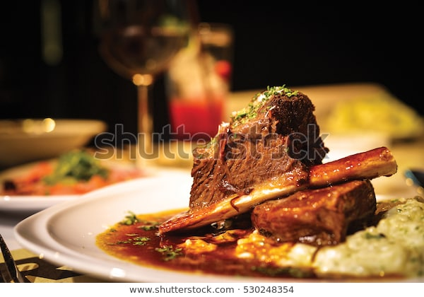
Ingredients
Meat and offal – in order for any chef to provide a quality menu they must have a good understanding of the quality points associated with of meat and offal. The quality points of meat and offal include:
There are many other factors that affect quality, including:
aroma
freshness
type
size
damage
colour
packaging
temperature
texture
fat content
muscle development
period of ageing
rearing
origin
breed
age
feed
slaughtering method
period of ageing
cut

Slide 5
Ingredients
Poultry – poultry is one of the most common meat used in a kitchen. The meat is easily digestible and is a good source of protein, but low in fat. The quality points of poultry include:
Duck
webbed feet that tear easily
plumb breasts with a pliable breastbone
undamaged and unbruised skin
feet and beak is yellow in colour
Turkey
a plump firm breast
a pliable breastbone (wishbone)
skin that is white and unbroken
Chicken
a plump firm breast
a pliable breastbone (wishbone)
skin that is white and unbroken
Goose
webbed feat that easily tear
plump breasts with a pliable breastbone
moist to touch

Slide 6
Ingredients
In order to preserve the quality of the end product the professional chef must first ensure the fish (round/flat/oily) which include fresh, frozen, pre-fillet, smoked or shellfish, purchased is of the correct quality from the start.
Quality points for whole fresh fish:
eyes which are clear and bright, not sunken
bright red gills
scales should not be missing, but firmly attached to the skin
the skin should be moist, even slippery
the skin should be shiny and have bright natural colouring
the tail should be stiff and the flesh firm
the fish should have a fresh sea aroma.

Slide 7
Ingredients
Quality points for frozen fish:
correct temperature of -18℃ or below
packaging should show no signs of damage and be sufficient to keep the fish safe and undamaged
the fish should be wrapped carefully to prevent any freezer burn
Quality points for pre-filleted fish:
firm flesh
neat and trimmed
fillets should be closely packed
white fish should be translucent with no discolouration
fresh sea smell.

Slide 8
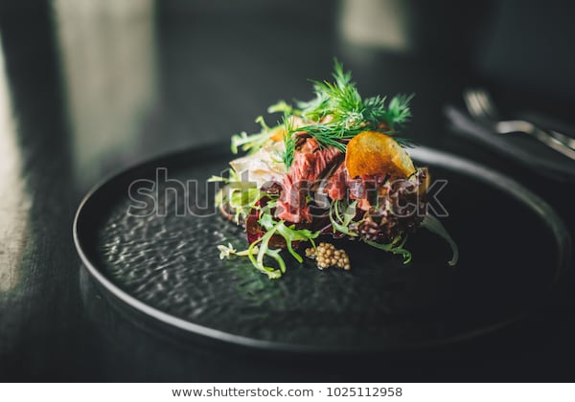
Ingredients
Quality points for smoked fish:
glossy in appearance
firm flesh
smoky aroma.
Quality points for shellfish and crustacean:
shells not cracked or broken
shellfish are tightly closed
lobsters, crabs and prawns should be heavy for their size
all crustaceans should have their claws tied to prevent damage to each other
any crustaceans should have all their limbs
should have a fresh sea aroma.

Slide 9
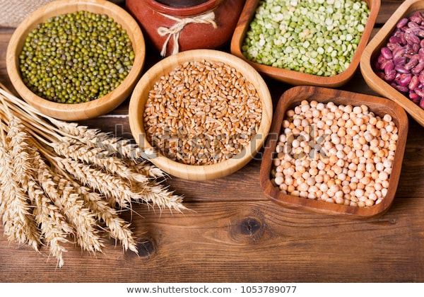
Ingredients
Eggs –
choose eggs with clean, uncracked shells.
don’t buy out-of-date eggs.
look for the grade shield or mark.
graded eggs must meet standards for quality and size.
Grains – grains provide chefs with a particularly good source of fibre and other nutrients for their customers, these should be stored in a cool dry store off the floor. Grains can be used in salads, soups, side dishes and as a main course in a risotto amongst other dishes. Types of grain include:
bulgur
quinoa
barley
wheat
Corn.

Slide 10
Ingredients
Herbs and spices – dried: You should replace whole spices every 4 years, ground spices every 2–3 years, and leafy herbs every 1–3 years is a good guideline to use. But unless you keep very detailed records of when you buy new herbs and spices, it’s a good idea to periodically check your spices for freshness.
Smell – there should be a strong aroma. If not, there’s a good chance that spice needs to be replaced.
Colour – red spices will turn brown as they age and green spices will darken.
Texture – if the spice has caked together in the bottle or on the lid, it most likely is outdated or moisture has been trapped inside the bottle.
Date – dried herbs and spices kept in their original containers, should have a best before date.

Slide 11
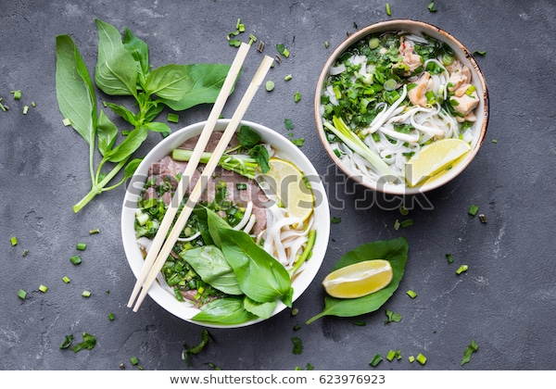
Ingredients
Herbs and spices – fresh: Fresh herbs add a burst of colour and flavour as the finishing touch to many dishes. Fresh herbs generally last about a week once picked.
The quality points of fresh herbs and spices include:
good quality fresh herbs should exhibit colour consistent with variety
hearty aroma
high leaf to stem ratio
leaves that are firmly attached to stems.
Avoid herbs with:
brown, black, or bruised leaves
limp leaves.

Slide 12
Ingredients
Meat substitutes, textured vegetable proteins – there are many different types of vegetable protein and are made from any part of the plant, examples include:
tofu
tempeh
seitan
All the above are derived from soya in one form or another. Another type is textured vegetable protein (TVP) used as a substitute for meat in many dishes.
Nuts – there are many different types of nuts available for a chef to enhance dishes and also create sauces. The addition of nuts to a recipe will add texture and flavour. Nuts should be stored in a sealed container to prolong their shelf-life and to prevent the absorption of odours from other food products.

Slide 13
Ingredients
Pasta – the variety of Italian pasta is enormous and each pasta is used with specific sauces to maximise the flavour of the finished dish as the shapes will absorb more or less sauce. Key groups for pasta are:
decorative pasta
small shaped pasta
stuffed pasta
long extruded pasta
short extruded pasta
ribbon cut pasta
When raw, good quality dry pasta must have the following characteristics:
uniformly smooth appearance and texture
no spots or dark shades must be visible when light shines through it
clear and unmistakable amber yellow colour
must be odourless
must taste slightly sweet
when broken it must make a dry sound.

Slide 14
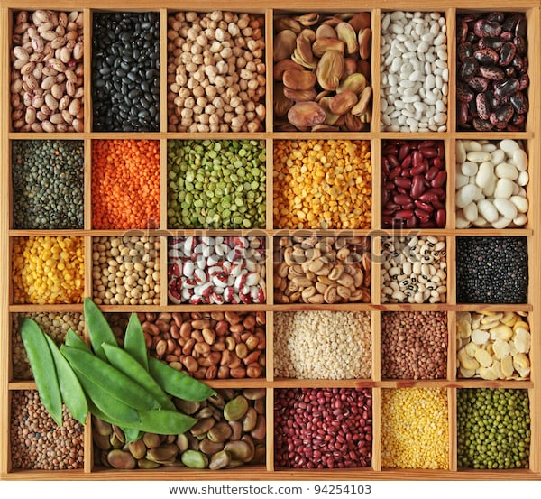
Ingredients
Pulses – pulses generally need to be washed, picked, and soaked before they are used, types of pulse include:
chickpea
soya beans
lentils
black eyed beans
kidney beans
As a rule, you should soak all your pulses before cooking. This reduces cooking time and gives the pulses their best eating texture. You do not have to soak lentils and split peas. Pulses need to be soaked for 10–12 hours.

Slide 15
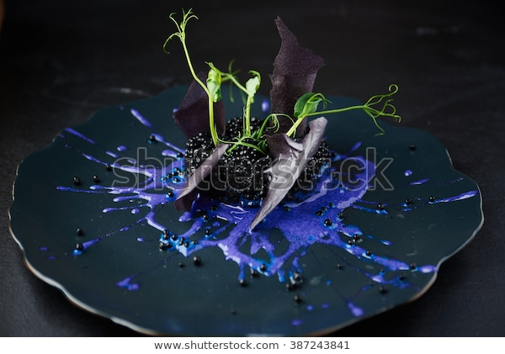
Ingredients
Rice – there are many different types of common rices, these include:
white
brown
basmati
jasmine
paella
Patna.
Rice should be stored in a sealed container in a dry store. Cooked rice must be cooled correctly to avoid the food poisoning bacteria bacillus cereus.

Slide 16
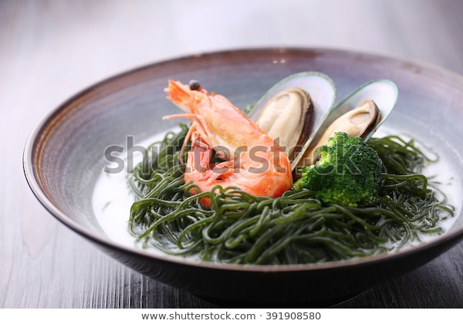
Ingredients
Sea vegetables/weeds – sea vegetables are becoming more popular within the UK, in the Far East they are a staple part of the diet and they are used for stir fry’s and as a vegetable, examples include
kelp
kambu
Irish moss
wakame
arame
duls
nori.
Seeds – there are many different types of seeds which can be used:
sunflower
pumpkin
sesame
poppy
flax.

Slide 17
Ingredients
Vegetables – quality points for vegetables:
Should not contains insect bites, spade marks, excess soil and should not be uneven size.
Green leaf vegetables should be firm and should not contain yellow sign.
Flower vegetables should not contain brawn brushing marks.
Fruit vegetables should have good shape, colours and fine texture.
Stem vegetables should have crisp texture, they should be fresh and should have no sign of insect bites.
Legume like peas, beans should be well and firm without any insect bites.
Fungi vegetables must be dry or fresh and should not contain any sign of stickiness and mould.

Slide 18
Ingredients
Alcohol – alcohol brings out the flavour in food. Whether you’re cooking with wine, beer, or liquor, spirits, the alcohol in those beverages improves flavour perception in at least two important ways; by evaporation and by molecular bonding. Popular alcohols used in cooking:
White wine – especially dry, crisp ones like Sauvignon Blanc, provide acidity, freshness and floras flavours to any dish.
Red wine – when you cook with red wine, there is so much variety and will add a deep earthy flavour to dishes.
Beer – has natural enzymes that help tenderize meat, making it a perfect ingredient in a marinade, beer adds a rich nuttiness to a dish.
Bourbon – is a great alcohol to add to a sauce or allow fruit to soak in. Its honey-like taste with a hint of sweetness and deep molasses undertones.
Whisky brings out the sea in seafood, the smoke in cured meats, and the sweetness in dessert.

Slide 19
Any questions?

