Slide 1
Small equipment used in the production of advanced main course dishes
PowerPoint presentation
Unit 308: Produce and present advanced main course dishes using standardised recipes

Slide 2
Small kitchen equipment task
Lets work together and see if we can list the different small kitchen equipment commonly used in the production, cooking and finishing of main course dishes:
Small Kitchen Equipment

Slide 3
Introduction
Small tools and equipment play a variety of different roles in the preparation, cooking and finishing of advanced main course. The size and nature of the hospitality establishment will depend on the equipment being used.
It is important to choose tools and small equipment that are of good quality and best fits your needs, you need the knowledge of the safe use of the tools and equipment. It is also beneficial to be familiar with the varieties of models that are available, how to maintain your tools and equipment.
It is important that when using tools and small equipment that you and your colleagues are fully trained on the piece of equipment and you fully understand how to use them in a safe manner.

Slide 4
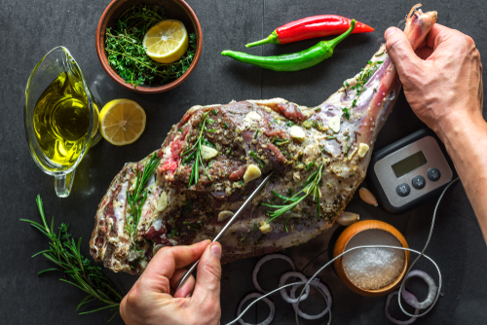
Monitor the safe use of small equipment
Temperature probe – used for checking the internal temperature of meat or other foods products to ensure that the appropriate and safe temperature has been achieved. When checking the temperature of the food, insert the thermometer probe into the thickest part of the meat and as close to the centre as possible.
Fish kettle – a long thin deep pan designed for cooking whole fish such as salmon or trout. Fish kettles have a handle at either end and a tightly-fitting lid. Inside the kettle there is a rack to lay the fish on, which also has handles, to make it easy to remove the cooked fish in one piece.

Slide 5
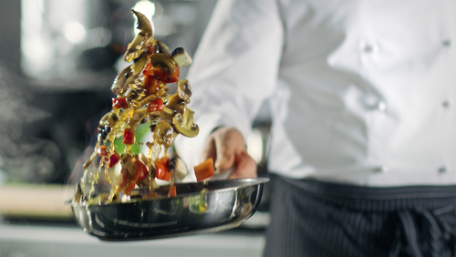
Monitor the safe use of small equipment
Food processor – are used to chop, grate, mince, slice, puree, and blend a variety of food ingredients. Food processors have different blades that perform the various functions. A food processor can usually perform any of these tasks in minimal time, which makes it an indispensable tool for a chef in a busy kitchen.
Frying pans – a flat-bottomed pan with shallow sides that are slightly curved. They are made of various materials, such as copper, cast-iron and aluminium, and some have a non-stick coating applied. There are several sizes available and they are generally round in shape. Also known as a "skillet."

Slide 6
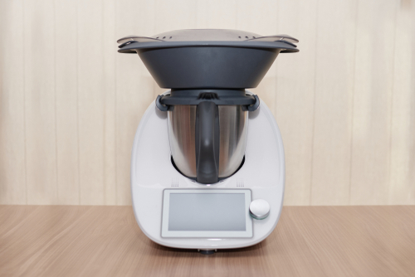
Monitor the safe use of small equipment
Mandolin/food slicer – is used for cutting and slicing fruits and vegetables. This mandolin has a variety of adjustable blades that enable the mandolin to make precise cuts of differing thickness. When using a mandolin the foods being sliced are held in place with the specially designed mandolin holder or grip.
Thermomix – the thermomix has a heating element, a motor for fast or slow blending and stirring, and a weighing scale. The functions can be accessed simultaneously to carry out steaming, emulsifying, blending, precise heating, mixing, milling, whipping, kneading, chopping, weighing, grinding and stirring.

Slide 7
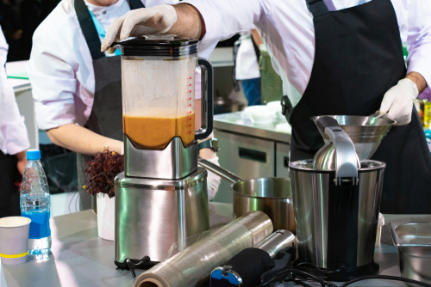
Monitor the safe use of small equipment
Blender – a blender is used basically to emulsify, liquify or puree. Blenders typically consists of a tall glass or plastic food container with a removable lid made with a filler hole for adding ingredients during the process. At the base of the food container there are motor driven blades that blend, chop, mix, or liquefy foods depending on the speed setting selected.
Can opener – a can opener is used to open or remove the top from a metal can. There are a wide variety of different designs available ranging from manually operated small tools to automated openers that quickly and easily remove the top of the can.

Slide 8
Monitor the safe use of small equipment
Chopping boards – come in a wide variety of thicknesses, colour’s, shapes and sizes to fit a variety of different preparation and storage needs. In modern day professional kitchens it is good practice to have colour coded chopping boards to reduce the risk of cross contamination.
Grater – an all-purpose grater or box grater generally has several grating sides that form a triangle or square with each side containing a different grating pattern. With different panels, the specific grating procedure can be easily selected as the food is moved across the flat grating surface.
Ladle – a large spoon with a deep semi-circular bowl usually approximately 8cm in diameter, and a long handle. Plastic and metal ladles are most readily available and are used to serve soups, stews and any type of liquid.

Slide 9
Monitor the safe use of small equipment
Saucepans – an essential cooking utensil that is round in shape with high, straight sides and a longer handle. Equipped with a tight fitting cover, the saucepan can range in sizes to hold contents. They are made of materials such as stainless steel, copper, anodized aluminium, glass, and enamelled steel or cast iron.
Scales – scales are used to measure the weight of ingredients and other food commodities. Kitchen scales are available in electronic balance or spring models. A electronic balance scale will give a more accurate reading than a spring scale.
Sieve – used to strain liquids or to sift dry ingredients, such as flour or powdered sugar. Also referred to as a strainer, a sieve has perforated holes or mesh and is available in many different shapes and sizes. Several similar kitchen tools that may be used as a sieve are a chinois or a colander.

Slide 10
Monitor the safe use of small equipment
Spatula – a small tool having a broad, flat, flexible blade that is used to mix, spread, or lifting material, commonly used when mixing ingredients. A slotted spatula allows air to get under food, so it slides off spatula easily.
Spoons – made from materials including wood, metal and plastic. Most spoons will feature a hole in the handle, so the utensil can also be conveniently stored and quickly accessed during busy periods of service. Spoonulas are also available which are made from a soft plastic and are non-abrasive.
Strainers – used to remove lumps from sauces.

Slide 11
Monitor the safe use of small equipment
Spider – a spider is a type of skimmer prevalent in East Asian cuisine in the form of a wide shallow wire-mesh basket with a long handle, used for removing hot food from a liquid or skimming foam off when making broths. The name is derived from the wire pattern, which looks like a spider's web.
Trays – are commonly found in every professional kitchen and are used for a variety of cooking tasks. Cake pans can be round, square, or rectangular and are available in several sizes. Aluminium is a good material for trays because it is a good conductor of heat, which results in even cooking.
Whisk – there are a variety of different types, shapes and sizes of whisks available depending on the requirements for their use. Some of the most common whisks include: Ball, round balloon, oval balloon, coil, flat end.

Slide 12
Any questions?

