Slide 1
Prepare meat, offal and poultry for advanced main dishes
PowerPoint presentation
Unit 308: Produce and present advanced main course dishes using standardised recipes

Slide 2
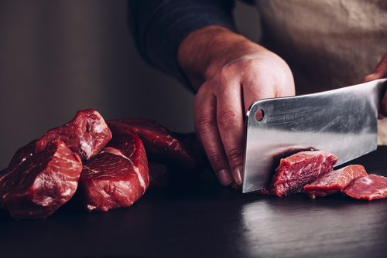
Introduction
Chefs can improve the quality of meat through using several different preparation techniques. These techniques are employed in order to tenderise and develop the flavour of the meat, they include.
The chef will need to chose which technique to employ to meet the dish specification, remembering the effect these techniques have on the end product.

Slide 3
Preparation methods
Larding – this is a process where fat is added to the learner cuts of meat artificially. Pork fat is generally used and strips are threaded through the meat using a larding needle, this in essence produces the marbling of the meat. Larding provides the meat by enhancing the moisture and adding flavour. This technique is especially useful for preparing game, such as venison, which is much learner than other meats.

Slide 4
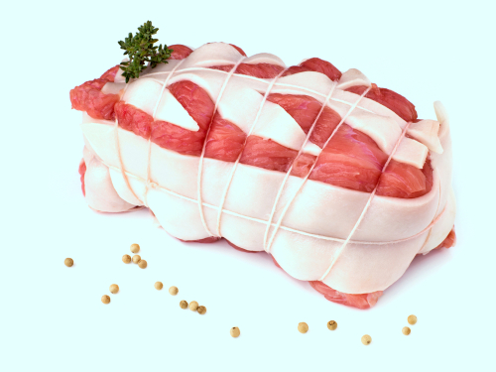
Preparation methods
Barding – another method employed by a chef to introduce fat to meat is barding. Barding is achieved using either bacon or fatback, pork fat, which is sliced and normally layered on the joint. Additionally, larding can be used to introduce the fat to specific areas within a meat joint. This technique bastes the meat whilst roasting and adds flavour to the finished product.
Chining – commonly known as a French Trim. Chining refers to the process of cleaning the bones of sinew and muscle. This technique gives your meat a clean, professional and well-presented appearance, It is often trimmed off to allow easier carving at the table.

Slide 5
Preparation methods
Filleting – or often known as seaming. Filleting is to remove whole muscle from bones or from other muscle.
Infusing – meat is not like a sponge which can soak up sauce, it's a dense muscle so requires the meat to be pierced and then infused with flavour. There are two main components to infusions, the liquid or food to be infused, and the flavouring agent. The two components are combined together and the flavours from the two meld into each other, leaving an infused liquid or food behind.

Slide 6
Preparation methods
Marinating – marinating meat in an acidic solution such as mixture of oil with vinegar or lemon juice will create the inhospitable environment in which bacteria do not reproduce. Marinating has the additional advantage of imparting flavours and tenderising the meat. This technique uses liquids, and other ingredients, to soak the meat before the cooking process. It is this solution that will help to breakdown the fibres within the meat thereby tenderising it.
Mincing – mincing is a technique that is used to process meat and offal before cooking. The meat offal is finely chopped using a mechanical mincer and additional ingredients can be added, these include: Herbs, spices, breadcrumbs and eggs (for shaping), and oils.
The selection of additional ingredients will depend on the requirements of the final dish, these include shaped patties, such as steak tartar and burgers made with offal.

Slide 7
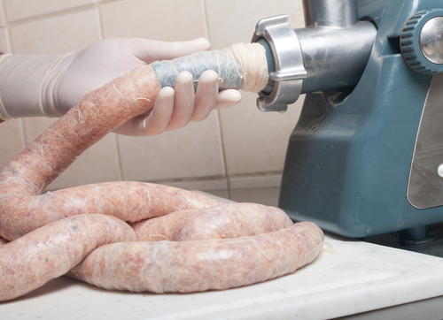
Preparation methods
Preparing forcemeats – Forcemeats are a blend of meat with different ingredients such as herbs, spices, creams, fats, etc. Forcemeats are made for a number of different dish requirements such as sausages, but also:
mousselines
terrines
pate.
Purging – this can be common in offal as a way of removing impurities, for example soaking liver in milk, will help to remove impurities.

Slide 8
Preparation methods
Removing sinew – sinew is the connecting tissue that attaches muscles to the bones. In meat when you are preparing it for cooking, it is good to remove what you can since it stays tougher than the rest of the meat and can be stringy and chewy.
Sous vide (water bath) – this technique requires the chef to place the meat in a plastic bag, sealing the bag and then placing it in a water bath. The length of time and temperature of the bath will depend on the cut, quality and thickness of the meat. This method of cooking can allow the chef to produce consistent dishes, basted in their own juices which is low risk of overcooking.

Slide 9
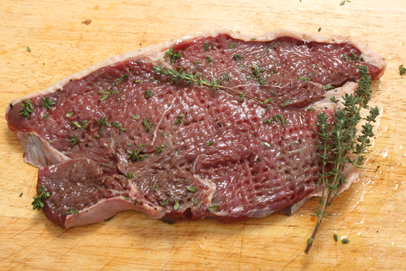
Preparation methods
Tenderising – tenderising is achieved in many different ways, from the aging process to the use of a tenderising hammer.
Trussing – to tie meat with string, which may be woven through the meat by using a needle threaded with the string, in order to create a more compact shape to the food being prepared. Trussing utensils may also include skewers or pins that are used instead of string to hold the meat together.

Slide 10
Preparation methods
Tying – a thick string used for tying and trussing meat. It is also used to tie other foods. It is used on roasts, medallions, and tenderloins to help hold their shape and provide for more even cooking. When barding, the twine is used to tie bacon or fat around the cut of meat.
Vac packing – bacteria require oxygen in order to reproduce, the technique of vacuum packing meat removes this and therefore preserves the meat longer. Other methods such as introducing an acid into the environment will also help the prevention of Clostridium botulinum multiplying.

Slide 11
Any questions?

