Slide 1
Cook meat, offal and poultry for advanced main dishes
PowerPoint presentation
Unit 308: Produce and present advanced main course dishes using standardised recipes

Slide 2
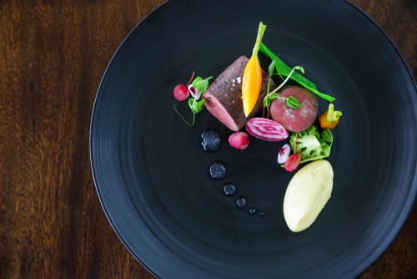
Introduction
The production of different dishes, the techniques used for their preparation, their cooking and the accompaniments required to enhance them require the chef to be able to use numerous advanced techniques for the cooking of:
beef
lamb
pork
offal – including sweetbreads, tongue, liver, kidney, heart and bone marrow
Chicken.

Slide 3
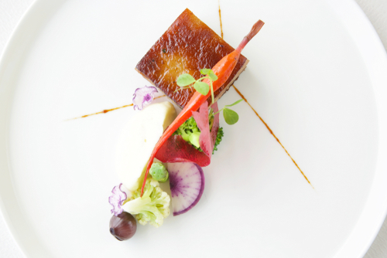
Cooking
Different methods of cookery for meat, offal and poultry dishes include:
boiling
poaching
steaming
simmering
baking
roasting
grilling
sous vide
stewing
shallow frying
deep frying.

Slide 4
Cooking beef
There are 14 primary joints on a side of beef and 10 on a forequarter. Some of these joints are relatively tender, mainly those that are least developed, whilst others are that are used a lot are tougher with more sinew. There are a range of dishes that can be made with beef to provide customers with an excellent choice on the menu, these include:
Tournedos rossini – a fillet steak served on a brioche bed, with liver pate and a rich red wine reduction.
Chateaubriand béarnaise – the thick part of the fillet which is sealed, roasted in the oven then served with a béarnaise sauce.
Braised oxtail – the oxtail is sealed on the stove then brown stock, onions, carrots seasoning and herbs are added. The dish is then braised in the oven and traditionally served with mashed potatoes.

Slide 5
Cooking beef
Beef bourguignonne – the meat from the shin is used in this dish and is marinated in a red wine overnight. The meat is then browned and vegetables are added. The cooking process takes approximately 3 ½ hours. The residue on the surface, of fat and impurities, can be removed using a spoon. Alternatively the dish can be cooled for the fat to set, removed and then gently reheated.
Roast prime rib – the most important point to remember when cooking a prime rib roast is to ensure that the meat is not overcooked. An expensive cut of beef, such as a prime rib roast, is most often best in flavour and tenderness when it reaches a doneness level of no greater than medium-rare.
Beef wellington – using a prime cut of fillet of beef. The classic recipe either has mushrooms or pâté around the beef with a thin layer of pancakes to hold it all together and then wrapped in puff pastry.

Slide 6
Cooking pork
The meat of a pig, which is slaughtered before they are 12 months old, should be pale pink in colour and the fat is white and firm to touch. Pork meat can be eaten at all meals, from sausages at breakfast to roast leg of pork at dinner. Other recipes for this versatile meat include:
Slow cooked pork cheek – this cut of the pig is delicate and flavoursome, it can be served as a dish in itself or as an accompaniment. A typical recipe for cheek is slow cooked or poached then fired and served with an apple compote.
Pigs trotters croquettes – this recipe requires trotters to be cooked in a water bath for 16 hours along with lemongrass, stock and garlic. The trotters are then skinned and the meat cut, along with a finely diced vegetables. Some of the stock is added back to the mix and it is cooled. The mix is cut and then floured, egg and bread crumbed, deep fired, served with a rich sauce.

Slide 7
Cooking lamb
Lamb is recognised as being a sheep up to one years old, older than this then they are known as mutton. The meat on the lamb is lighter in colour and more tender to cook and eat. There are 7 joints on a sheep.
Roasted best end – rack of lamb – this cut is taken from the back of the lamb and should be roasted in the oven, a crumb of parsley, garlic and breadcrumbs should be added 10 minutes from the end of the cooking process, as a coating. This dish should be served pink and can be accompanied with a mint or butter sauce.
Slow cooked saddle of lamb – for best results this cut should be marinated overnight and cooked in a warm oven for no longer than 50 minutes. Served with a reduction jus and potatoes.

Slide 8
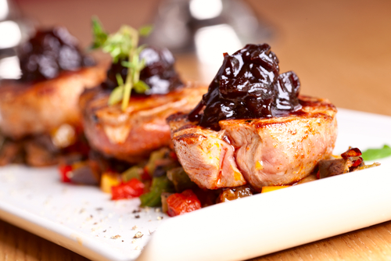
Cooking lamb
Noisette of lamb – the noisette are cut from the saddle of the lamb using only the eye of the loin. This meat is tender so only requires to be pan fried or grilled for a short time. This cut can be served with a mint and lime marinade or a jus with the addition of rosemary and lemon, even a pesto can be served with this delicate meat.
Slow cooked lamb shanks – this meaty cut from the lower end of the leg is full of flavour and will become meltingly tender. Always braised - usually in a luxuriously rich sauce of some form dish such as a heady red wine and rosemary, the lamb shanks are meltingly soft when cooked for a long time and full of intense flavour.

Slide 9
Cooking Offal
Offal is any internal organs or entrails of an animal, these cuts of animals are considered to good sources of nutrients and are generally delicate to cook; some examples include:
sweetbreads
tongue
liver
kidney
heart
bone marrow.

Slide 10
Cooking Offal
Sweetbreads – comes from the thymus or pancreas glands, in cooking it is often the taken from a calf or lamb. These are delicate in their flavour and are best cooked by braising or grilling. The sweetbreads should be served with a suitable sauce such as a reduction, a béarnaise or a mornay sauce.
Bone marrow – in some parts of the world the bone marrow is recognised as a delicacy and eaten from the bone. It is also used as an accompaniment to other dishes such as tornedos. The marrow is blanched, removed from the bone, chopped, seasoned and herbs added. It can then be formed, cut or the bone reused and stuffed with the mixture.

Slide 11
Cooking Offal
Tongue – the tongue should be cooked in water for approximately 3 hours, this is then cooled, the skin removed and sliced thinly. It can then be served with several different sauces from a horseradish sauce to a sauce Gribiche. Tongue can also be cooked and pressed to use as a starter.
Liver – there are many various recipes for liver from braised to Chinese style stir fried. In each case the chef must ensure that the liver is not overcooked as it becomes rubbery and looses flavour.

Slide 12
Cooking Offal
Kidney – can be served at breakfast as a sautéed choice served with a sauce, or as a main course where it can be grilled with the addition of garlic butter. Ox kidney are large and are generally braised or used in puddings. Lamb and calf kidneys are usually grilled or fried as they are more tender.
Heart – depending on the animal some hearts, such as calves and lambs may be stuffed, sealed and braised. The ox’s heart, however, is large enough to slice and grill or fry. Heart can also be used in stews, it is also occasionally minced with other offal to make faggots, such as liver.

Slide 13
Cooking poultry
During the preparation and cooking of poultry and game dishes it is essential that correct food safety and correct techniques are used.
The dish specification must be adhered to ensure consistency and quality.
The correct equipment must be used to ensure safety of the chef and the customer.
Finishing techniques and accompaniments should enhance the presentation of the dish.
Evaluation of the dish must take place before delivery to the customer.

Slide 14
Poultry dishes
Some common poultry dishes served in restaurants around the world:
fricassée of chicken
chicken curry
chicken Kiev
confit of duck
braised chicken with apricots and African spices
turkey with cranberry cream sauce
wild duck in kumquat sauce
chicken schnitzel
turkey cordon bleu
roast turkey with cranberry and chestnut stuffing
tikka murg (Indian chicken rissoles)
grilled spatchcock
roast duck with spices and orange sauce.

Slide 15
Cooking poultry
Coq au vin – coq au vin means chicken in wine). It uses the bone-in, skin-on chicken. Like all braised dishes, tougher cuts with lots of connective tissue work best, and on a chicken that would be the thigh/leg section. The bacon and the wine make a rich red wine sauce as the flavours develop during the cooking process.
Duck a l'orange – or canard à l'orange is a French dish in cuisine bourgeoise consisting of a roast duck with a bigarade sauce. Use fat ducks, either wild or domesticated.
Pheasant breasts braised in cider – the lean, gamey meat of a brace of pheasants (a male and female bird) makes for a tasty autumnal treat when cooked with caramelised onions, bacon and cider and buttered root vegetable mash.

Slide 16
Cooking poultry
Pate – the livers of a chicken are cooked with added flavours such as garlic, brandy and cream. The mixture is then blended and seasoned. The mixture should then be potted and sealed with melted butter until required. The butter can be garnished with herbs and other ingredients such as peppercorns.
Terrine – a chicken and pistachio nuts terrine is made from chicken, pistachio , double cream and egg whites. The ingredients are made into a farce and then cooked in a bain marie. The mixture is then cooled overnight and can be served as a starter with salad
Chicken chasseur – the French for pan frying is sauté, one of the classical dishes for this technique of cooking is sauté poulet chasseur. The chicken is cut for sauté, 8 pieces, then browned and cooked on the stove with the addition of shallots, button mushrooms, jus and white wine. The dish is finished with tomato concasse and tarragon.

Slide 17
Any questions?

