Slide 1
Finishing advanced meat, poultry and offal dishes
PowerPoint presentation
Unit 308: Produce and present advanced main course dishes using standardised recipes

Slide 2
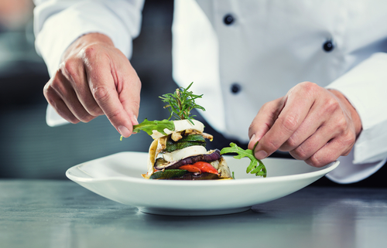
Introduction
Food presentation is very important for how guests experience our plates of food so finishing the dishes can make or break the guests experience.
It is very important to ensure that advanced fish, shellfish and crustacean dishes are finished correctly and inline with the organisations requirements. Garnishing, sauces and dressing are used to enhance the dish for the guest, they provide:
texture
moisture
flavourings
Colour.

Slide 3
Finishing
Correct temperature – the best procedure for checking doneness is to use a cooking thermometer, checking to make sure the fish has reached an internal temperature of 63ºC. It is important to remember that after a cut of beef is removed from the heat source, the internal temperature will continue to rise.
Resting – there are benefits from a "resting" period before serving. The resting period, which may range between 10–30 minutes, depending on the cut of meat, it allows the juices to redistribute, the muscle in the meat to relax and allows the internal temperature to rise because of residual heat.

Slide 4
Finishing
Serving and portioning – it is important to ensure that the correct portions are served to the guest, ensuring that it is not too small or not too large. The portion should represent the dish and any accompaniments being served.
Garnishing – a garnish is often best as a simple, colourful ingredient. Use edible garnishes whenever possible. Garnishes are not only for decoration; they can add new flavours and textures to the meal as well. Vary the colour and texture. Pick a colour that contrasts with the colour of the dish, so the garnish is more visible and appealing.

Slide 5
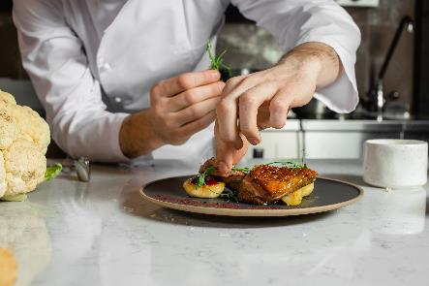
Finishing
Plating – plating isn't just an aesthetic choice. It controls the way we interact with our food, from first glimpse to final fork. It is always worth plating up a test plate before your guests arrive to figure out the best layout of the elements on the plate and whether the colours work.
Tips for plating:
create height on the plate
cut meat horizontally
play with textures
use contrasting colours
match presentation to the restaurant theme
choose the right plates
serve smaller portion sizes
use edible garnishes and decorations
when in doubt, keep it simple.

Slide 6
Finishing
Monté au beurre – monté au beurre or “beurre monté” means "to mount with butter“. It is a French term used to describe the process of adding or whisking in whole, cold butter into a sauce at the end of the cooking process. The meeting of cold with hot and the whisking makes an emulsion and changes the whole appearance of sauce. This process, which is usually done off the heat, adds shine, flavour and richness.
Foams – made by using natural flavours such as meat juices, infusions of aromatic herbs, etc are mixed with a neutrally-flavoured gelling or stabilizing agent such as agar-agar or lecithin, and either whipped with a hand-held immersion blender or extruded through a whipped cream canister equipped with nitrous oxide cartridges. Some famous food-foams are foamed espresso, foamed mushroom, foamed beetroot and foamed curried coconut.

Slide 7
Finishing
Saucing/dressing – the sauce or accompaniments used in the dish, are as key to final dish as the beef or pork.
Beef and pork – suitable sauces or accompaniment:
Mushroom sauce is made with sautéed mushrooms, shallots and just a splash of sherry.
Red wine reduction sauce is made by reducing red wine and chopped shallots with a basic demi-glace.
Robert sauce is made with onions, mustard, and white wine.
Lyonnaise sauce is a demi-glace based sauce made with onions and white wine vinegar.
Chasseur sauce is made with sautéed mushrooms and shallots and a white wine reduction.
Béarnaise sauce is a rich, buttery, aromatic sauce featuring shallots, tarragon, ​and crushed black peppercorns.
.

Slide 8
Finishing
Saucing/dressing – The sauce or accompaniments used in the dish, are as key to final dish as the poultry.
Poultry – suitable sauces or accompaniment:
Suprême sauce is a finished sauce made by enriching a chicken velouté sauce with heavy cream.
Hungarian sauce is made by reducing white wine with sautéed onions and paprika and then adding chicken velouté.
Creamy mushroom sauce is made by adding sautéed mushrooms to a basic suprême sauce or allemande sauce.
Allemande sauce is a made by thickening a chicken velouté with a mixture of egg yolks and heavy cream called a liaison.
Poulette sauce is made by adding sautéed mushrooms, chopped parsley and lemon juice to a basic allemande sauce.​​​​

Slide 9
Finishing
Saucing/dressing – the sauce or accompaniments used in the dish, are as key to final dish as the lamb and offal.
Lamb – Suitable sauces or accompaniment:
Traditional redcurrant jus sauce is made with shallots, reducing port, redcurrants and lamb stock.
Red wine reduction sauce is made by reducing red wine and chopped shallots with a basic demi-glace.
Mint sauce is made from vinegar and mint.
Offal – suitable sauces or accompaniment:
orange chutney
cranberry chutney
red onion marmalade
tomato based sauce.

Slide 10
Any questions?

