Slide 1
Prepare fish, shellfish and crustacean advanced main course
PowerPoint presentation
Unit 308: Produce and present advanced main course dishes using standardised recipes

Slide 2
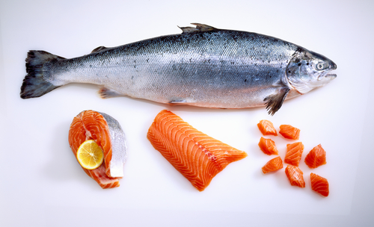
Introduction
Seafood preparation requires a high skill level to avoid excessive waste. Whilst more and more pre-cut product are used the chef must know the basic preparation steps and portion cuts.
Seafood is very susceptible to contamination through poor handling during preparation so you need to establish standard operating procedures (SOPs) and systems to prevent any food poisoning.

Slide 3
Seafood Preparation
Seafood can be purchased live, fresh whole, fresh gutted, as fillets and frozen.
They can be purchased individually or in bulk. Portion controlled cuts and prepared items such as marinated skewers, pre-cleaned mussels, shucked oysters and sliced smoked salmon are also available.
Fish is often delivered gutted to extend its lifespan and ice is placed on top to keep it at a temperature of 0-2ºC to maximise storage life.
Use designated cutting boards (correct colour e.g. blue) to prevent cross-contamination.
Process only small amounts at a time and put it straight back into the fridge or cold room.

Slide 4
Seafood Preparation
Fresh fish
Fresh fish can spoil fairly easily and this is exacerbated by poor handling practices such as unwashed hands or equipment, leading to cross-contamination.
Fresh whole fish is best stored on ice until ready for filleting.
Afterwards, the contact with water and ice should be minimised to prevent gaping and loss of flavour.
Keep covered at 0-2ºC.
Fresh shellfish
To prepare shellfish wash, clean and remove shell, barnacles or byssus thread on mussels, clean cephalopod and remove beak, intestines and skin. Place on ice.
Only process a small amount of seafood at a time and do not leave seafood at room temperature for extended time periods.
Seafood can be processed further into farces, stuffed or filled, wrapped or coated e.g. crumbs.

Slide 5
Preparation
Blending/mincing – is used to make fishcakes or other dishes such as fish mousselines, often using cheaper cuts of fish. This can be done using a knife or through a blender/food processor.
Boning – or often referred to as pin boning. Is where a fillet of fish that has had the fine pin bones removed. Pin bones are the fine, tiny bones found in the centre of a fish fillet; if you slide your finger from head to tail down the flesh-side of a fillet you can feel the ends of the bones. The best way to remove the bones is to grip the end of each bone with a pair of tweezers and draw it out of the fillet.

Slide 6
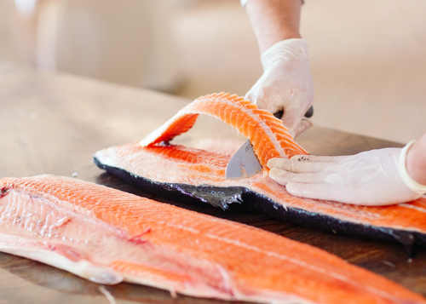
Preparation
Butterflying – both large and small fillets of fish, whole fish and some shellfish and crustacean can be butterflied for more even and quick cooking. When butterflying whole fish it removes most, but not all of the bones in a fish, and it creates a larger cavity for stuffing, and stuffing is the primary reason to butterfly a fish. Butterflying, is also known as splitting or kiting a fish.

Slide 7
Preparation
Coating is a process in which foods are pulled through dry ingredients, such as flour, in order to coat the food before cooking. Flour can be used alone as a coating, but it is more often combined with other dry ingredients such as herbs, spices, salt, or breadcrumbs to create a seasoned coating on the food that becomes brown and crispy after it is cooked.
There are several reasons for dredging: the coating applied to the food acts as a barrier that keeps the food from sticking to the pan as it cooks; it enables the exterior of the food to become crisp and darken evenly without burning; and it prevents the texture of the food from becoming tough.

Slide 8
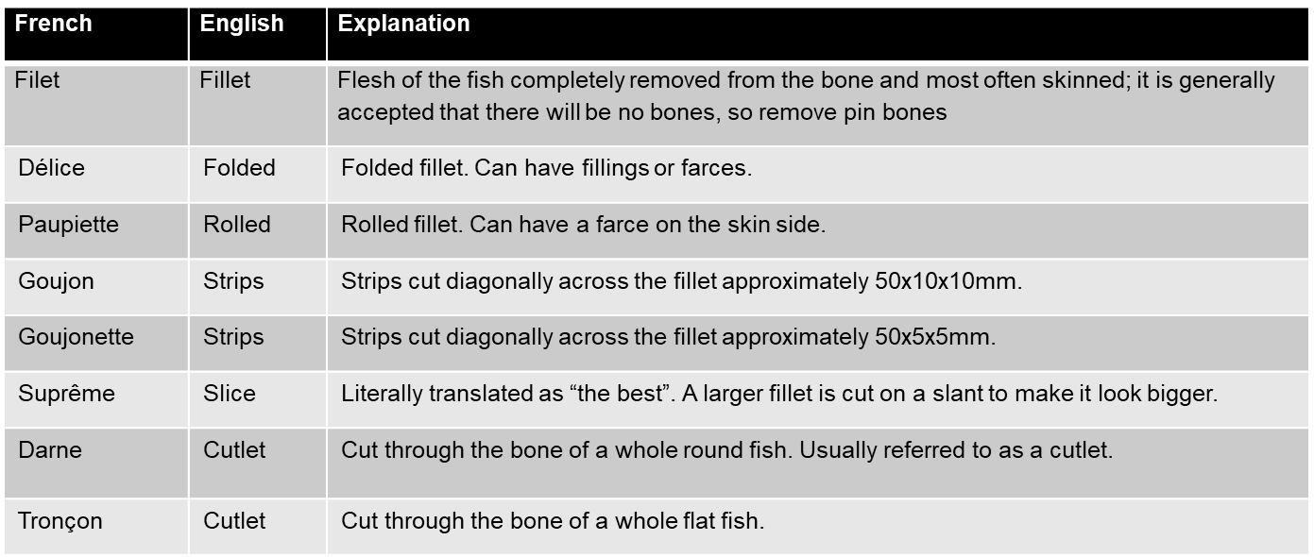
Preparation
Cuts – fish can be prepared and served in a wide variety of ways, which are determined by the cut of fish and the portion size.
Round fish has a waste percentage of 50%, Flat fish has a waste percentage of 60%
The following cuts can be achieved from fish:

Slide 9
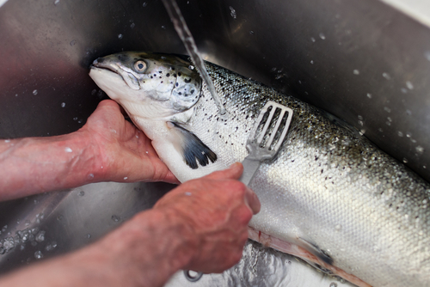
Preparation
Descaling – is removing the scales from a whole fish before cooking, this process is also referred to as scaling. Some fish have a layer of tough scales that need to be removed before cooking. This can be done using a specialist fish scaler or a knife, it is quite a messy job so if possible do it in a sink or in a polythene bag or alternatively ask the fishmonger to descale the fish.

Slide 10
Preparation
Filleting – is removing the flesh of the fish from the bone and body of the fish. It can be done it different ways dependant on the type of fish being used.
Flat fish – using a flexible fish filleting knife, cut down the central line until you come into contact with bone. Cut a small incision across the tail. Rest the knife on the backbone and draw it down, listening for the knife pinging along the bones, repeating until you begin to get underneath the fillet.
Round fish – some chefs remove the head first but not always necessary. Using a flexible fish filleting knife, work firmly from the tail, holding the knife parallel to the backbone. Remove the fillet, then turn the fish over and repeat the process.
Always wash fish fillet in cold water after filleting and pat dry with a clean cloth or paper towel.

Slide 11
Preparation
Gutting – the guts of a fish are inedible and need to be removed before cooking. Washing the fish after gutting is also very important.
You may choose to leave the head and tail in place if you are cooking the fish whole but the eyes and gills must be removed. In some cases the gills can be removed just by pulling them out, whilst in others you may have to cut them out with scissors. Use the scissors to trim off the fish's fins.

Slide 12
Preparation
Seasoning – fish with white meat should be seasoned differently than fish with darker meat. The reason is that fish tastes different depending on both the species of fish and the colour of its meat. An easy seasoning for fish with white meat is a combination of salt, pepper, fennel seed, thyme, parsley and lemon.
Scraping – it is important when preparing shellfish such as mussels to remove any unwanted parts such as the beard, and also scrape any barnacles off using the back of a knife then rinse.

Slide 13
Preparation
Skinning – not all fish need to be skinned. Leaving the skin on during cooking can help with a crispy skin texture if fried. For oven baking it will help to retain moisture and flavour. If you leave the skin in tact, remember that you must scale the fish instead.
Flat fish – includes plaice, sole, turbot, halibut and brill. Fillet flat fish by slicing them along the backbone. The backbone in flatfish usually runs along the midline of their body. Make a small incision between the flesh and the skin at the tail-end. With the knife moving away from you and the blade slightly angled towards the skin, cut the flesh from the skin in a sawing motion.
Round fish – includes salmon, cod or haddock. Like flat fish you slice them along the backbone, then make a cut with a sharp knife across the skin of the fish, just below the head. Loosen the skin with your fingers and then pull it down towards the tail in one big strip. Cut the skin off with the knife. Repeat on the other side.

Slide 14
Any questions?

