Slide 1
Cooking advanced fish, shellfish and crustacean dishes
PowerPoint presentation
Unit 308: Produce and present advanced main course dishes using standardised recipes

Slide 2
Introduction
In order for a chef to meet the dish requirements they will need to understand how to use advanced cooking techniques, as well as the effect these techniques have on the fish and shellfish, these techniques include:
poaching/braising/sous vide
steaming
roasting
pan frying/grilling
deep frying.
Seafood is an expensive commodity for a restaurant so it has to be used wisely.
Knowledge of seasonality, use of special menus and understanding how to maximise yield will help you to maintain a successful restaurant.

Slide 3
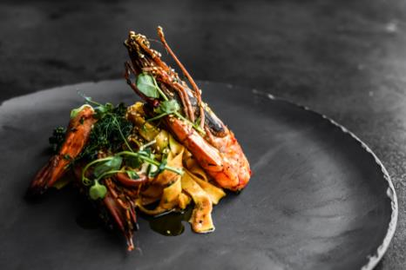
Introduction
Creating perfect seafood dishes requires excellent cooking skills as well as skills in the preparation of a wide variety of seafood, appropriate sauces and garnishes.
High quality, attractively presented seafood dishes will satisfy the guests.

Slide 4
Cooking
Boiling – not often used for fish as the rapid movement of the cooking liquor will tend to break up the fish flesh. However, lobster can be rapidly boiled in salted water for a short period of time. Once cooked the lobster can be used to produce the classic French lobster thermidor consisting of a creamy mixture of cooked lobster meat, egg yolks, and brandy (often cognac), stuffed into a lobster shell.
Braising – although braising is associated with cooking tough meats, it can also be used on fish and shellfish. This is especially so when cooking octopus. The octopus is skinned and cut into smaller pieces, mixed with red wine and herbs and spices braised, a traditional Greek method.

Slide 5
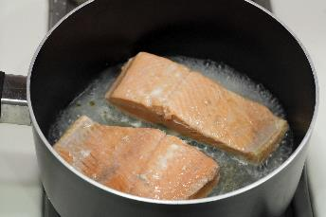
Cooking
Poaching – poaching is a good technique for cooking lean fish like tilapia, cod, sole, haddock, snapper, or halibut as well as fatty fish like salmon or trout. Poaching allows for a delicate fish to be cooked thoroughly and to add flavour and moisture to a dish. Cod can be poached in a white wine and fish stock and served with a tomato and chilli salsa and green herb salad.
Sautéing – often used for shellfish, it can be used to add colour and flavour to crustacean such as lobster and prawns. Dishes such as Dublin Bay prawns with garlic and white wine with crispy pancetta provide a balance of flavours.

Slide 6
Cooking
Steaming – dover sole or turbot are ideal fish for steaming, as is most white fishes. A Chinese style is dish is steamed with ginger and spring onions, the liquor is reduced and dark and light soy is added to produce a sauce. This can be thickened with butter for a fuller flavour and glaze.
Sous vide – very slow cooking method which works well with fish and shellfish. Scallops are especially good using this technique as they are very delicate. Scallops should be placed in a bag with lemon and pepper and cooked for 30 minutes at 50ºC. The liquor should then be poured in a saucepan and lemon and orange juice added, reduced and cream added to form a sauce. Another fish that works really well with this technique is salmon. Cooked with lemon and dill and served as a darne or steak.

Slide 7
Cooking
Baking – many fish can be cooked by baking/roasting from hake to halibut and even lobster. Lobster is cut in half, length ways, scrapped cleaned and the lobster meat is cut into chunks and returned to the shell. A champagne soufflé mix is then made and poured over the lobster. The shell is then roasted and served on a plate with chervil, chives and a crusty bread. Whole fish can be de-boned and stuffed with a farce, coated with oil and baked. Fish fillets or shellfish can be wrapped in pastry for baking.

Slide 8
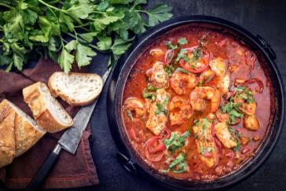
Cooking
Grilling – is a quick technique for cooking fish, from small whole fish, fillets to a darne and steaks. The high heat of grilling sears the surface of fish, creating meat with a flavourful crust. Dishes include Grilled salmon with saffron potato and carrot foam.
Stewing – is suitable for cheaper fish species such as black bream, mackerel or mullet, especially when they are cooked in an aromatic liquid. Popular stewed fish dishes include the traditional provençal French fish stew bouillabaisse.

Slide 9
Cooking
Shallow/pan frying – is a popular method of cooking fish. It works well with small whole fish, steaks and fillets. Lean fish are better pan-fried than oily fish because the oil helps keep them too moist. Always coat the fish in ingredients such as seasoned flour to protect the delicate skin and flesh and this will help to provide a crispy outer texture with a great colour.
Deep frying – fish that has a meaty texture such as haddock or cod are well suited to deep frying, as are other white fishes. A beer batter can be used and the fish is traditionally served with chips and peas. To make simple fish and chips more advanced, the chips could be pont neuf and peas may well be a pea puree with a mint foam to enhance the overall dish.

Slide 10
Any questions?

