Slide 1
Ingredients used in the production of hot and cold desserts
PowerPoint presentation
Unit 309: Produce and present advanced desserts and dough products using standardised recipes

Slide 2
Introduction activity
In the boxes below write the different classification of ingredients commonly used in the production of hot and cold desserts and dough items. The first box has been completed as an example
Flours

Slide 3
Introduction
Hot and cold desserts generally use a limited number of ingredients in the recipe. However, making a successful product depends on the accuracy of the weighing, the execution of the preparation and the final presentation.
This is really important to keep in mind as chefs often cook by sight and feel, using estimates quantity of ingredients based on judgement rather than measurements. Hot and cold desserts require an exact process and care must be taken to weigh everything correctly and follow the correct process/step in the recipe sheet.
It is important to be aware of the commodities used in hot and cold desserts. This awareness will enable you to create and judge a quality product.
The ratio of the ingredients used in preparation of the desserts influences the appearance and taste of the finished product.

Slide 4
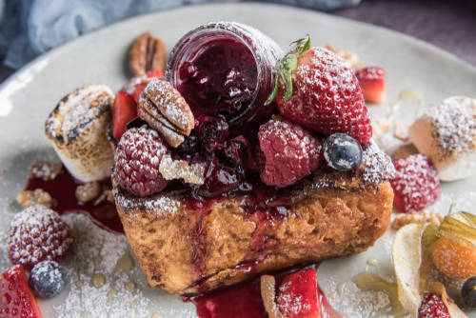
Introduction
There are many ingredients that have special functions in the production of hot and cold desserts and dough items. Some functions are critical to the success of the finished product. Some of these ingredients can be substituted with other ingredients and produce the same outcome but many times substitutions will have some affect on the end product.

Slide 5
Ingredients
Eggs: Eggs are used in hot and cold desserts and dough products for a variety of reasons, including:
binding properties
flavour
coating properties
emulsifying properties.
Dairy: There are many types of creams used in making and finishing of hot and cold deserts:
Milk – different fat content - 3% fat milk, 2% milk, 1% milk, skim milk
Double cream – minimum fat content of 48%
Single cream - minimum fat content of 35%
Whipping cream – addition of gelatine makes for easier whipping
Crème fraîche – double cream “soured” with the addition of yoghurt
Light cream – minimum fat content of ~20%
Sour cream – contains 15% fat content and lactic acid
Imitation cream – made from vegetable fats. It requires no refrigeration.

Slide 6
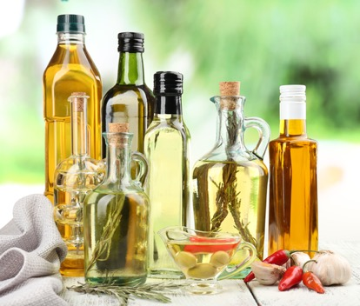
Ingredients
Fats and oils – are used in pastry as well as for frying of pastry products. As the fat prevents the gluten from forming long strands it is also referred to as shortening.
Shortening – is made from vegetable oil which has been hydrogenated to make is solid. Virtually tasteless, it provides a baked desert to be flaky and light.
Butter – this is the best fat to be used in baking. Due to its superior flavour it is ideal for shortcrust paste, Genoise and biscuits. It needs to be used with care due to its low melting point
Lard – typically baked into pie crusts, lard gives baked goods a flakiness without that intense butter taste.
Vegetable oil - used in making filo paste
Coconut oil – used just like vegetable oil, it provides a tender crumb but no flakiness. Muffins and quick breads made with it are moist and tender, with a slight coconut flavour.

Slide 7
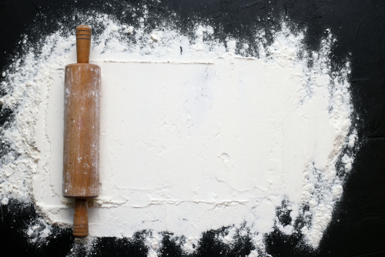
Ingredients
Flours
Flour is produced in many forms and will provide a different outcome in making biscuits, cakes and sponges. The table provides some examples of the different types of flours available:
Weak (soft) flour: ~9% protein used for sponges or biscuits in which eggs provide additional structure
Medium flour: ~11% protein used for yeast goods, e.g. Danish pastries
Strong (hard) flour: >12% protein used for bread and puff pastry
High protein: ~15% protein used for pasta and high protein bread – durum wheat added to flour for this purpose.
In most kitchens bakers flour is purchased and then the flour can be weakened by the addition of cornflour or wheat starch or it can be hardened by the addition of semolina, durum wheat or dry gluten. By adding baking powder the flour is changed to self-raising flour

Slide 8
Ingredients
Fruits are used to flavour, decorate and provide texture to many deserts and puddings. Fruits used in deserts and puddings include:
Fresh – nearly all fruits can be used in hot and cold desserts and dough items
Dried fruits – dried fruit is fruit from which the majority of the original water content has been removed either naturally, through sun drying, or through the use of specialized dryers or dehydrators. This includes peaches, apples, lychees, apricot, prunes, figs, cranberries, currants, raisins, pears, banana, pears, strawberries, raspberries.
Candied fruits – whole fruit, smaller pieces of fruit, or pieces of peel, are placed in heated sugar syrup, which absorbs the moisture from within the fruit and eventually preserves it. This includes oranges, peaches, pears, apples, sour cherries, whole fruit (mix).

Slide 9
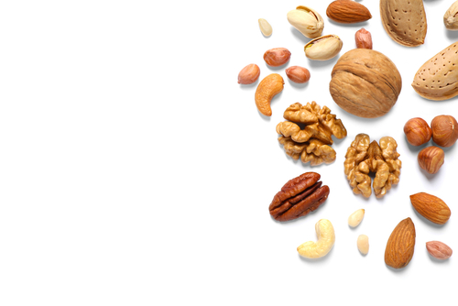
Ingredients
Nuts – almonds, walnuts, cashew, peanut, coconut, pistachio, chestnuts, hazelnuts, brazil, pine, macadamia, pecans.
Liquids – these are key within any creation of hot and cold desserts and dough products and will vary depend on the dish that is being made, it may include:
water
juice
milk
glucose
alcohol

Slide 10
Ingredients
Raising agents
Baking powder is made from a combination of alkaline and acid substances. The composition of baking powder is usually of cream of tartar and bicarbonate of soda which react when they come in contact with moisture and warmth to produce carbon dioxide gas in the form of small bubbles.
Bicarbonate of soda is also known as baking soda or cooking soda, which is used in a variety of dishes such as biscuits, batters, puddings, etc.
Cream of tartar is fine white powder which is extracted from the tartaric acid. It can also be added to increase stability and volume of whisked egg whites to increase their stability when making meringues or folded into cake batters.
Yeast is a single cell fungus that feeds on simple sugars to produce carbon dioxide, gas, and alcohol. It is also used as a leavening agent to produce a wide range of bakery products.

Slide 11
Ingredients
Sugars
Sugar comes in many different types such as granulated, caster and icing sugars. In biscuits, cakes and sponges sugar is used:
as a sweetener
to increase tenderness and provide softer texture to the product
to promote browning and crust development
to retain moisture which adds to the texture of the finished product
to assist in the absorption of air when beating egg white or Genoese mixture
for garnishing such as sprinkling product with icing sugar, spun or blown sugar
Types of sugar:
molasses
caster
granulated
demerara
dark and light muscovado
dark and light soft brown
glucose.

Slide 12
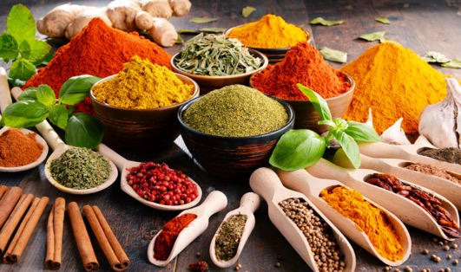
Ingredients
Spices
Spices are a crucial ingredients in many hot and cold dishes and dough products. Popular spices used include:
Allspice: Blend of cinnamon, nutmeg, and cloves
Anise seed: Sweet liquorice flavour
Cardamom, ground: Mild ginger flavour
Cinnamon: Warm, spicy flavour
Cloves: Hot, spicy flavour
Ginger, ground: Sweet, spicy flavour
Mace: Spicy, sweet taste
Poppy seed: Nut-like, sweet flavour
Sesame seed: Nutlike flavour when toasted
Vanilla bean: Sweet, rich taste.
Saffron: Light delicate flavour.

Slide 13
Ingredients
Alcohol
Adding alcohol to desserts can add a depth of flavour and provide moisture.
Limoncello – lemon flavour
Bourbon – deep whiskey oak flavours
Rum
Sherry
Vodka
Kahlua – coffee flavours
Irish Cream liquor – smooth creamy whiskey flavours
Tequila
White wine
Red wine.

Slide 14
Ingredients
Chocolate
There is a wide variety of chocolate to choose from; each with its own unique taste sensation.
Dark chocolate - has its own unique taste sensation, ranging from extra bitter to mild and aromatic. It all depends on the amount of cocoa solids present in the finished chocolate, this can range from 50–85%.
Milk chocolate has its own unique taste sensation, ranging from a pronounced cocoa taste to a full, creamy taste with subtle caramel touches. A typical milk chocolate will contain between 20–40% cocoa solids.
White chocolate has its own unique taste sensation, ranging from creamy taste to subtle caramel touches. A typical white chocolate will contain between 15 – 30% cocoa solids. White chocolate contains more cocoa butter than milk and dark chocolate which gives it a creamy taste and texture.
Cocoa butter can be coloured and printed on to transfer sheets which when tempered chocolate is laid on top the pattern will come off on to the chocolate.
Flavoured chocolate comes in many flavours such as white with strawberry or milk chocolate enriched with a dash of caramel, cappuccino or honey or fruit flavour and colour.

Slide 15
Ingredients
Fruit compounds are mixtures of fruits, natural and artificial flavourings that are used to boost the fruit flavour in dessert items.
Jams:
Apples, blackberries, cranberries, currants, gooseberries, grapes, plums, and quinces work well in recipes without added pectin
Other fruits, such as apricots, blueberries, cherries, peaches, pineapple, raspberries, rhubarb, and strawberries need addition pectin in the recipes.
Fruit curd is a dessert topping and filling usually made with lemon, lime, orange, or raspberry.

Slide 16
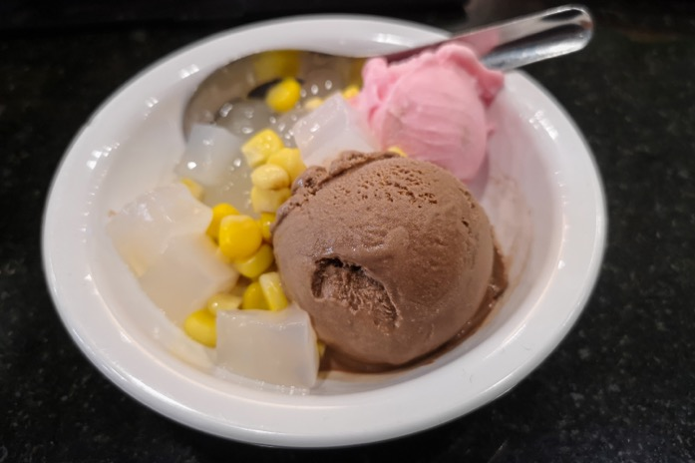
Ingredients
Setting agents – setting and gelling agents are used to thicken and stabilize various desserts such as fruit gels or ice creams. Setting agents may also improve the suspension of other ingredients or emulsions which increases the stability of the dessert:
Leaf gelatine
Powdered gelatine
Agar-agar
Gum arabic
Pectin
Carrageenan
Alginates
Guar gum
Xanthan gum
Sodium carboxymethyl cellulose
Egg

Slide 17
Ingredients
Rice
Rice is often thought of as a savoury ingredient but it is also used around the world in desserts including rice puddings and sweet dessert risotto. Short grain rice tends to be almost round and is typically moist when cooked, giving sticky rice which is perfect for desserts and puddings.
Types:
Short grain/rounded
Risotto
Patna
Carolina
Brown grain.

Slide 18
Ingredients
Grains – often used in desserts but importantly used with the production of dough items, there are many different grains, below are a common few used:
Buckwheat: It is most often ground into flour and used in pancakes, crepes, and muffins. Buckwheat has an earthy, grassy flavour with a slight cocoa taste and it tastes best when the kernels are roasted.
Corn: Popcorn is a special variety of dried corn that contains a high moisture content. About 14% of the composition of the kernel is water, which creates steam when the kernel is heated. This causes the popcorn kernels to explode and pop open because the steam cannot escape
Oats: Used to produce to items such as oat bran, oat flakes, oatmeal, and oat flour.
Wheat: Hard wheat used for yeast breads and similar products. The protein content of hard wheat usually ranges from 10 to 14 percent. Soft wheat used for products, such as cakes, cookies, and pastries that do not require the same level of leavening capability as yeast breads. The protein content of soft wheat varieties usually ranges from 6 to 10 percent.

Slide 19
Ingredients
Flavourings, colourings and essence
Flavourings, colourings and essences all contribute to the final flavour or presentation of the desert or pudding. Some of these include:
Essences
Vanilla
Brandy
Liquorice
Flavourings
Orange
Chocolate
Lemon
Colouring
All colours

Slide 20
Any questions?

