Slide 1
Cook a range of advanced dough items using different methods of cookery
PowerPoint presentation
Unit 309: Produce and present advanced desserts and dough products using standardised recipes

Slide 2
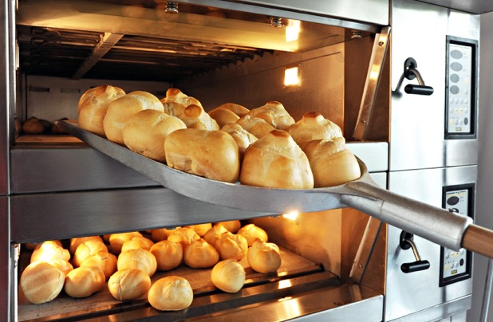
Introduction
Dough items can be cooked in many ways from baking to deep frying but the most common way is baking.
Before the use of indoor electric or gas oven, most dough items were baked in large wood fired masonry ovens, communal ovens, or over and open fire. The large masonry ovens yielded excellent results; however, other methods, such as open fire baking, resulted in dough items that were inconsistent in texture, flavour, and done-ness.

Slide 3
Methods of cookery
Baking – the heat of the oven transforms the moisture in the dough into steam causing the bread to rise rapidly. The yeast in the dough continues to produce carbon dioxide gas, contributing to the rising action of the baking bread. Usually within the first 10 minutes of baking, the temperature of the dough has increased to a level that kills the active yeast cells, ending the rising action. The final shape and size of the bread is set and the crust begins to form. The oven door should not be opened before this stage is completed. Further baking allows the natural sugars in the dough to caramelize, which results in the golden brown col
our that is characteristic of many varieties of bread.
The level of moisture in the oven is an important factor in achieving proper results when baking bread. Moisture, in the form of steam, allows the bread to form a thin, golden crust while allowing the interior to remain soft and moist. It is often beneficial to add moisture to the oven either before the bread is placed in the oven or during the baking process.

Slide 4
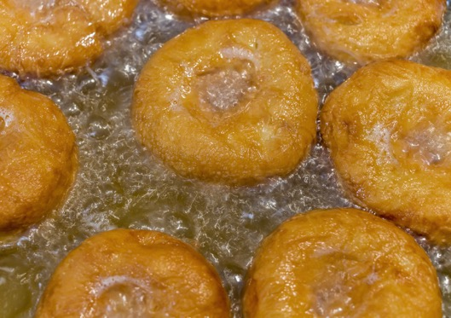
Methods of cookery
Frying – there are variety of different types of dough items that can be deep fried. A common and favourite is doughnuts or a fruit fritter.
When we are deep frying dough items, we need to fully submerge the item into hot cooking oil. The temperature of this oil is set at somewhere between 177–191ºC (350 - 375ºF ). If the temperature is wrong, then the dough item surface might form too slowly, causing the dough items to absorb large amounts of oil. On the other hand, if the heat settings are too high then the surface of the dough will colour on the outside but be raw inside.

Slide 5
Methods of cookery
Boiling – bagels are probably the most common dough item that uses boiling as part of the cooking method.
The boiling is not to cook the bagels, but rather to create the distinctive skin on the outside of bagels and pretzels. When making bagels you only boil them for about 30 seconds.
A bagel dough contains course flour and thus starches. When placing the dough in boiling water the starch granules will gel. The starch will absorb water and swell, starch granules will break down. This gelling of starch will stiffen the outside of the bagel. Boiling kills off the yeast so the dough will not rise anymore. Together with the firmer shape, boiling the bagel dough will set the final shape of the bagel, it will not rise any further in the oven. Since they don’t rise anymore, the structure remains denser and chewier.

Slide 6
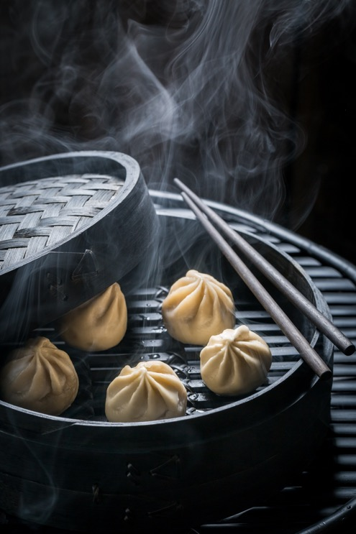
Methods of cookery
Steaming – typically produced from leavened dough, the steamed bun can be made as a seasoned bun to hold a filling of cooked meat and vegetables blended into a semi-smooth texture or it may be made as a sweet bun containing a filling of pureed fruits or sweet bean pastes. When served, the sweet bun will generally be designated with a small coloured spot in the centre of the bun where it closes together on the top. The process to cook the bun involves steaming rather than baking, providing a white soft-textured result throughout the bun, rather than a golden brown, crisp outer crust that is soft and white only on the inside.

Slide 7
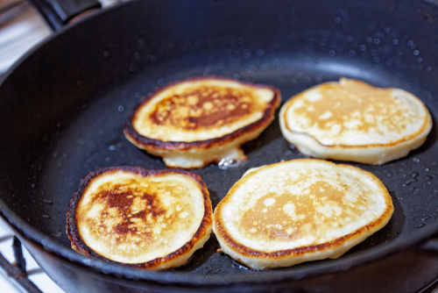
Methods of cookery
Griddling – griddling blinis are common. They are a large flat cooking surface and generally have a ridge around the outside edge to catch grease or juices from the food as it cooks. The cooking surface is often a non-stick material.

Slide 8
Any questions?

