Slide 1
Finish a range of advanced dough items using appropriate finishing methods
PowerPoint presentation
Unit 309: Produce and present advanced desserts and dough products using standardised recipes

Slide 2
Introduction
Discuss as a class the different types of finishing methods that can be used for dough items.
Finishing

Slide 3
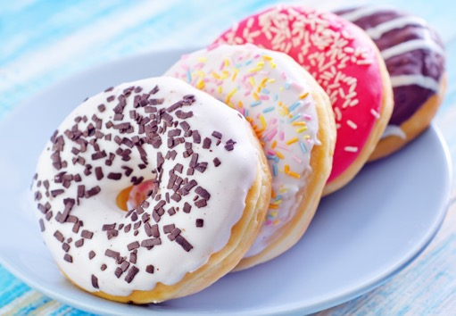
Finishing
Icing – can be used to enhance the appearance of a dough item. Typical icings types include:
Royal icing – last a long time because it dries very hard. It flows easily so it works well for writing, piping, and outlining when decorating dough items.
Frosting – there are many different frosting types and each has a variety of frosting recipes. Each different type of frosting has the same basic ingredients and is prepared in the same manner, but they vary slightly in the amount of some of the ingredients and flavouring used.

Slide 4
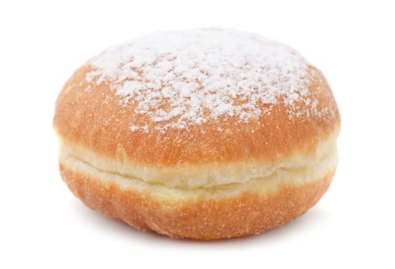
Finishing
Dusting – using powdered sugar for dough items is fairly common. There are many other ingredients you can use for dusting light and dark dessert such as cocoa powder, but other ingredients, such as cinnamon, sugar, and finely chopped nuts, can also be used. Be sure to use a dusting ingredient that has a flavour that will go with the flavour of the dough items.
Dusting can be done just as an overall coating or a stencil can be used to create a pattern on the dough item. A doily or store-bought stencil can be used or you can cut your own pattern out of a light weight cardboard.

Slide 5
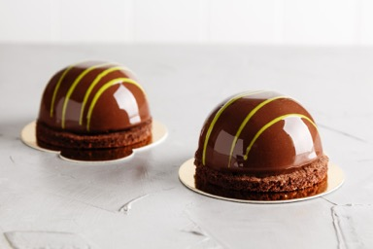
Finishing
Brushing – dough items can be brushed with a melted buttered or a sweet syrup or which will enhance dough items by both their flavour and their appearance.
Glazing – to enhance a dough items, preparations used include:
Sweet sugar – often used in the finishing of Belgium and cinnamon bun.
Mirror glaze –traditionally mirror glaze involve pouring the glaze over a dough item. For example chocolate glaze, where it is made with glucose syrup, sucrose and water, to which you add condensed milk, gelatine and chocolate
Chocolate ganache – a richly flavoured chocolate coating made from chocolate and cream blended together over low heat.

Slide 6
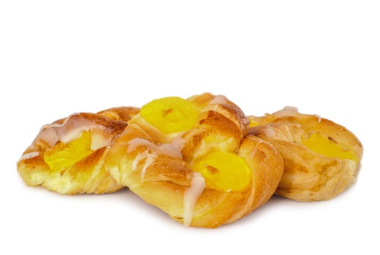
Finishing
Piping – is a skill used to enhance the appearances of dough items, the following are some preparations that may be used to pipe:
Water icing
Royal icing
Whipped cream
Chocolate
Fondant
Filling – there are many dough items that require filling such as sweet doughnuts which can be filled with jam and custard, you want to be sure the filling compliments the dough items and the filling is stable enough to stay within the dough items so that it doesn’t leak out.

Slide 7
Any questions?

