Slide 1
Allergens
PowerPoint presentation
Unit 309: Produce and present advanced desserts and dough products using standardised recipes

Slide 2
Introduction
Food allergens can be life threatening and the only way people can manage a food allergy is to avoid the foods that make them ill.
Food allergens cannot be removed by cooking. That is why it’s essential to practise good kitchen hygiene, as well as careful separation, storage and labelling of ingredients when preparing food.

Slide 3
Types of allergens
Within the European Union food suppliers, restaurants and individuals who sell food have an obligation to highlight any of the 14 prescribed allergens to consumers. The 14 allergens are:
cereals containing gluten
crustaceans
eggs
fish
peanuts
soybeans
milk
nuts
celery
seasame
sulphur dioxide
lupin
Molluscs.

Slide 4
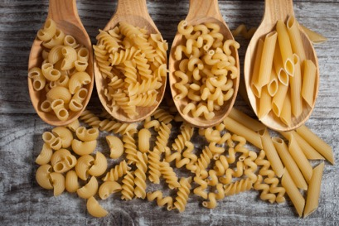
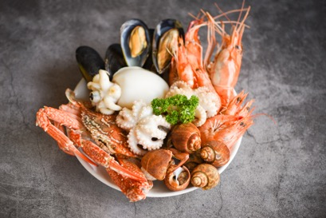
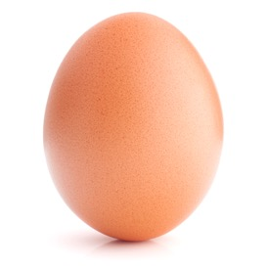
Types of allergen
Cereals containing gluten
Wheat, rye, barley and oats is often found in foods containing flour, such as batter, breadcrumbs, breads, cakes, couscous, some meat products, pasta, pastry, sauces, soups and fried foods which are dusted in flour.
Crustaceans
Crabs, lobster, prawns and scampi are crustaceans. Shrimp paste, often used in Thai and south-east Asian curries or salads, is an ingredient to look out for.
Eggs
Eggs are often found in cakes, some meat products, mayonnaise, mousses, pasta, quiche, sauces and pastries or foods brushed or glazed with egg.

Slide 5
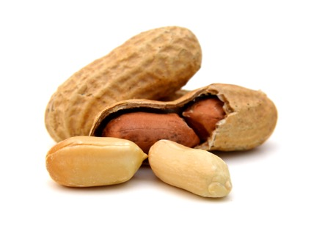
Types of allergen
Fish
You will find this in some fish sauces, pizzas, relishes, salad dressings, stock cubes and Worcestershire sauce.
Peanuts
Peanuts grow underground, which is why it’s sometimes called a groundnut. Peanuts are often used as an ingredient in biscuits, cakes, curries, desserts, sauces such as satay sauce, as well as in oils and flours.
Soybeans
Often found in bean curd, miso paste, textured soya protein, soya flour or tofu. It can also be found in desserts, ice cream, milk, meat products, sauces and vegetarian products.

Slide 6
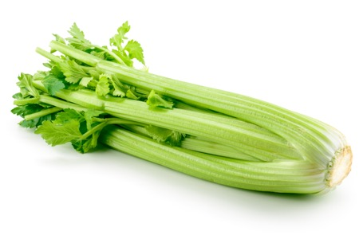
Types of allergen
Milk
Milk is an ingredient in butter, cheese, cream, milk powders and yoghurt. It can also be found in foods brushed or glazed with milk, and in powdered soups and sauces.
Nuts
Nuts grow on trees such as cashew, almonds and hazelnuts. This ingredient can be found in breads, biscuits, crackers, desserts, nut powders (often used in Asian curries), stir-fried dishes, ice cream, marzipan (almond paste), nut oils and sauces.
Celery
This includes celery stalks, leaves, seeds and the root called celeriac. You can find celery in celery salt, salads, some meat products, soups, stocks and stock cubes.

Slide 7
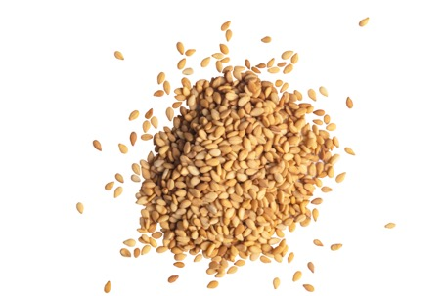
Types of allergen
Sesame
These seeds can often be found in bread, sprinkled on hamburger buns, breadsticks, houmous, sesame oil and tahini. They are sometimes toasted and used in salads
Sulphites
This is an ingredient often used in dried fruit such as raisins, dried apricots and prunes. You might also nd it in meat products, soft drinks, vegetables as well as in wine and beer. It is also known as sulphur dioxide.

Slide 8
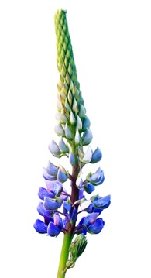
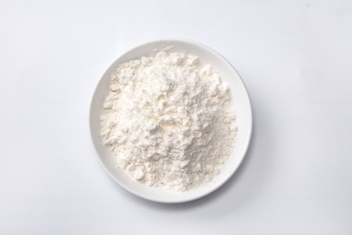
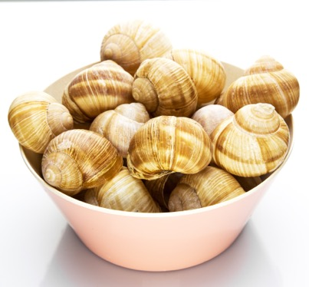
Types of allergen
Lupin
Lupin is a flower, but it’s also found in flour. Lupin flour and seeds can be used in some types of bread, pastries and even in pasta and pastries.
Molluscs
These include mussels, land snails, squid and whelks, but can also be commonly found in oyster sauce or as an ingredient in fish stews.

Slide 9
Any questions?

