Slide 1
Large equipment used in the production of hot and cold desserts
PowerPoint presentation
Unit 309: Produce and present advanced desserts and dough products using standardised recipes

Slide 2
Large kitchen equipment task
Lets work together and see if we can list the different large kitchen equipment commonly used in the production, cooking and finishing of hot and cold desserts:
Large Kitchen Equipment

Slide 3
Introduction
As a chef working in a professional kitchen you will use a number of a large pieces of equipment when producing hot and cold desserts. The size and nature of the establishment will depend on the equipment being used.
It is important to choose large equipment that is of good quality and best fits your needs. You need the knowledge of the safe use of the equipment. It is also beneficial to be familiar with the varieties of models that are available, how to maintain the equipment in line with the organisation and manufactures requirements.
It is important that when using large equipment that you and your colleagues are fully trained on the piece of equipment and you fully understand how to use the in a safe and efficient manner.

Slide 4
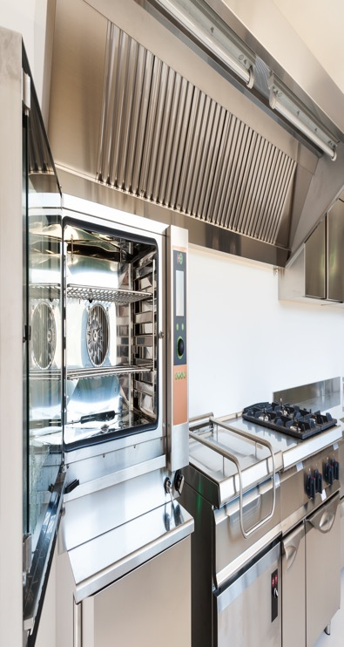
Large equipment
Blast chillers and blast freezers offer a systematic, safe method of cooling food quickly and hygienically, minimising bacterial growth and preserving food quality.
Cold holding equipment (refrigerators and refrigerated displays, freezers):
A fridge should operate at a temperature range of 1–5C. Its primary use is for the storage of food and beverages with the intent to extending freshness of the product.
A freezer should operate at a temperature range of -18 to -22C. Its primary use is for the storage of food with the intent of preserving the product.

Slide 5
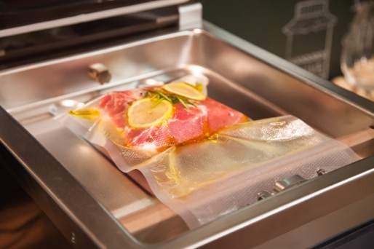
Large equipment
Hot holding equipment and bain-marie – there are a variety of different methods to hold hot desserts at the correct temperature. It is important to hold desserts at the correct temperature to ensure that you comply with legalisation and reduce the risk of food poisoning.
Hot holding equipment will have a heat source from the bottom and usually a heat source from the top in the form of heat lamps.
These are usually near the front of the kitchen which is commonly known as the pass, where the chefs will hold and then plate up dishes for the customer.

Slide 6
Large equipment
Deep fat fryers – a deep fat fryer is used to heat cooking oils so foods can be completely covered in hot oil to be cooked.
It is often used to deep fried pastry items that can be used in hot and cold desserts such as dough and choux pastes
It is important when using deep fat fryers that you are able to control the temperature and allow for different settings for various types of food. Temperature controls may have ranges that begin at around 150ºC and almost reach 190ºC or more at the upper end. This is key to ensure that the correct colour, texture and flavor are obtained.
Griddles – a typical griddle uses either an electric element or gas as its heat source. A griddle will have an adjustable heat control so they can be used for cooking food or keeping food warm. Can be used for a variety of tasks such as cooking pancakes or shallowed fried dessert items such as caramelised fruits.

Slide 7
Large equipment
Grills – there are different types of grills these fall largely into 3 categories salamander, open flame grill/barbeque, contact grill. Grilling is an ideal method for cooking fruit or finishing off desserts that require colour.
Hobs (induction, solid top, open range):
Induction – an induction hob uses electromagnetism to create a magnetic field between the pan and the hob. Induction hobs are quicker and cheaper to run because the heat is transferred directly to the pan.
Solid top – solid tops are usually either powered by gas or electricity and heat a solid plate which distributes the heat. These can take a while to heat up and are less controllable than gas open range hobs.
Open range – open range hobs are powered by gas, they provide instant, direct and controllable heat.

Slide 8
Large equipment
Ovens
Conventional, fan assisted (convection) – a type of oven that uses convection currents to cook food. Fans are used to distribute hot air around the oven, which helps to cook the food more evenly and quickly than in a conventional gas style oven. Most often contains two heating elements, others, contain a heating element which is also built around the fan so the air flows to a specific temperature levels keeping the air not only circulating but heating uniformly as well.
Combination (steam/dry heat) – a combination style oven allows the mixture of dry and wet heat, this is useful usually when using dough products or the kitchen has limited space to have both a steamer and an oven.

Slide 9
Large equipment
Steamers (low and high pressure) – commercial steamers can still be found in professional kitchen especially in cost sector catering, however, many have been replaced with combination ovens (steam/dry heat).
A commercial steamer allows you to quickly cook large quantities of a wide range of foods quickly and easily, making them ideal for mass catering of desserts in schools, hospitals, large restaurants and more.

Slide 10
Large equipment
Dehydrator – an ideal piece of equipment when producing desserts as you are able preserve fresh fruit by removing their moisture content. They work by circulating warm air around stacked trays made from slatted plastic or metal gauze, allowing water to evaporate evenly and simultaneously.
As no cooking is required, all flavour and nutrition is locked in – in some cases the flavour is intensified – and the end result has a much longer shelf life than the fresh ingredient.

Slide 11
Large Equipment
Ice Cream machine – commercial ice cream machines make it easy to produce large quantities of ice cream, sorbet, gelato and frozen yoghurt.
Many of these ice cream makers include a built-in freezer, meaning you don't need to pre-freeze the bowl first, making the production of ice cream faster, easier and much more efficient.
Many new ice cream machines have a density control feature which ensures the machine stops when the production has reached the correct density, this ensure the correct texture.

Slide 12
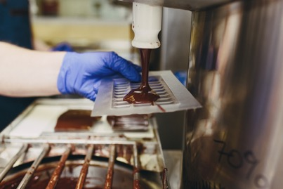
Large equipment
Chocolate tempering machine – when needing a large quantity of workable chocolate, then it’s best to use a chocolate tempering machine.
Chocolate tempering machines take the guessing out of tempering dark, milk and white chocolate and deliver shiny tempered chocolate with optimised shelf life every time.
Counter-top and commercial chocolate tempering machine that are ideal for tempering or holding chocolate in-temper due to the precise thermostat that keeps the desired temperature.

Slide 13
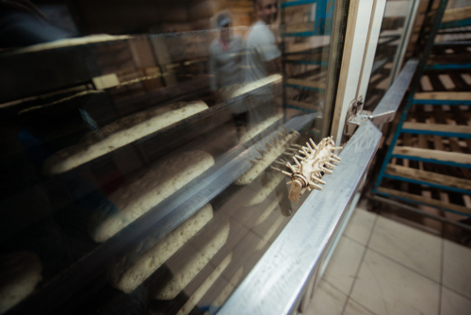
Large equipment
Prover/retarder – a prover/retarder is a cabinet with a controlled and adjustable temperature and relative humidity.
During the final stage of the cycle, it transforms from a cold storage room to a heated cabinet to encourage proving.
Dough/fermented goods can be retarded and stored overnight or through the weekend, automatically proving the product ready for baking at a pre-set time.

Slide 14
Any questions?

