Slide 1
Small equipment used in the production of hot and cold desserts
PowerPoint presentation
Unit 309: Produce and present advanced desserts and dough products using standardised recipes

Slide 2
Small kitchen equipment task
Lets work together and see if we can list the different small kitchen equipment commonly used in the production, cooking and finishing of hot and cold desserts:
Small Kitchen Equipment

Slide 3
Introduction
Small tool and equipment play a variety of different roles in the preparation, cooking and finishing of hot and cold desserts. The size and nature of the hospitality establishment will depend on the equipment being used.
It is important to choose tools and small equipment that are of good quality and best fits your needs, you need the knowledge of the safe use of the tools and equipment. It is also beneficial to be familiar with the varieties of models that are available, how to maintain your tools and equipment.
It is important that when using tools and small equipment that you and your colleagues are fully trained on the piece of equipment and you fully understand how to use the in a safe manner.

Slide 4
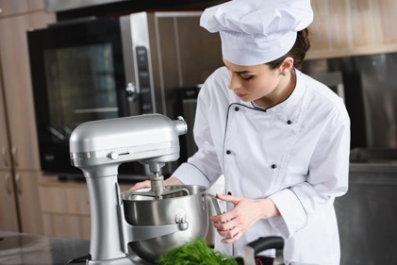
Small Equipment
Blender – A blender is used basically to emulsify, liquify or puree. Blenders typically consists of a tall glass or plastic food container with a removable lid made with a filler hole for adding ingredients during the process. At the base of the food container there are motor driven blades that blend, chop, mix, or liquefy foods depending on the speed setting selected.
Blow torch – used as a finishing tool, this tool is most often used to add the golden tan surface to desserts by caramelising sugar sprinkled over the top. Small in size, the blow torch uses butane gas for the flame emitted from the torch. Blow torches are typically built with safety locks, holding stands so they don't need to be laid down on counters.

Slide 5
Small Equipment
Chopping boards – come in a wide variety of thicknesses, colour’s, shapes and sizes to fit a variety of different preparation and storage needs. In modern day professional kitchens it is good practice to have colour coded chopping boards to reduce the risk of cross contamination.
Cooling racks – are used for placing cooked foods onto a surface that will enable the food to be cooled on all sides after being cooked. Most cooling racks are made of stainless steel wires that are formed into a mesh squares so that food to be cooled can easily be supported without falling through, yet allowing enough air to reach the bottom of the food.

Slide 6
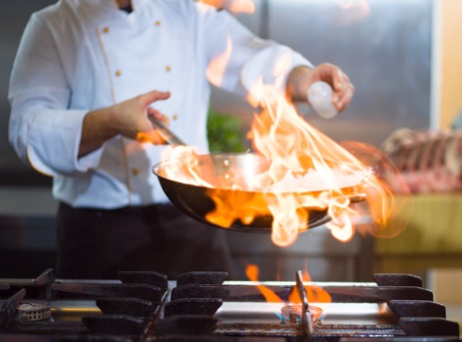
Small equipment
Food processor – are used to chop, grate, mince, slice, puree, and blend a variety of food ingredients. Food processors have different blades that perform the various functions. A food processor can usually perform any of these tasks in minimal time, which makes it an indispensable tool for a chef in a busy kitchen.
Frying pans – a flat-bottomed pan with shallow sides that are slightly curved. They are made of various materials, such as copper, cast-iron and aluminium, and some have a non-stick coating applied. There are several sizes available and they are generally round in shape. Also known as a "skillet."

Slide 7
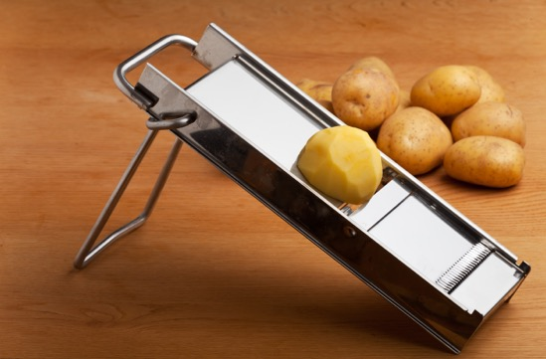
Small equipment
Mandolin /food slicer – is used for cutting and slicing fruits and vegetables. This mandolin has a variety of adjustable blades that enable the Mandolin to make precise cuts of differing thickness. When using a mandolin the foods being sliced are held in place with the specially designed Mandolin holder or grip.
Measuring jug – measuring cups/jugs are available in a variety of styles and materials such as tempered glass, plastic, aluminium, or stainless steel.

Slide 8
Small equipment
Mixers – the mixer is an important utensil used for mixing ingredients or beating foods. The types of electrical mixers vary in size and features beginning with hand-held models and moving up to heavy-duty models mounted on stands. The mixer provides several speeds and mixing, kneading or whisking attachments. Additional function of the mixer can include a food grinder, a juice extractor, and a slicer or shredder for attachments.

Slide 9
Small equipment
Moulds and cases – can be made from several different materials, shapes and sizes. Each can have a different effect on the outcome of your baked goods. Silicone bakeware are robust and reusable material that are used for baking moulds. It is made of a flexible and bendable silicone material that can be used in the oven, microwave, and freezer
Pastry brushes – usually 1" to 1–1/2" wide, small brush made with nylon or sterilized natural bristles. The brush is used to apply glazing to breads, pastries or cookies before or after baking. It is also commonly used to brush on egg washes.

Slide 10
Small equipment
Piping bag and nozzles – a cone shaped bag that has a small opening on one end and a large opening on the opposite end. The small opening is the decorating end that generally has different tips that can be interchanged to create different decorative shapes. Some of the common tips are the round tip for line work and writing, an open star tip for borders and a closed star for flower shapes.
Saucepans – an essential cooking utensil that is round in shape with high, straight sides and a longer handle. Equipped with a tight fitting cover, the saucepan can range in sizes to hold contents. They are made of materials such as stainless steel, copper, anodized aluminium, glass, and enamelled steel or cast iron.

Slide 11
Small equipment
Scales – scales are used to measure the weight of ingredients and other food commodities. Kitchen scales are available in electronic balance or spring models. A electronic balance scale will give a more accurate reading than a spring scale.
Sieve – used to strain liquids or to sift dry ingredients, such as flour or powdered sugar. Also referred to as a strainer, a sieve has perforated holes or mesh and is available in many different shapes and sizes. Several similar kitchen tools that may be used as a sieve are a chinois or a colander.
Silicone mats – referred to as non-stick baking made from a silicone construction, which prevents baked goods from sticking so they can easily be removed. This also makes them easy to keep clean.

Slide 12
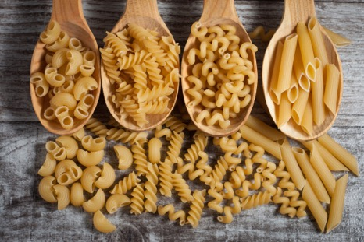
Small equipment
Spatula – a small tool having a broad, flat, flexible blade that is used to mix, spread, or lifting material, commonly used in making hot and cold desserts. A slotted spatula allows air to get under food, so it slides off spatula easily
Spoons – made from materials including wood, metal and plastic. Most spoons will feature a hole in the handle, so the utensil can also be conveniently stored and quickly accessed during busy periods of service. Also Spoonulas are available which are made from a soft plastic, the spoonulas are non-abrasive
Strainers – used to remove lumps from sauces.

Slide 13
Small equipment
Sugar thermometer – will ensure jams, caramels and fudges are produced at the perfect temperature. The sugar thermometer displays optimum temperatures for each stage of the sugar boiling process from thread to caramelisation, helping you achieve the desired result with ease. This thermometer features a temperature range of +40 to +200ºC (104 to 392⁰F).
Sugar lamp – the sugar lamp quickly heats up your sugar, allowing you to later create sugar designs through a blowing pump and allowing you to pull the sugar, making it ideal for desserts and sugar garnishes.

Slide 14
Small equipment
Temperature probe – used for checking the internal temperature of meat or other foods products to ensure that the appropriate and safe temperature has been achieved. When checking the temperature of the food , insert the thermometer probe into the thickest part of the meat and as close to the centre as possible.
Trays – are commonly found in every professional kitchen and are used for a variety of cooking tasks. Cake pans can be round, square, or rectangular and are available in several sizes. Aluminium is a good material for trays because it is a good conductor of heat, which results in even cooking.
Whisk – there are a variety of different types, shapes and sizes of whisks available depending on the requirements for their use. Some of the most common whisks include: Ball, round balloon, oval balloon, coil, flat end.

Slide 15
Small equipment
Turntable – the turntable is a plate, generally about 12 inches in diameter, that is mounted on a pedestal on which it can rotate. This tool makes it easy to turn the dessert as it is being decorated, providing easy access to all sides of the dessert when the coating, glaze, frosting is applied.
Cream whippers – espuma or air, is created by a cream whipper, also known as a siphon, using N2O cartridges to incorporate the air which creates a dense mousse type foam. They are sealed canisters which use pressurized gas to aerate cream quickly. Although this is their primary function they are also capable of a lot more than whipping up cream for dessert toppings. They can also be used to add texture to components to sweet dish. They are perfect for making foams as well as, infusions, sauces and mousses, not to mention flavoured cream for desserts.

Slide 16
Any questions?

