Slide 1
Preparation methods used for hot and cold desserts
PowerPoint presentation
Unit 309: Produce and present advanced desserts and dough products using standardised recipes

Slide 2
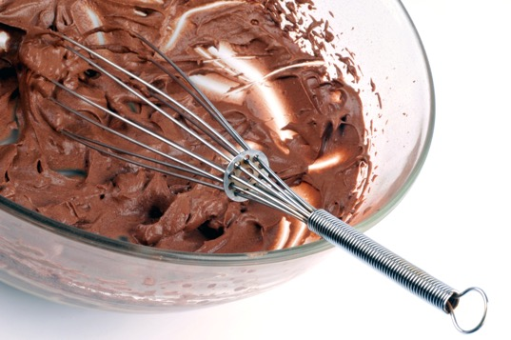
Preparation methods
Aerating – this technique is used to allows the mixture to aerate and increase in volume within a desert or pudding such as a mousse or meringue.
Beating – the beating technique is employed when a smooth consistency is required. Beating of a mixture, ensures there is a uniform mix of the ingredients and a smooth batter is achieved.

Slide 3
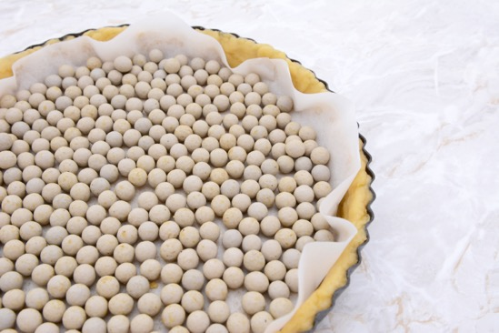
Preparation methods
Blind bake – a process of cooking pastry before adding the filling, sometimes referred to as "baking empty" or "cooking empty.“ Some fillings can make the pastry soggy if they are added to a raw pastry. Pre-cooking a pastry can also help in controlling any shrinking that may occur during the baking process.
Blending – is a technique used to combine two or more ingredients together to create a uniform mixture.

Slide 4
Preparation methods
Creaming – is the technique used when mixing the sugar and butter together before adding the flour, and other ingredients. The method is best done using a mixing machine, but can also be achieved by hand.
Churning – this is a mixing of ingredients together, often referred to when making butter but also the technique used to make ice cream and sorbets.

Slide 5
Preparation methods
Depositing – the main goals of depositing batters and fillings are always accuracy, You can use small depositing tools to accurately place filling, sauces etc into your desserts, for example created a layered dessert.
Dividing – the technique used for the portioning of ingredients/ mixtures into countable or single pieces for example bread dough or pastry mixtures.

Slide 6
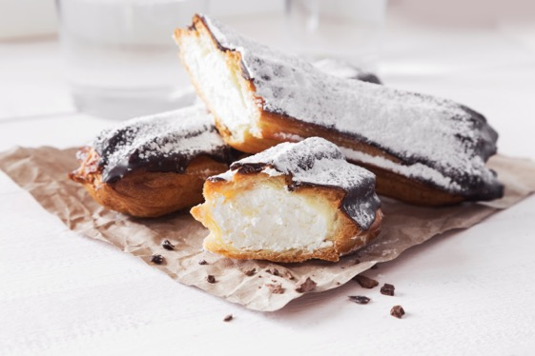
Preparation methods
Dusting – the technique of lightly sprinkling a fine layer of a powdered or granulated ingredient onto food. Dusting can also refer to the process of dusting a pan with flour in preparation for baking.
Folding – is the technique used to incorporate an ingredient with others that have already been aerated. An example of this is a mousse, where the cream is folded in after the gelatine mix has been cooled and strained. Folding is also used when making puff or flaky paste..

Slide 7
Preparation methods
Dehydrating – ingredients that have been dried to remove most of their natural moisture in order to preserve or dry the food. The typical result is a food that is smaller in size and may have a flattened or irregular shape.
Glazing – glazing is often the final steps in dough preparation prior to baking. Although glazes are often optional ingredients, they do add a boost of flavour and enhance the appearance of the dish. Glazing can also be used to add colour and texture to a dessert, i.e. the glazing of dessert with sugar then heating to add a caramelised effect.

Slide 8
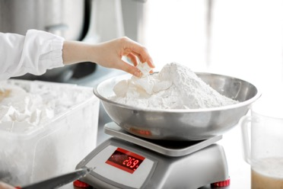
Preparation methods
Lining – correct lining preparation will result in easy removal of the desserts or dough item from a mould i.e. cake tin or dessert mould. There are several preparation methods that work well and include the use of parchment paper or plastic, that is cut to fit in the mould and then the ingredients are added before either cooking or chilling.
Measuring/weighing – correct measuring/weighing of ingredients is important to successful cooking and baking. Some foods can be greatly affect by too much or too little of certain ingredients.

Slide 9
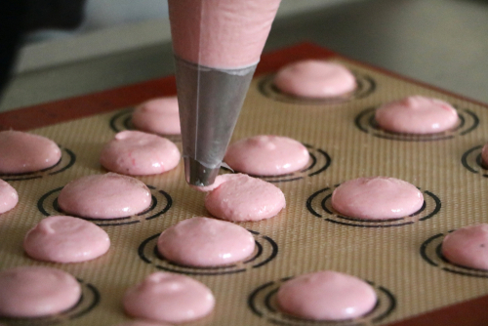
Preparation methods
Piping – techniques such as piping can be used to create chocolate and fondant garnishes and also to pipe deserts such as baked Alaska.
Pulling sugar – sugar can be formed into just about any shape you can imagine. When liquefied and heated, it becomes pliable enough for a few moments to be sculpted into objects, ribbons and decorations. The process of moulding sugar is known as pulling, as you pull the molten sugar in order to form smooth lines that then harden into a brittle sugar garnishes.

Slide 10
Preparation methods
Resting – with the exception of choux paste, all other pastes should be rested, this method will allow the gluten to relax and aid in the rolling and shaping process; prevent the paste from shrinking during the cooking.
Rolling – predominantly in the preparation of pastry and doughs, but also when rolling out fondant icing.

Slide 11
Preparation methods
Rubbing in – this technique is used when making a different paste items. It can be achieved using mechanical means, a mixing machine, or by hand.
Scoring – large desserts such as tortes and gateaux are scored to indicate where the cake should be cut without actually cutting it. Dough items such as rolls and bread are often scored for decorative effect.

Slide 12
Preparation methods
Shaping – is essential for the preparation and finishing of deserts and puddings. An example of shaping would be the use of spoons to create a quenelle of mousse or the shaping of a dough mixture before cooking.
Tempering – tempering chocolate involves putting it through a cycle of temperatures (heat, cooling, reheating) to align cocoa butter crystals within the chocolate. Once aligned the chocolate will have the familiar snap and shine this process is called ‘tempering’.

Slide 13
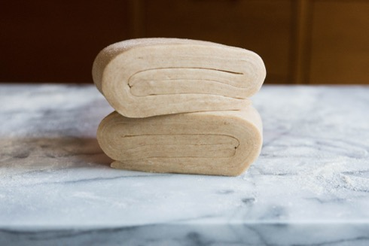
Preparation methods
Passing/straining – the preparation procedure of passing a dry ingredient such as flour or sugar or a wet ingredient such as a fruit puree through a mesh bottom sieve to remove any lumps or undesirable particles and to have a smooth ingredient.
Laminating – a good example of this is the preparation of puff pastry is folded 6 times with a resting period of 20 minutes between each fold. The resting period is to allow for the gluten to relax to ease the rolling of the paste. The result of the folding is many layers of pastry, and is called lamination.

Slide 14
Any questions?

