Slide 1
Cooking methods used for hot and cold desserts
PowerPoint presentation
Unit 309: Produce and present advanced desserts and dough products using standardised recipes

Slide 2
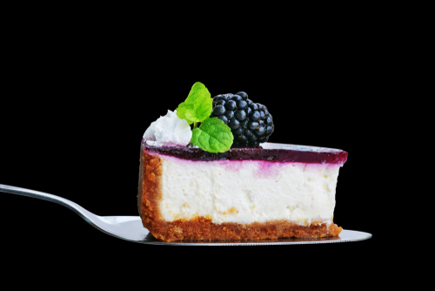
Introduction
When producing hot and cold deserts it is essential that the correct techniques are applied and followed to ensure:
the correct mixing of ingredients
appropriate temperatures for cooking are achieved
the correct equipment is used
the final product meets the standard required.

Slide 3
Methods of cookery
Boiling – boiling is the process of heating liquid to the temperature at which it will begin to transform into a gaseous state. Boiling can often be used in the production of dessert and sauces when there is a requirement to bring the liquid to a high temperature and then would normally be reduced, for example boiling of a liquid which could then be thicken for use in a sauce.

Slide 4
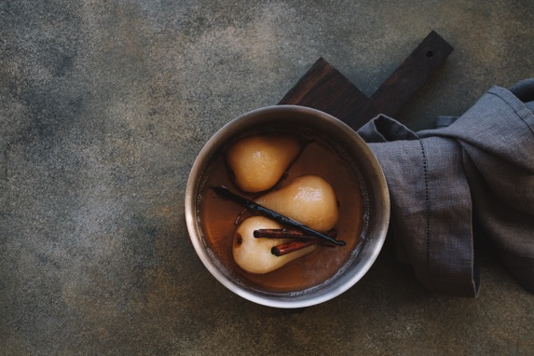
Methods of cookery
Poaching – poaching is a process of cooking foods, such fruit or meringue in a liquid that has been heated to just below the boiling point, so the liquid is barely moving while the food is being cooked. Poaching fruit such as pear, plum, peaches and rhubarb slowing in stocks and syrups such as red wine, fruit (orange etc.), spiced (cinnamon, cloves) adds both colour, flavour and texture to the dish. The liquid, in which the fruit is poached, can also be used for hot or cold syrups and sauces.

Slide 5
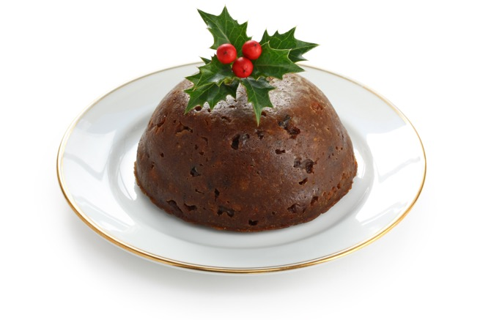
Methods of cookery
Steaming – the steaming process is the simple; as the water boils, the steam rises and surrounds the food with heat and moisture, cooking the dessert often used just for hot desserts. Pastry items and pudding maybe steamed for such dishes as sweet Asian steamed buns, steamed puddings (jam, fruit, chocolate, syrup), Christmas puddings.

Slide 6
Methods of cookery
Baking – is the process of applying dry heat in an enclosed space to cook food. The key to achieving correct baking techniques comes down to the proper ratio between the oven temperature and the baking time, which can be determined by the size or weight of the dish being cooked.
Pastry and dough items are commonly cooked using the baking methods it can produce rise, change the texture and colour of an dessert item.
Fruit such as baked apples are commonly baked, the centre (core) is removed and can be filled with dried fruits, spices and sugar and then baked in the oven. During the baking process, the apple flesh cooks and the apple skin becomes crispy.

Slide 7
Methods of cookery
Sous-vide – also known as low temperature long time (LTLT) cooking, is a method of cooking in which food is placed in a plastic pouch or a glass jar and cooked in a water bath for longer than usual cooking times usually 1–7 hours at an accurately regulated temperature.
Most of the time, sous vide cooks tend to focus on savoury dishes but it also be used for hot and cold desserts. Items such as fruits can been sous-vide by placing into a pouch, flavours such as flavoured syrups or spices can be added and then sealed and sous-vide.
Desserts can include sous vide plums with red wine granita, blueberry and saffron crème brûlée, black pepper and mint sous vide pineapples, ginger tea pears with spiced jelly.

Slide 8
Methods of cookery
Stewing – stewing is a moist heat cooking process much like braising except that the ingredient are totally immersed in liquid for example a stock syrup rather than being only partially immersed as it is with braising. Stewing is often used in the production of hot and cold desserts with stewed fruits, where fruits such as plum, peaches and rhubarb are stewed over a long period of time in a syrup or flavoured sweet stock and can include wine, to break down the natural fibres in the fruit.
Rhubarb is commonly stewed, because rhubarb varies in sweetness, it is hard to determine how much sugar is needed. The rhubarb will also sweeten as it cooks. Start out with a small amount of sugar. Once the rhubarb has cooked, more sugar can be added if necessary.

Slide 9
Methods of cookery
Shallow frying can be a quick method of cooking food and adds colour and texture to dessert items.
Pan frying can be used to produce pastry items such as crepes, drop scones etc. It is important that when cooking pastry item that you don’t use too much oil as this could soak into the pastry items, you must also take care with the temperature of the pan and ensure it is monitored throughout the cooking process.
Caramelising fruit on the stove in a frying pan using fruits such as apples, pears, are easy to prepare and provide taste and texture to a dish. Fried bananas also make a great desserts served with a toffee sauce.

Slide 10
Methods of cookery
Deep frying is the process of "dry" cooking food totally covered in hot cooking fat or oil. This process produces evenly cooked food with a golden, crisp surface on the outside. While the moisture on the inside of the food which acts to repel the oil is heated and boils, the food steam cooks, making it moist and tender.
Items such as bananas and apples can be suitable for deep frying. They should be coated in a batter and deep fried and then can be finished with flavoured sugars such as a cinnamon sugar.
Dough based or choux paste products are variety of different types of pastry items that can be deep fried. A common and favourite is doughnuts. Other products that can be deep fried are sweet spring rolls wontons, samosas and deep fried choux buns. This can be filled and garnished to improve the flavours and texture of the finished dish.

Slide 11
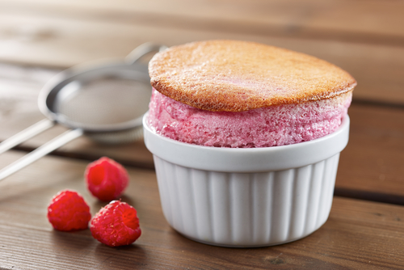
Methods of cookery
Combination is a method that incorporates both dry- and moist-heat cooking.
Not often used in the production of hot and cold desserts, however, used in cooking of souffles and crème caramel.

Slide 12
Any questions?

