Slide 1
Finishing methods used for hot and cold desserts
PowerPoint presentation
Unit 309: Produce and present advanced desserts and dough products using standardised recipes

Slide 2
Introduction
When finishing a plated dessert, there are five characteristics that should be considered: Flavour, texture, temperature, colour and shape.
Visually, a variety of colours and shapes can be attractive, but be careful not to include too much or the result will come across as a jumble. The plate needs to be visually appealing. Through the balanced use of colour and shape, you can present a dessert simply and elegantly.
Always consider:
Variety and diversity in textures and the elements of taste make for interesting food; avoid monotony.
Contrast is as important as harmony but avoid extremes and imbalance.
Food that comes from the same place (time/season or location) usually works together.

Slide 3
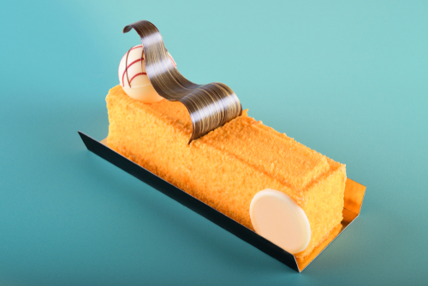
Finishing
Brushing – plates can be brushed with a sauces which will enhance desserts by both their flavour and their appearance. Apply a small amount of sauce and streaking it with a brush, an offset spatula, or the back of a spoon adds a modern presentation to the dessert.
Chilling – some elements of a dessert made need them to be child before serving, this will allow the dessert or its components to set and to be at the correct temp and texture prior to serving for example a mousse based dessert.

Slide 4
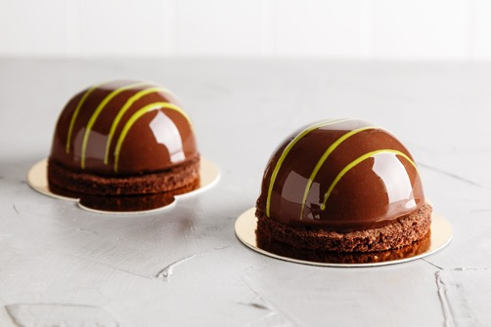
Finishing
Coating/glazing- to enhance a cold desserts, preparations used include:
Mirror glaze – traditionally mirror glaze involves pouring the glaze over a perfectly smooth, mousse-covered dessert. For example, chocolate glaze, where it is made with glucose syrup, sucrose and water, to which you add condensed milk, gelatine and chocolate.
Chocolate ganache – a richly flavoured chocolate coating made from chocolate and cream blended together over low heat .
Meringue – desserts can be coated in meringue and then heat applied for colour and texture.

Slide 5
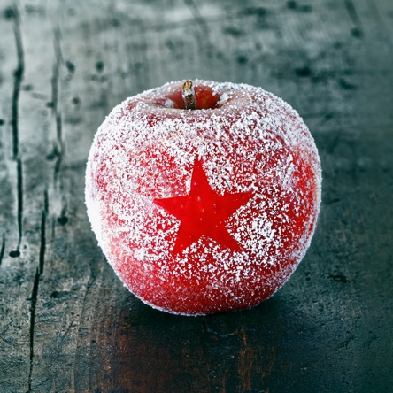
Finishing
Dusting using powdered sugar for dessert dusting is fairly common and is a great dessert decorating choice for dark coloured dessert, such as chocolate dessert recipes. There are many other ingredients you can use for dusting light and dark dessert such as cocoa powder, but other ingredients, such as cinnamon, sugar, and finely chopped nuts, can also be used. Be sure to use a dusting ingredient that has a flavour that will go with the flavour of the dessert.
Dusting can be done just as an overall coating or a stencil can be used to create a pattern on the dessert. An doily or store bought stencil can be used or you can cut your own pattern out of a light weight cardboard.

Slide 6
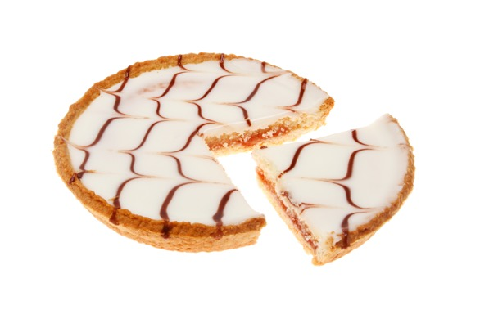
Finishing
Feathering is the technique of decorating a dessert with either icing or chocolate and feathering through the layer with a contrasting colour. Examples of this include:
Bakewell tart
Chocolate gateau
Filling: There are many dessert filling recipes and techniques to choose from but you want to be sure the recipe compliments the flavour of the dessert and the filling is stable enough to hold up to the type of dessert you are finishing.

Slide 7
Finishing
Icing – can be used to enhance the appearance of a dessert and is often used to create fine designs for desserts. Typical icings types include:
Royal icing – last a long time because it dries very hard. It flows easily so it works well for writing, piping, and outlining when decorating desserts or cakes.
Frosting – there are many different frosting types and each has a variety of frosting recipes. Each different type of frosting has the same basic ingredients and is prepared in the same manner, but they vary slightly in the amount of some of the ingredients and flavouring used.
Soaking – allows the chef to introduce more moisture to a cake or torte. A good stock syrup is required and the sponge or cake must be cool before applying the syrup. An example of using the soaking method is a rum baba or a black forest gateaux.

Slide 8
Finishing
Piping – is a skill used to enhance the appearances of dough items, the following are some preparations that may be used to pipe:
Water icing
Royal icing
Whipped cream
Chocolate
Fondant
Spraying – sometimes referred to when finishing desserts as flocking. Flocking is a technique used to create a fine velvety textured coating on desserts. A spray is used to disperse small drops of flavoured, coloured cocoa butter. It is particularly popular with French pâtissiers who create layered mousse cakes known as 'entremets'. The cocoa butter spray not only creates a sophisticated show-stopper dessert but helps the dessert to retain its moisture.

Slide 9
Finishing
Portioning – allows the chef to portion the desserts for the customers whilst keeping the visual appearance of the dessert.
Saucing – sauces enhance desserts by both their flavour and their appearance. Crème anglaise, chocolate sauce, caramel sauce, and the many fruit sauces and coulis are the most versatile. One or another of these sauces will complement nearly every dessert. The use of a squeeze bottle is useful for making dots, lines, curves, and streaks of sauce in many patterns; or just a spoon is needed to drizzle random patterns of sauce onto a plate.
Many modern presentations may have a minimal amount of sauce. Sometimes this is done just for aesthetic reasons and not for how it will complement the dessert.

Slide 10
Finishing
Use of decorations or garnishes – a garnish, simply put, can be just an add-on whose main purpose is decoration. However, carefully selected garnishes have other functions too. This ‘decorative’ item can add important flavour, texture, and functional elements to the plating of the dessert, and can enhance the enjoyment of the dessert.
Biscuits, such as tuiles, add visual, flavour, and texture elements
Berries and fruit can be used fresh or dried to make fruit leather or powders
Sugars, such as spun or pulled sugar
Meringue can be piped into sticks, disks, or baskets
Chocolate garnish correctly tempered, will ensure a crisp texture and proper sheen such as barks, curls, fans, and cigarettes
Crumbs – cake, crushed nuts, or brittle
Gels for spherification.

Slide 11
Any questions?

