Slide 1
Apply quality checks for hot and cold desserts
PowerPoint presentation
Unit 309: Produce and present advanced desserts and dough products using standardised recipes

Slide 2
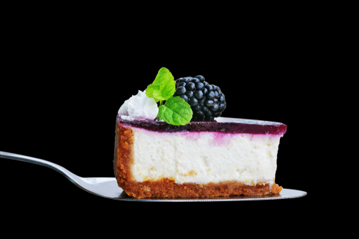
Introduction
It is important that as a chef you are able to apply quality checks for hot and cold desserts and measure and evaluate your desserts against quality standards throughout preparation, cooking and service.
You must also be able recognise any faults and know the correct procedures to deal with them.
The quality standard may include producing the desserts to the correct specification of the recipes cards and the agreed standard expected of the establishment.
Use the questions in the following slides as a quality checklist.

Slide 3
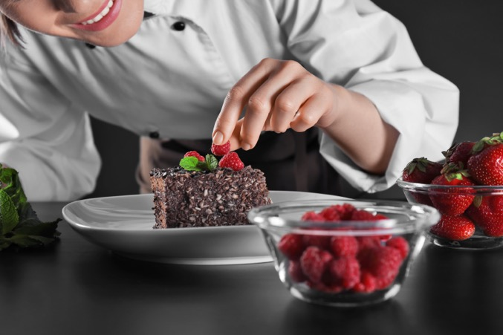
Evaluation
Performing a sensory evaluation
Every dessert is made up of an ideal combination of elements related to our senses:
Appearance
Taste
Aroma
Texture
Consistency
A quality dish should appeal to all our senses.

Slide 4
Quality checks
Correct temperature
Does it need to meet the legal temperature requirement?
Is it too hot or too cold?
Has the dessert been reheated?
Timing
Has the dessert been cooked/chilled for the required time according to the recipe?
What affect would it have, if the dessert if it wasn’t served immediately?
How long can I hold the dessert before serving to a guest?
Texture
Is it over cooked? Is it under cooked?
Does the outside need to be crispy?
Is the inside of the product moist?
Is it evenly cooked throughout?

Slide 5
Quality checks
Evaporation/liquid levels
Has there been any evaporation of liquid during the preparation and cooking of the dessert?
Are additional sauces required?
Moisture
Is the dessert still moist?
Is the dessert too moist?
Will the moisture effect any other part of the dessert?
Aroma
Does the dessert smell good?
Are there any unfamiliar or bad aromas?
Is there any overpowering aromas?

Slide 6
Quality checks
Colour
Is the dish correctly coloured to meet the requirements of the dish?
Does it have too much or too little colour?
Does it need cooking for longer to achieve the desired finished colour?
Is it evenly coloured?
Consistency
Is the dish at the correct consistency?
Are any sauces too thick or too thin?
Is there consistency over time between the same dishes served to other guests?
Portion size
Does the size reflect the dish/recipe/menu/course?
Is the portion size suitable for any accompaniments?

Slide 7
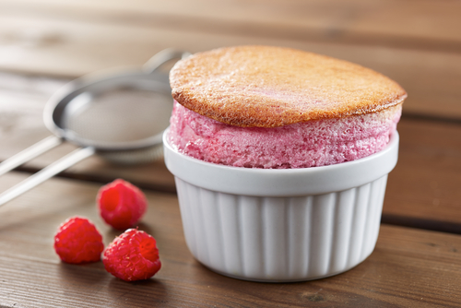
Quality checks
Presentation
Does it look appealing to the guest?
Is it correctly garnished?
Does it follow the establishment service guidelines?
Is it served with the correct sauce or accompaniment?
Is it served on the correct service equipment?
Correct degree of cooking
Is the dessert correctly cooked?
Is the dessert correctly chilled?
Is the dessert correctly set?
Taste
Is it correctly flavoured?
Does it taste like it is supposed to?
Are there any overpowering flavours?
Does the flavouring need any adjustment?

Slide 8
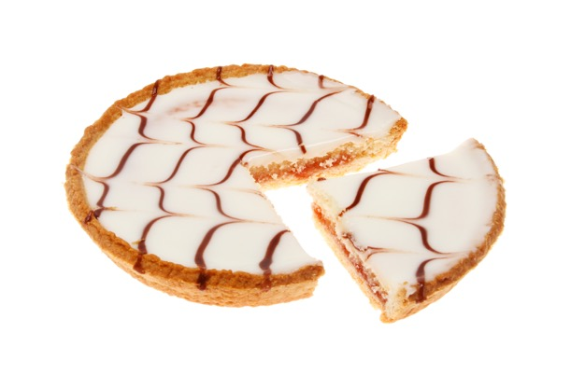
Fault reporting
Throughout all stages of preparation, cooking and finishing, if you find a problem with the ingredients, equipment or the dessert you must report it to your supervisor immediately.
You must know the correct procedures how to deal with it in a safe and efficient manner.
Failing to recognise faults may lead to the dessert being inedible or the guest complaining. This can have a financial impact to the business.

Slide 9
Any questions?

