Slide 1
Prepare a range of advanced dough items using correct preparation methods
PowerPoint presentation
Unit 309: Produce and present advanced desserts and dough products using standardised recipes

Slide 2
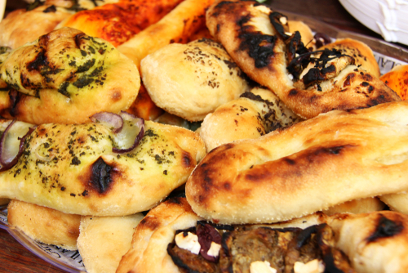
Introduction
Breads and other types of dough items are made and consumed all around the world, in different forms.
Yeast products come in many types, can be sweet or savoury and can be eaten as part of a meal at any time of the day.
The preparation and production of dough items are the basic skills required by all bakers, pastry chefs and chefs.
Understanding the principles of production and key steps in the preparation will ensure that you can produce successful products and avoid costly mistakes.

Slide 3
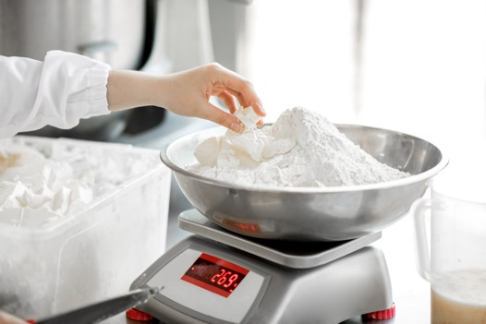
Preparation methods
Weighing/measuring – the weighing and measuring of commodities used in fermented doughs is essential if a quality product is to be achieved. Wholemeal flours will absorb more water than other flours. The temperature of the liquids is also key as too cold and the yeast may not activate, too hot and it may kill the yeast.
Kneading – is the term used when mixing the ingredients together. This technique is used to develop the formation of gluten which provides the bread with its strength and structure, trapping the gasses created from the fermentation to allow the dough to rise.

Slide 4
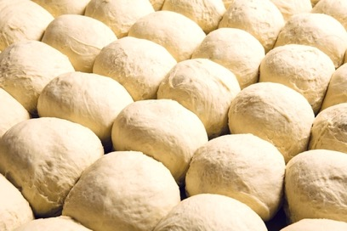
Preparation methods
Proving – once the dough has been kneaded it must be left to rise to at least double in size. It is the second rising of the dough. The proving process allows the dough to rest and for the fermentation process to occur again. It is essential not to over or under prove the dough as this will affect the final product.
Proofing should occur in an area that is free of drafts and is of a constant temperature. If the temperature of the proofing area is below 24ºC (75ºF), the dough can be placed on top of a preheated oven. There is nothing wrong about proofing the dough in a cool area - it will just take more time. Always cover the dough with a clean kitchen towel or oiled plastic wrap during the proofing period.

Slide 5
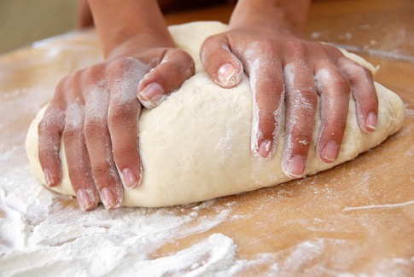
Preparation methods
Developing – for many bread recipes the final rising is often the second rising, while other breads may require two or more cycles of rising, punching, and kneading before being shaped and allowed to rise for the final time. This final rising period, known as proofing, is faster (usually about half the time of the initial rising period) due to the abundance of yeast cells that are present in the dough from the previous fermentation period.
Knocking back – the dough is then knocked back, this produces a smoother dough and allows for easier handling and shaping to form the finished product.

Slide 6
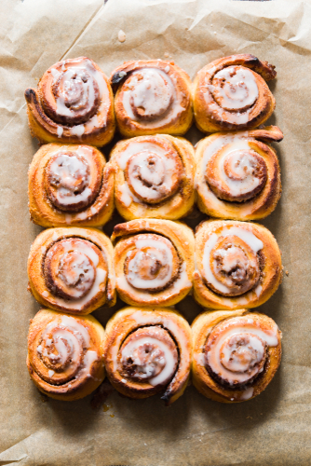
Preparation methods
Rolling – After the dough has been punched down, kneaded, and then has rested briefly, it is ready to be shaped. This can be done in a variety of ways but items such a croissants, Chelsea buns, pain au chocolate the dough will need to be rolled before shaping and filling. A wooden rolling pin, which is used to prepare dough for baking, that does not have handles. When shaping the dough, it is important to handle it carefully and not overwork the dough. Shape and work the dough on a floured surface and after shaping, allow it to rise a final time.
Filling – filled dough items may include Danish pasties. A large, flat dough mixture which is often filled with fruit, preserves, nuts, or cheese and is a popular breakfast item.

Slide 7
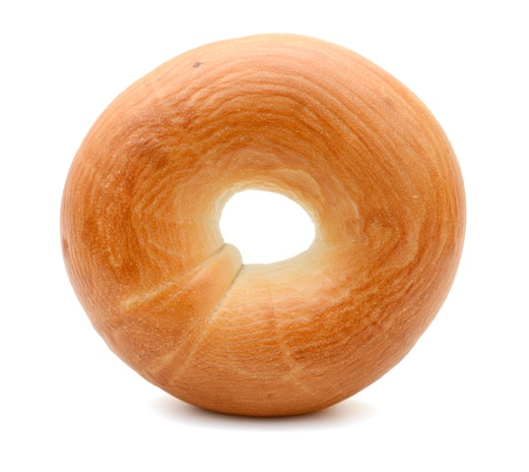
Preparation methods
Dividing – refers to the portion sizes required of the finished dough item. This is best seen when dividing dinner rolls from a bread dough before proving and baking. Commercially this is seen when making bread loaves and the bulk mix is divvied between the bread tins
Shaping – the shaping of the dough is achieved through physical means, shaping a bread roll or naan bread, or by the use of mould's such as bread tins or savarin rings, or using cutters to make a bagel. The dough is shaped ready for baking and is then rested.

Slide 8
Preparation methods
Dusting – this is the technique of dusting a surface to prevent the dough sticking during the kneading process, it is also used as a decorative technique just before dough is baked, where a bread loaf is dusted with flour.
Scoring – scoring a dough before proving breaks the “skin” that will form as it proves allowing for further expansion. It is also aesthetically pleasing for the finish of the end product. This method is used in artisan cooking especially soda breads.
Lining – bread tins can be lined with a silicone oil spray or using a traditional fat/oil and flour technique, where oil/fat is brushed inside the tins and then flour is put in the tin and then banged out, leaving a fine lining of flour which helps the dough item not to stick during the cooking process.

Slide 9
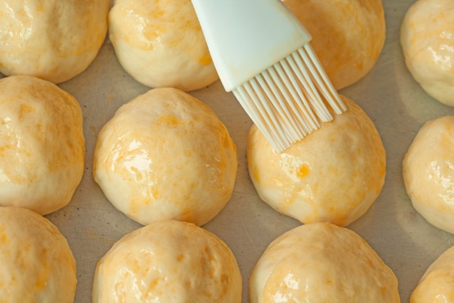
Preparation methods
Glazing – glazing of doughs items is done to enhance the finish of the final product. There are several ingredients used in glazing a dough.
Milk and salt water – this will darken the final products crust
Butter or other oils – this will change the flavour of the bread slightly and also provide a golden crust , a good example of this is an olive bread
Egg washing/egg glaze – using egg glazes will provide a glossy finish to the product. This glaze is also used when binding other commodities to the bread such as oats and seeds, as in a cholla bread.

Slide 10
Any questions?

