Slide 1
Next Steps
Safety Standards Service
V1.1

Slide 2
Next Steps
Ensure you have:
Received your Award in MOT Testing certificate.
Prepared for your Demonstration Test.
All required documentation for eligibility checks.
Request Demonstration Test
Safety Standards Service

Slide 3
Request Demonstration Test
Having ensured:
You are ready to carry out a
demo test in front of a DVSA Vehicle Examiner
You know the
VTS Site No. / Training Centre Site No.
of where your demo test will be carried out.
Log into the MOT Testing Service
Safety Standards Service

Slide 4
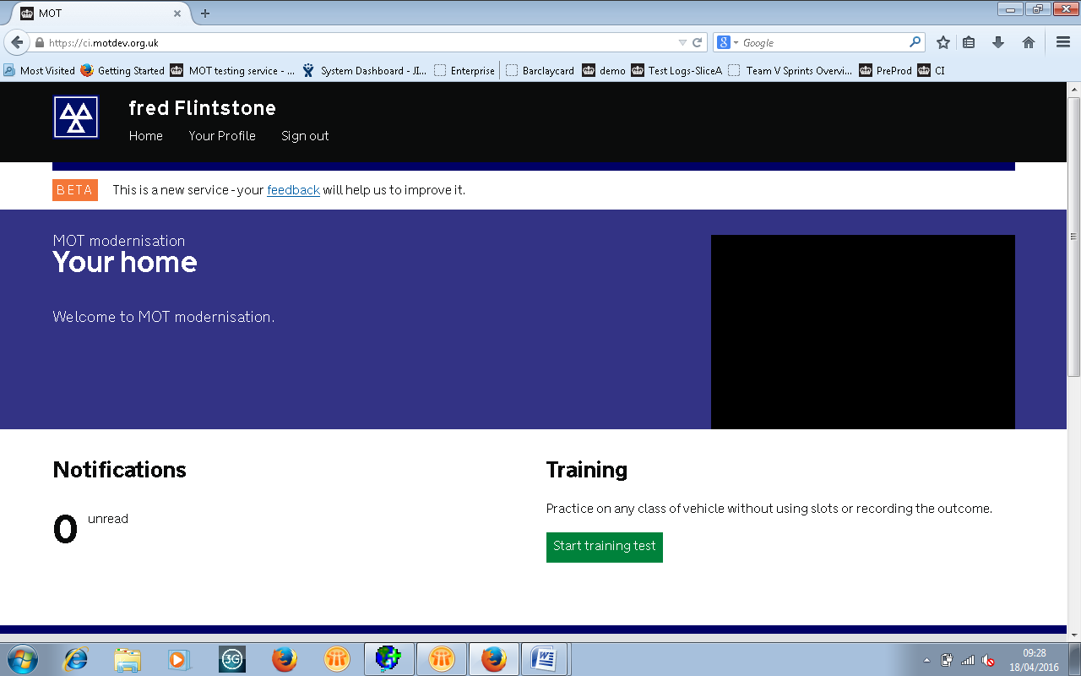
MOT Testing Service
Select ‘Your Profile’
Safety Standards Service
Notes:
Having logged in, from their home screen, user selects ‘Your Profile’

Slide 5
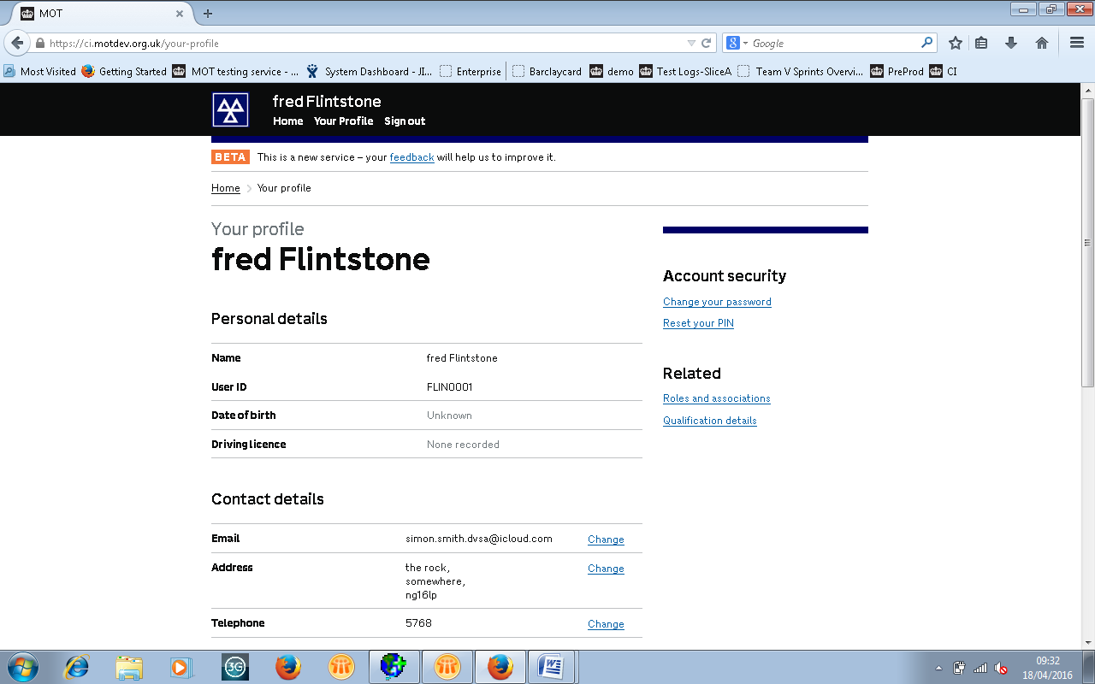
MOT Testing Service
Select ‘Qualification Details’
Safety Standards Service
Notes:
From their profile page, select ‘Qualification details’ **Please Emphasise that the “Add Certificate” function is a request for a Demo Test**

Slide 6
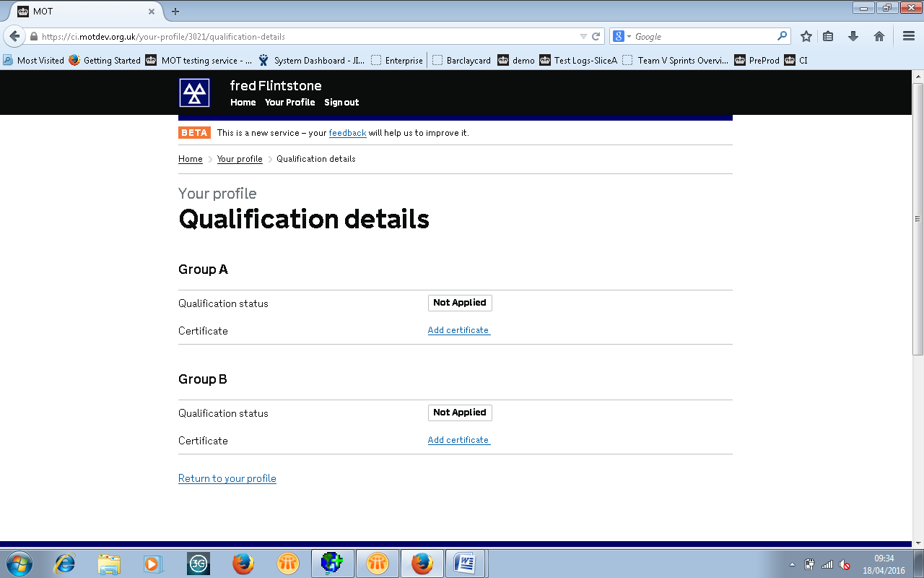
MOT Testing Service
Select ‘Add Certificate’ for each relevant group
Safety Standards Service
Notes:
Both groups are shown as Not Applied, user selects ‘Add certificate’ for the relevant group

Slide 7
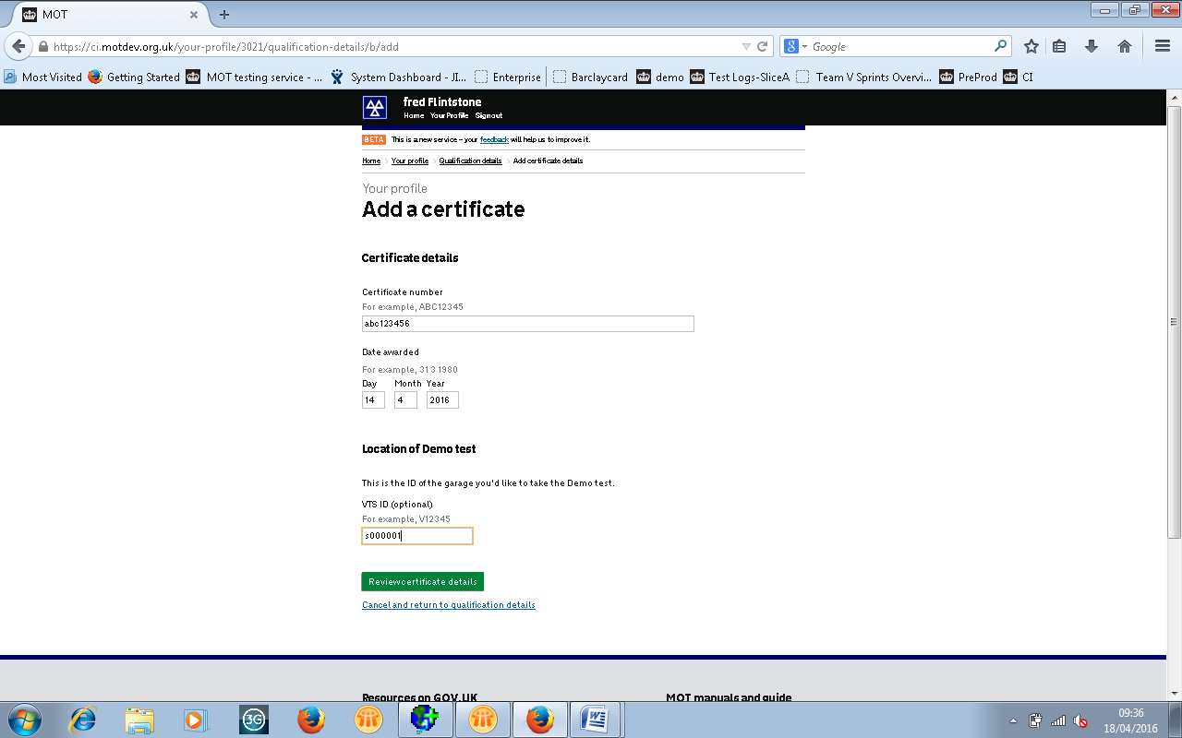
MOT Testing Service
Add certificate no. and date awarded
Add VTS site no. or training centre site no.
Finally select ‘Review’
Safety Standards Service
Notes:
User adds certificate number and date awarded. Location of Demo test is optional, MTS will look up to validate against a site, user then selects ‘Review certificate details’

Slide 8
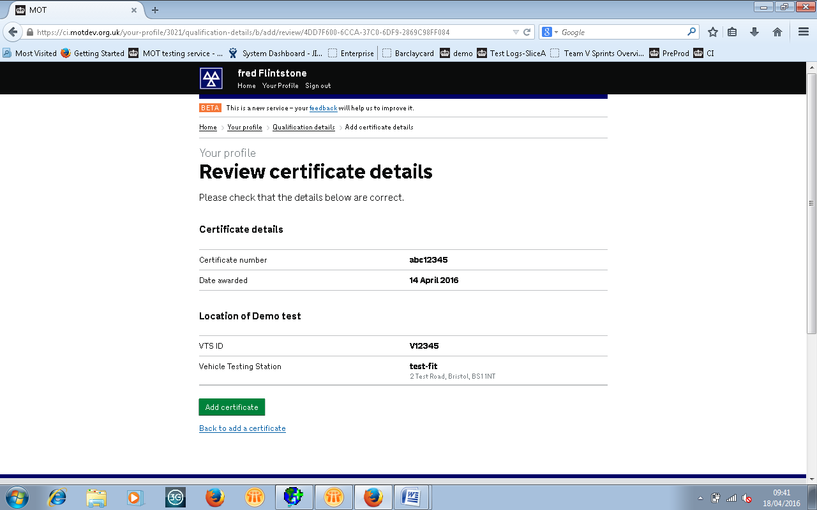
MOT Testing Service
Details correct select
‘Add Certificate’
Details incorrect select ‘Back to Add Certificate’
Safety Standards Service
Notes:
User is taken to confirmation screen, to ‘Add certificate’ or if details are incorrect, they can return back

Slide 9
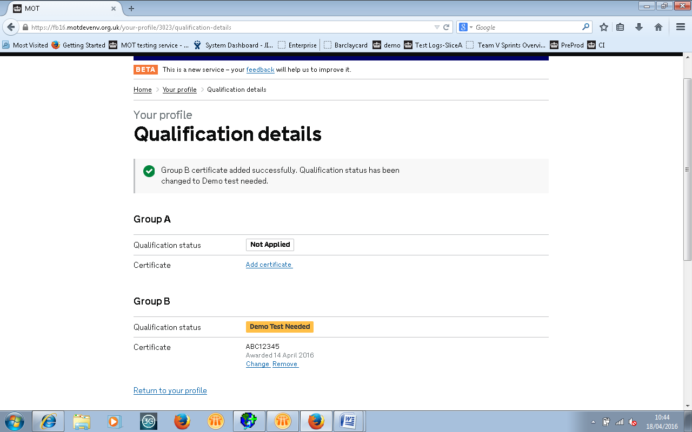
MOT Testing Service
Status automatically changed to Demo Test Needed
Option to ‘change’ or ‘remove’ the certificate details
Safety Standards Service
Notes:
After ‘Adding certificate’ the user is taken to a confirmation page, the status of the group added automatically changes to ‘Demo Test Needed’
The user has the options to ‘Change or Remove’ the certificate.
If the user removes the certificate the group status returns to ‘Not Applied’

Slide 10
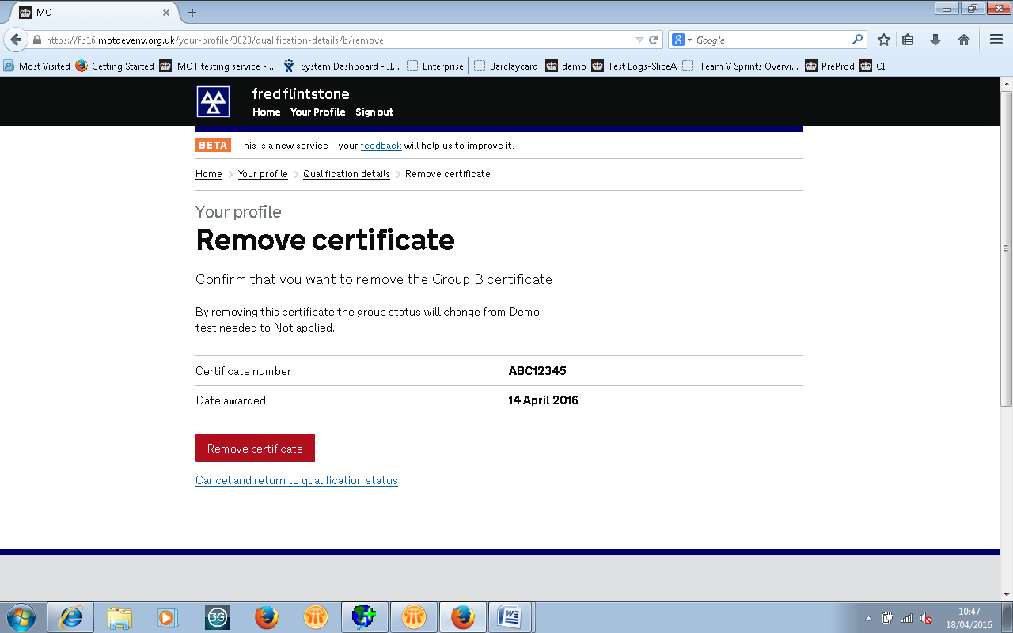
MOT Testing Service
Removal of a certificate will return your status to ‘Not Applied’
Safety Standards Service
Notes:
If the user removes the certificate the group status returns to ‘Not Applied’

Slide 11
What happens next?
A Vehicle Examiner will contact you to arrange
a visit ,and during the visit they will:
check your eligibility documentation
ask you to register the test (in training mode)
observe you doing a demonstration test (ATL /OPTL approved in MANUAL mode)
ask you to enter the results and complete the documentation using the MOT Testing Service
Safety Standards Service
Notes:
Having added a certificate, a Vehicle Examiner will make contact to arrange a suitable time for both parties to facilitate the demonstration test.

