Slide 1
Using the MOT Testing Service

Slide 2
TQI
Test Quality Information is provided to assist in the quality management process at a VTS.
It is intended to be a starting point when monitoring the standard of testing.
As a tester if your rates are different to the site or national average it doesn’t necessarily mean that anything is wrong with the standard of your testing but you may wish to reaffirm this by reviewing the appropriate sections of the relevant testers manual.
Notes:
Understanding test quality information (TQI).
Test quality information is provided to assist in the quality management process at a VTS.
It is intended to be a starting point when monitoring the standard of testing.
If your rate is higher or lower to than the site or national average it doesn’t automatically mean that anything is wrong with the standard of testing at that site but changes within a site, between tester examining vehicles of the same customer base or trends should be monitored.

Slide 3
TQI
Dependant on a user’s specific roles TQI can be accessed via the AE service reports screen or the VTS details screen.
TQI is displayed by test Groups
Group A covers classes 1 & 2
Group B covers classes 3 4 5 & 7
The group(s) displayed is dependent on what class(es) the VTS is authorised to test.
The initial view of TQI at a site level displays headline figures for the last completed month, the user has the option select to view the last 3 completed months of information.
Notes:
At VTS level
Dependant on a user’s specific roles TQI can be accessed via the AE service reports screen or the VTS details screen.
TQI is displayed by test Groups
Group A covers classes 1 & 2
Group B covers classes 3 4 5 & 7
The group(s) displayed is dependent on what class(es) the VTS is authorised to test.
The initial view of TQI at a site level displays headline figures for the last completed month, the user has the option select to view the last 3 completed months of information.
The figures show
Total number of tests
Average vehicle age
Average test time
% of tests failed
The screen also displays this information for each tester associated with the site within the relevant time period.
To calculate the number of tests that have failed - divide the number of tests done by the % failure rate
e.g. 150 tests done divided by 20% failure rate = 30 tests failed
Test failures by component category for individual testers can be shown by clicking the view link at the end of their overview figures. This screen also shows the site and national averages for the specific component categories (work to display the site averages is still in development).
The component fail rate is calculated by taking by the number of tests that failed for one or more defects within a specific component category and then dividing this by the number of failed tests then multiplying by 100.
e.g. 6 out of a total of 30 failed tests failed for at least one lighting defect
6 / 30 x100 = 20%
A CSV file can be downloaded from the site overview screen (separate CSV available for each test group – this is still in development).
The CSV contains both the site overview figures and the component breakdown details for all testers as well as the site and national average figures (work to display site averages is still in development).

Slide 4
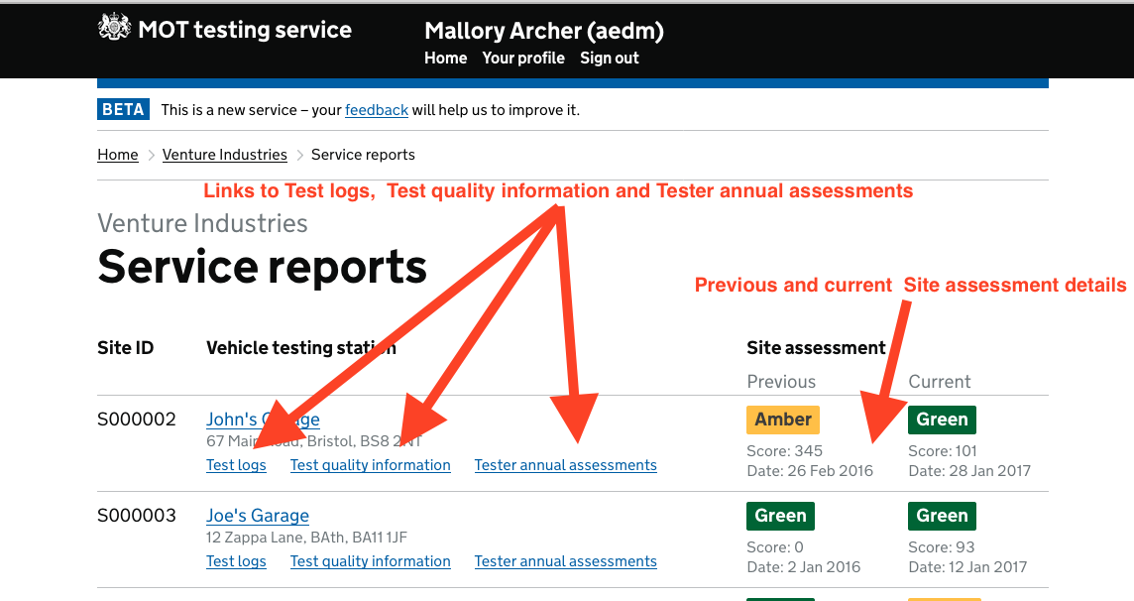
AE Service reports screen
Notes:
AE Service reports screen (previously named Test Quality Information)
The Test quality information link on the Authorised examiner (AE) screen has been replaced with a link to Service reports, this screen displays Vehicle testing stations that are associated to the AE with links to
Test logs
Test quality information
Tester annual assessments
along with details of the current and previous Site assessments.
This provides AE’s (AEDM) with access to management information for each of their VTS’s. This view would not be available to Site managers or testers
The following screen give information on how to access and use this information

Slide 5
Notes:
The AE would be able to access individual test site and from there access Test Logs, Test Quality information and Testers annual assessments. AEs can also access other VTSs that he is AE for. Similar levels of access would be available to those with the role of AED.
Testers would not be able to access this page.

Slide 6
Site assessments
Notes:
Site assessments
The Vehicle testing station screen now shows more information about Site assessments
The information box at the top right of the screen now includes the date of the last site assessment.
A new section has been added to the screen showing details of the current and the previous assessments
This will assist AE’s and Site managers as they will see the difference between the assessment results and will be able to plan their quality management processes accordingly.

Slide 7
TQI

Slide 8
Notes:
Select test quality information/service reports
Testers would only be able to view the TQI at the site or sites where they are active testers.

Slide 9
Notes:
You can view the test quality information over the previous month or previous 3 months for each tester as you consider appropriate.
It defaults to the Last Month view
In this example I will look at Sylvie Humberto

Slide 10
Notes:
The AE/AEDM and tester can compare averages against the site and the national average.
This can provide a useful starting point for discussion, for example are there any trends? One tester fails more vehicles for tyres than another, it may mean that the tester is appyling a slightly different standards or it may just mean that one tester is getting more vehicles to test with defective tyres than the other.
The TQI gives the opportunity to review the tests. You can expect differences with the national average, but at the same site with the same customer/vehicle profile you may not expect big differences in fail rates.

Slide 11
Notes:
You can then select 3 months, and update, to review the TQI over this period

Slide 12
Notes:
I can then check the TQI for the site over the previous 3 months and then return to the testing station view.

Slide 14
TQI
Notes:
This is an example of TQI from a different site
In this example of the service report you compare the testers results over the month with the national average.
As there is more than one tester at the site you can compare the testers with each other and the site average
A tester who is working at more than one site can access the information from all sites (separate access for classes 1&2 from 3,4,5 & 7)
A site manager (AE.AEDM) would be able to access information on individuals by clicking on view

Slide 15
TQI
Notes:
This tester has not carried out any tests this month. The question that the AE, AEDM and site manager may ask is why? Is it leave, sick absence or involved with other duties? What the management of this site might want to consider is that if this is a prolonged absence will there be a need for training or quality assurance before he/she would be allowed to resume MOT testing.

Slide 16
TQI
Notes:
In this example we a comparing the testers over a 3 month period which gives a more reflective insight to the operation of the VTS, A tester may not have done many tests over a month due to absence etc
We can still compare performances to the national average, site average and individuals by opening each view.
A another option is to download the report as a CSV spreadsheet

Slide 17
TQI
Notes:
This 3 month view of another tester shows that 190 tests were carried out in a 3 month period. 24% of the vehicle tested failed, that equates to 46 vehicle failing the MOT test. Of that figure of 46 vehicles 46.7% failed for Lamps, Reflectors and Electrical Equipment. That equates to 21 vehicles failing for Lamps, Reflectors and Electrical Equipment.
To satisfy the AE that the correct standards have been applied he/she may ask the tester questions about vehicle suspension as this is the tester’s highest fail section. It is also higher than the site average.
It should be noted that just because a particular section shows a higher or lower fail rate than the national average that does not necessary mean that an incorrect standard has been applied. Dealerships may have a different fail rate to independents because of the nature of the vehicles that they encounter, city garages may have a different fail rate to rural garages because of the type of use etc.
So reviewing the TQI can assist the AE in the early identification of areas that may be of concern or conversely to reassure the AE that correct standards are being applied.
This tester would probably need further checks by the Site management to satisfy them that correct standards are being applied.

Slide 18
TQI
CSV
Files 1 month
Click Above
Notes:
The 1 month view allows a snapshot view of the testing carried out at a site, it allows comparisons of the volumes being tested at the site as well as fail rates. Some site may download these spreadsheets for a year on comparison of test volumes etc.
The only disadvantage is that a month view may not be an accurate reflection of the testing carried out by individual testers. (leave and other absentee's etc).
Downloading the information as a CSV file makes it easier to compare differences between testers (and site and national averages)

Slide 19
TQI
CSV
Files 3 months
Click Above
Notes:
The 3 month view would present a more reflective vision of what is carried out at the site.

Slide 20
Test Logs

Slide 21
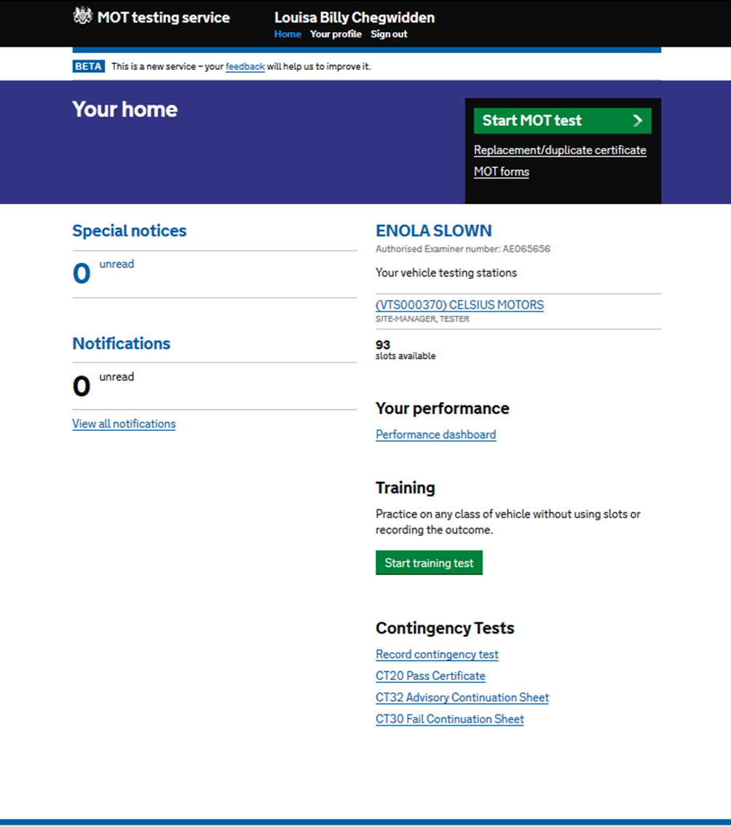
Notes:
This is the home page for L B Chegwidden, You arrive at this page after logging in with your user id, password and entering the number from your security card.
Select your profile

Slide 22
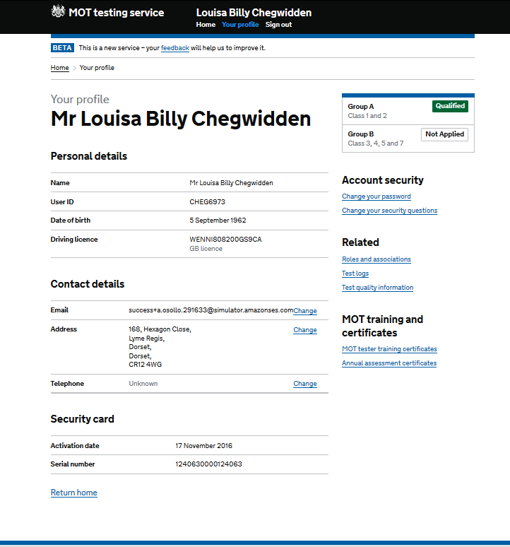
Notes:
Select roles and associations

Slide 23
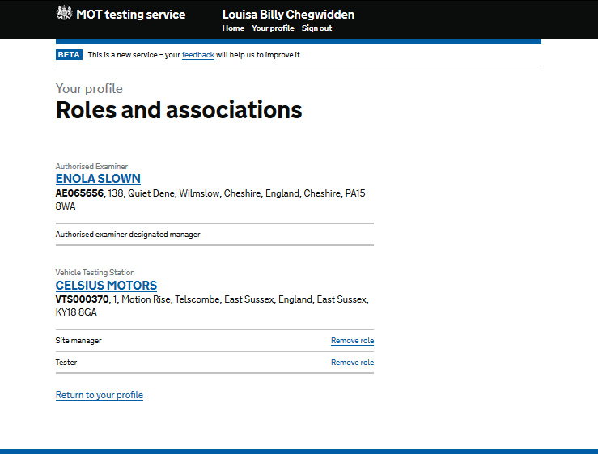
Notes:
We can see that the role of AE and tester is held. Go into Celsius Motors. As she has the role of AE (AEDM), she would be able to open all sites under this authorisation and examine the service reports, test logs etc. Someone with the role of site manager at one of the sites would not have this same level of access across all sites within that authorisation and would only be able to view the information for the site that they have the role of site manager.
A tester would be able to access the test quality information only at the sites that they test at. Similarly, he would only be able to compare their results against others at that site. There are separate reports for group A and group B vehicles.

Slide 24
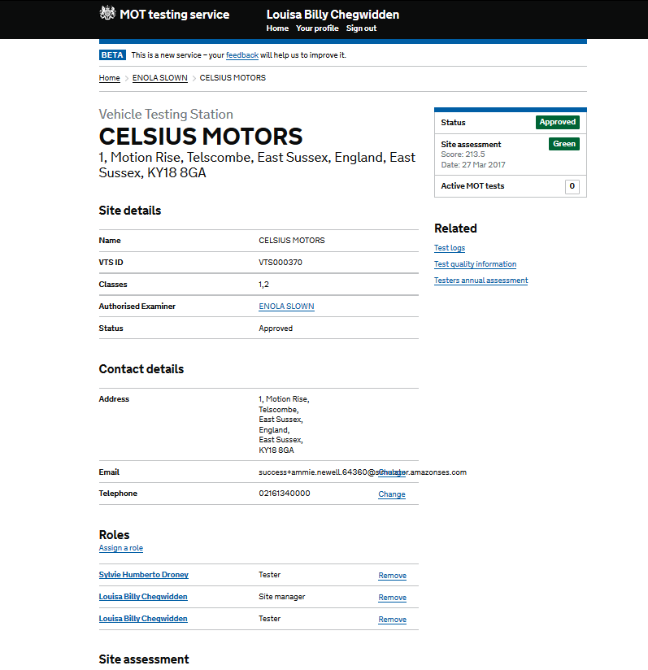
Notes:
Scroll down; An AE/AEDM can use this page to check all the details are correct and that any testers who have left this site are removed.

Slide 25
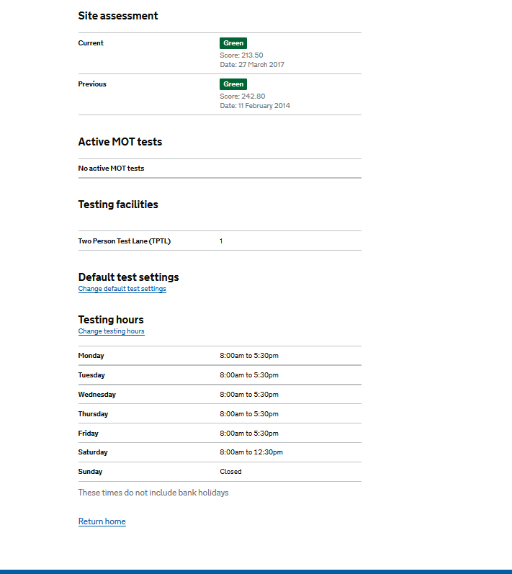
Notes:
The AE/AEDM can check the results of the most recent, and previous site assessments, and if there are any active tests.

Slide 26
Notes:
Select Download test logs

Slide 27
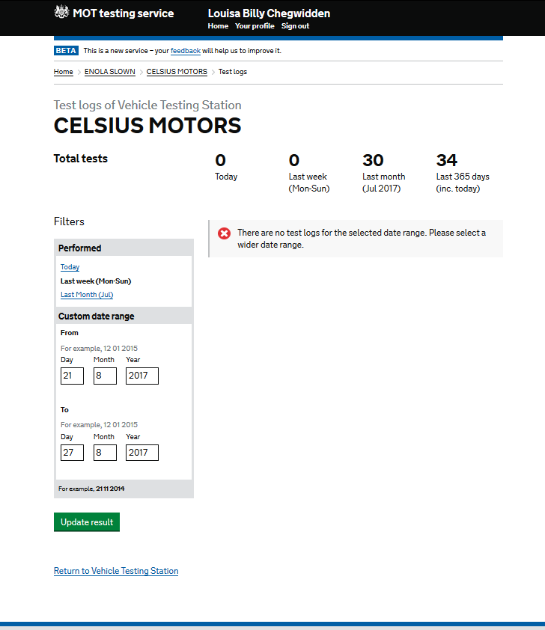
Notes:
Then select last month, and view all the pages. Scroll down then Select Download test logs as a CSV (Spreadsheet) file

Slide 28
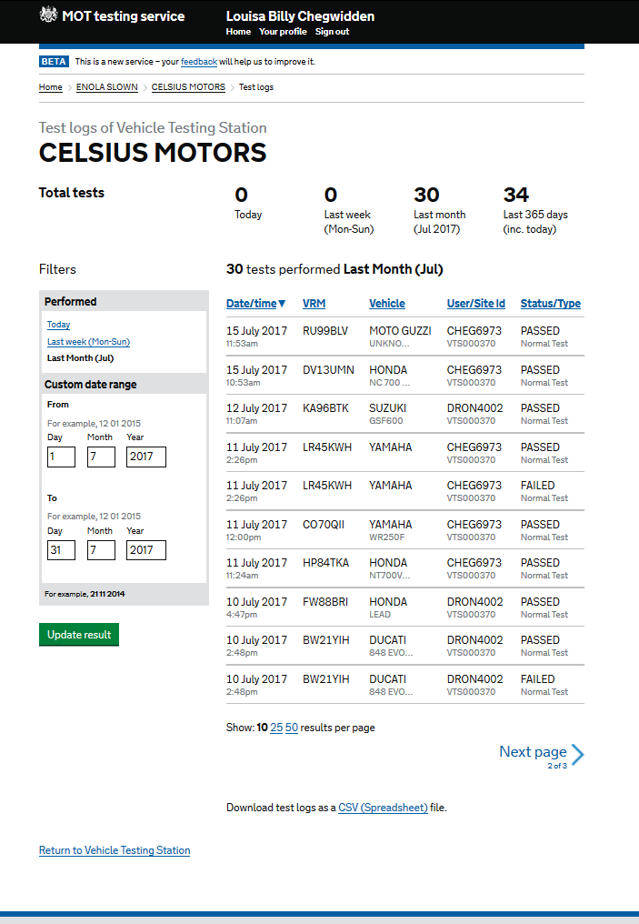
Notes:
Scroll down, some users may find it easier to view the tests carried out on a daily basis from here.

Slide 29
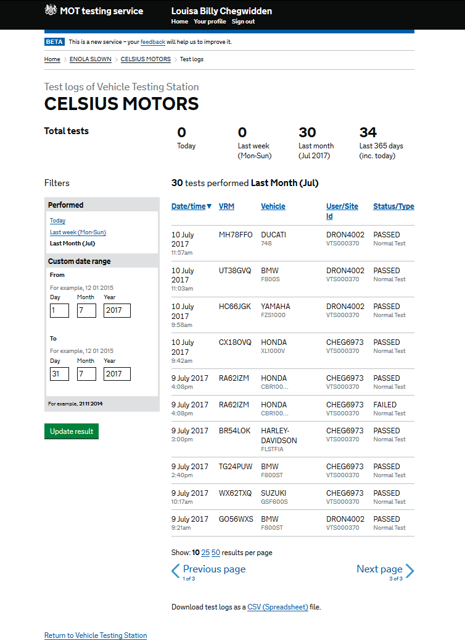
Notes:
Scrolling down

Slide 30
Notes:
Scroll down. Then Select Download test logs as a CSV (Spreadsheet) file.

Slide 31
Test Log Spreadsheets
CSV
Click Above
Notes:
Understanding test logs (CSV)
When viewing test logs on screen the user can view logs for the current day, last week (Monday to Sunday – this is the default view), last month or for a custom date period (maximum 31 days).
The on screen display of site test logs gives basic information
Date / time of test
VRM
Vehicle make and model
User / site ID
Test status / type
Users can also download a CSV file that includes the following further information
IP address
Test number
VIN
Test class
Test duration
Contingency code
Contingency test reason
Date / time of recording contingency test
User ID of tester who recorded contingency test
When viewing the CSV users should consider the following points
Date / time of test – are tests carried out within declared test times, if not is there a legitimate reason why.
Check appointment recording facility at site . How do you deal with vehicles without a current MOT?
Vehicle make and model – check these match test appointment record, if not why?
User ID – are the majority of tests carried out by a minority of the testers? Consider this when planning quality control activities.
Test status / type –is there a high number of aborted tests, if so why?
IP address – is the IP address the same for all tests on the same date (if the site IP address is not fixed it may change from date to day)
Test duration – are there any normal tests that have been completed very quickly (the pass test of a PRS test shows as one second on the test log) or have taken an excessive amount of time.
Date / time of recording a contingency test – how long did it take after the contingency period to record the test? A delay in entering test results can prevent users from taxing vehicle online and there vehicle could appear as being out of test during Police enquiries.
User ID of tester recording contingency test – if a different tester recorded the contingency test why was this? Also a quality check should be carried out to ensure tests details were correctly recorded.
To assist with the viewing of the information a filter can be placed on spreadsheet (may be dependent on what application is used to view the CSV).

Slide 32
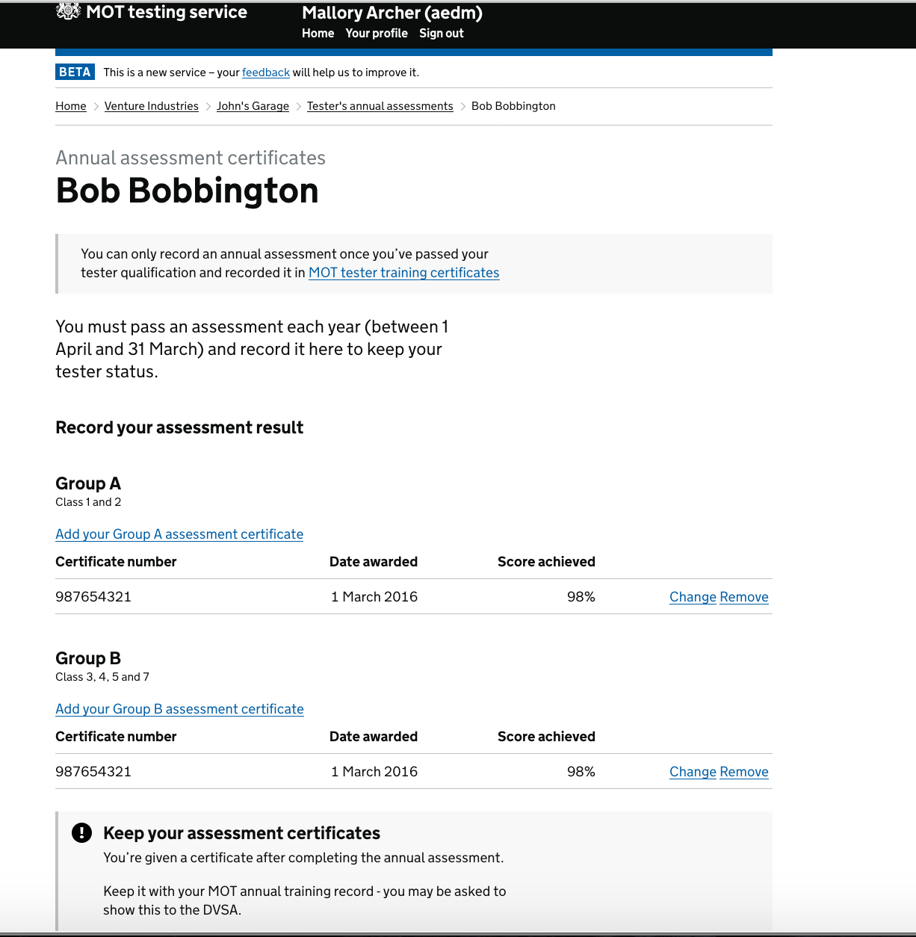
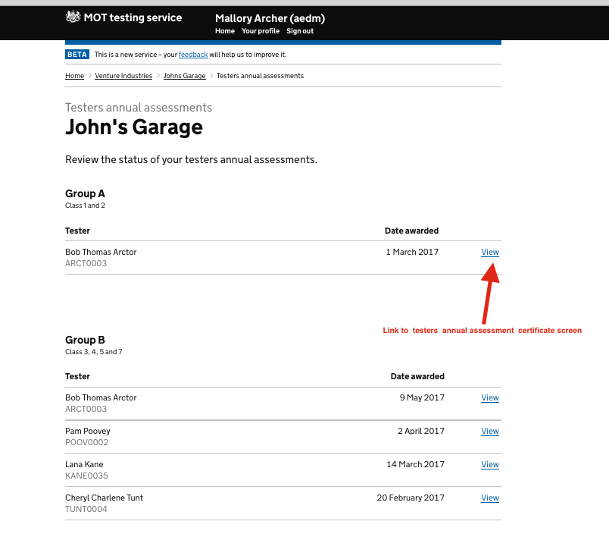
Annual Assessment
Notes:
Testers Annual Assessment Screen
After listening to feedback requesting access to information about annual assessments a new Testers annual assessments screen has been created. This screen lists the testers at a VTS along with the date of their last assessment, there is also a link to view full details of the Tester’s annual assessment.
The screen is accessed via a Testers annual assessments link on the Vehicle testing station screen.
Tester can access this page via their profile page but this allows AE & AEDM to check the results of annual assessments and that the data has been entered correctly (correct Group etc).

Slide 33
EU Directive
The EU directive come into force on the 20th May 2018
To allow the transition of test standards the will be a slight interruption to the Total Quality Information available
The TQI will only allow a view of 1 month for May June & July
From the end of August the full service will be resumed allowing 1 month and 3 month views
Notes:
FYI
The EU directive will have a slight impact on the availability of TQI in a 3 month format, as there will be a difference in the manual sections.

Slide 34
Any Questions

Slide 35
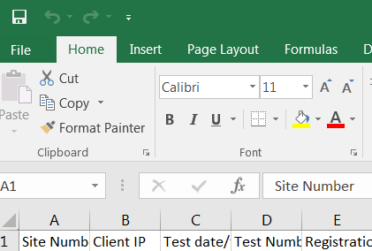
Test Quality Information
Click here
Then double click here to get cell spaces formatted
Notes:
Can be used if appropriate
Understanding test logs (CSV)
When viewing test logs on screen the user can view logs for the current day, last week (Monday to Sunday – this is the default view), last month or for a custom date period (maximum 31 days).
The on screen display of site test logs gives basic information
Date / time of test
VRM
Vehicle make and model
User / site ID
Test status / type
Users can also download a CSV file that includes the following further information
IP address
Test number
VIN
Test class
Test duration
Contingency code
Contingency test reason
Date / time of recording contingency test
User ID of tester who recorded contingency test
When viewing the CSV users should consider the following points
Date / time of test – are tests carried out within declared test times, if not is there a legitimate reason why.
VRM – do all VRM’s match the test appointment records, if not why? check appointment recording facility at site . How do they deal with vehicles without a current MOT?
Vehicle make and model – check these match test appointment record, if not why?
User ID – are the majority of tests carried out by a minority of the testers? Consider this when planning quality assurance activities.
Test status / type –is there a high number of aborted tests, if so why?
IP address – is the IP address the same for all tests on the same date (if the site IP address is not fixed it may change from date to day)
Test duration – are there any normal tests that have been completed very quickly (the pass test of a PRS test shows as one second on the test log) or have taken an excessive amount of time.
Date / time of recording a contingency test – how long did it take after the contingency period to record the test? A delay in entering test results can prevent users from taxing vehicle online and there vehicle could appear as being out of test during Police enquiries.
User ID of tester recording contingency test – if a different tester recorded the contingency test why was this? Also a quality check should be carried out to ensure tests details were correctly recorded.
To assist with the viewing of the information a filter can be placed on spreadsheet (may be dependent on what application is used to view the CSV).

