Slide 1
Transitioning to the new
Commis Chef and Team Member
apprenticeship standard
Wednesday 28 June 2017, 14.30 - 15.15
Jason Benn
Industries Manager, Hospitality, catering, Travel & Tourism

Slide 2
Contents
Overview of the apprenticeship reforms
Planning your transition
Commis chef occupation
Team member occupation
Planning your delivery – points to consider
How we can support you to prepare for delivery and end-point assessment
Next steps
Q & A

Slide 3
Overview of the apprenticeship reforms

Slide 4
Apprenticeship reforms
Apprenticeships are changing.
You are part of that change.
1
Give employers
control in designing apprenticeships
2
Increase the
flexibility of
delivery
3
Simplify
the funding
system
4
Increase the effectiveness
of training

Slide 5
Funding changes
Funding examples for frameworks (comparison of current and new funding)
Framework name and level | Framework pathway name | Current funding based on average between 16-18 and 19+
Professional cookery (L2) | Hospitality and catering | £3167-3909
Food and beverage service (L2) | Hospitality and Catering | £3167-3909
New standards equivalents
Standard name and level | Funding band (all ages) | 16-18 Incentive (£1000 for the employer, £1000 for the provider)
Commis chef Level 2 | Band 9 - £9,000 | £2000
Team Member Level 2 | Band 7 - £5,000 | £2000
N.B. Employers with 50 or less employees pay nothing towards the cost of an apprenticeship for a 16-19 year old learner. The Government pays the full costs of these apprenticeships.

Slide 6
Additional Funding Support For Frameworks
20% on top of the full cost of apprenticeship framework delivered to 16-18 learners
Additional support for apprenticeship framework delivery
20% on top of full cost apprenticeship delivery for learners aged 19-24 with ECHP, or care leavers
Extra funding support for apprentices living in the top 27% most deprived areas in England
N.B. these are interim support arrangements for frameworks. ESFA will look to remove or alter these uplifts at some future point.
Notes:
Providers will receive payments towards the additional cost associated with training 16-18 year old apprentices and those requiring extra support. The amount will be 20% of the full cost of a framework for apprentices:
aged between 16 and 18 years old (or 15 years of age if the apprentice’s 16th birthday
is between the last Friday of June and 31 August).
aged between 19 and 24 years old with either an Education, Health and Care plan
provided by the local authority, or those that have been in the care of the local authority.
undertaking an apprenticeship Framework and recorded on the ILR as having
a postcode listed within the 27% most deprived areas of the country.

Slide 7
Planning your transition

Slide 8
Why planning is so important
Reforms are happening now – you need to plan now.
Our research with customers tells us there is a high level of concern about readiness to deliver new apprenticeship standards and the impact of funding changes from May 2017.
This presentation may reassure you that your plans are well on track, or it may help you identify your action plan to move forward.
We can help you, whatever stage you’re at.

Slide 9
Decisions you need to make
Stay with SASE frameworks?
Funding may not be enough to deliver, and potential for loss in revenue.
Stay with SASE frameworks for now?
Probable short-term financial challenges but time to plan for embedding the new standards.
Move to new standards straight away?
Potential for more funding.
Switch off delivery?
Loss of income until you implement a new plan.
No matter where you are in your planning process we can help. We know your challenges and the questions you need answered.

Slide 10
Understanding apprenticeships
– old and new
Moving from frameworks to standards
Notes:
What are the new standards – what is the difference
What does this mean for qualifications – qualifications are no longer a mandatory requirement in apprenticeships.
An apprenticeship standard is a minimum of 1 year
Structure to on programme training covering on and off the job elements is required – this could be qualifications or evidence of robust internal training
How will you know your apprenticeship programme is robust and fit for purpose?
Many of the new standards don’t require qualifications as part of the on programme learning. Employers will have a much stronger say in what their programme will consist of and how they will monitor the progression of their apprentices
Job role specific
Not only does the training need to meet the needs of the job role but include all aspects of the apprenticeship – behaviours, skills, knowledge, maths & English
The on programme element will need to be evidenced to meet Ofsted and SFA requirements

Slide 11
Maths and English
Funding is available for apprentices who have not previously attained a GCSE grade A*- C,
and will support;
GCSE English Language or Maths
Functional Skills English or Maths
In exceptional circumstances SFA will fund approved stepping stone qualifications
to support progression to GCSE or Functional Skills
Maths and English are funded directly to the provider, not out of the employer levy
Level 2 standards learners must achieve a level1 qualification and the have training towards a level 2.
Level 3 standards learners must achieve a level 2.

Slide 12


Simple steps to plan
Whether you’re an employer or an employer-provider, follow out step-by-step guide to developing your apprenticeship programme.
Employers guide
Providers guide

Slide 13
Commis Chef & Team Member standards
The standard was developed by these employers:
Edward Gallier, head of learning and development, Amaris
Johanna Keith, apprenticeship manager, Azzurri Group
Melanie Hayes, resourcing and development director, Compass
David Hoyle, people director, Fuller, Smith and Turner
Serena von der Heyde, business partner, Georgian House Hotel
Graham Briggs, apprenticeship manager, Greene King
Alison Knight, senior manager, talent and leadership development, Hilton Worldwide
Aideen Whelehan, human resource manager, Lancaster London
Mary Payne, apprenticeship programme manager, McDonald’s
Jan Smallbone, director of learning & talent development, Mitchell and Butlers
Maggie Pavlou, HR director, Parkdean Resorts
Brian Turner, president, representing the chefs of the Royal Academy Culinary Arts
Julie Barker, director of accommodation and hospitality University of Brighton
Malcolm Redmond, education manager, Whitbread
Tracy Read, HR director, Young’s
The standards and assessment plan are online:
http://www.people1st.co.uk/apprenticeships/standards-assessment-plans/hospitality-apprenticeship-standards/
Notes:
These are the notes from the Customer Service Practitioner standard – you can use it to set your own
Employers set up working groups and the level 2 standard (Customer Service Practitioner) was developed by the above group of employers. At a later stage the Awarding Organisations were brought in to give assistance with for example the mapping and assessment plans. Awarding Organisations were brought in at an earlier stage with the level 3 but overall the two standards were essentially developed and driven by the employers. As you can see there is a diverse group of employers and the standards were developed to cover the wide range of industries they are from. Here you have a group of employers covering eg retail, property and call centres and the standard was written to ensure the framework could be delivered in these areas.. The standards and assessment plan can be obtained from the website noted and other standards can be obtained from www.gov.uk

Slide 14
Developing skills, knowledge and behaviors to prepare apprentices for EPA
Assessment is required during on programme student’s needs, tracking progress and providing support
The apprentice should meet with the on-programme assessor to record their progress against the standard
A minimum of six meetings at least every two months required to be recorded
The provider will need to build into the delivery plan the milestones against which progress will be reviewed
Once the employer is satisfied that the apprentice has achieved full competence the apprentice can be put forward for the EPA
Once the apprentice is deemed competent the relevant section(s) of the standard should be signed off by the on-programme assessor and employer
Notes:
The maintenance of an on-programme record is important to support the apprentice, on-programme assessor and employer in monitoring the progress of learning and development and to determine when the apprentice has achieved full competence in their job role and is ready for independent end assessment.”

Slide 15

Definition of ‘off the job training’
Defined as;
Off-the-job training is defined as learning which is undertaken outside of the normal day-to-day working environment and leads towards the achievement of the apprenticeship. This can include training that is delivered at the apprentice’s normal place of work but must not be delivered as part of their normal working duties.
Off-the-job training does not include training which takes place outside the apprentice’s paid working hours
The minimum duration of each apprenticeship is based on the apprentice working 30 hours per week or more including any off the job training – if the apprentice works less than 30 hours you must extend the minimum duration pro rata to take this into account ’
(Apprenticeship Funding Rules Version 3 2017/18)
Anything not written into the standard as mandatory cannot be paid for by Government and must be paid for by the employer and cannot be part ‘of off the job training’.

Slide 16

What does NOT constitute ‘off the job training’?
Enrolment
Induction
Diagnostic assessment or prior assessment
English and maths (up to level 2) – this is funded separately
Progress reviews or on programme assessment needed for
an apprenticeship framework or standard
Off the job training ONLY delivered by distance learning
(although you can include on line and other blended learning activity
as part of an apprenticeship)
Training that takes place outside the apprentice’s paid working hours

Slide 17

What ‘off the job training’ could include – list is not exhaustive?
It MUST be directly relevant to the apprenticeship framework or standard
(Apprenticeship Funding Rules Version 3 2017/18)
Teaching of theory - lectures
Simulated exercises
Role play
Some on line learning e.g. webinars/blended learning
Manufacturer training e.g. new equipment or technologies
Practical training
Shadowing
Receiving mentoring
Industry visits/visiting other companies/suppliers
Attendance at competitions
Visiting other employer departments
Learning support provided by you or the employer
Time spent by the apprentice writing assessments/assignments

Slide 18
Evidence Pack – produced by the training provider
A collection of documents and information brought together to form a single point of reference relating to the learning that is taking place. This provides the evidence to prove that the apprentice exists and is eligible for funding, and for the learning to be provided. This must be available to the SFA if required.
The evidence pack must include with other information;
Details of the negotiated cost agreed between the employer and provider.
Details of how the 20% ‘off-the-job’ training, excluding English and maths, will be quantified and delivered.
Details of how English and maths will be delivered.
Details of employment including: the name of the employer and the agreed contracted hours of employment, including paid training and 20% ‘off-the-job’ time, the total planned length of the apprenticeship.
The commitment statement signed and dated by the apprentice, employer and main provider.

Slide 19
Commis chef standard

Slide 20
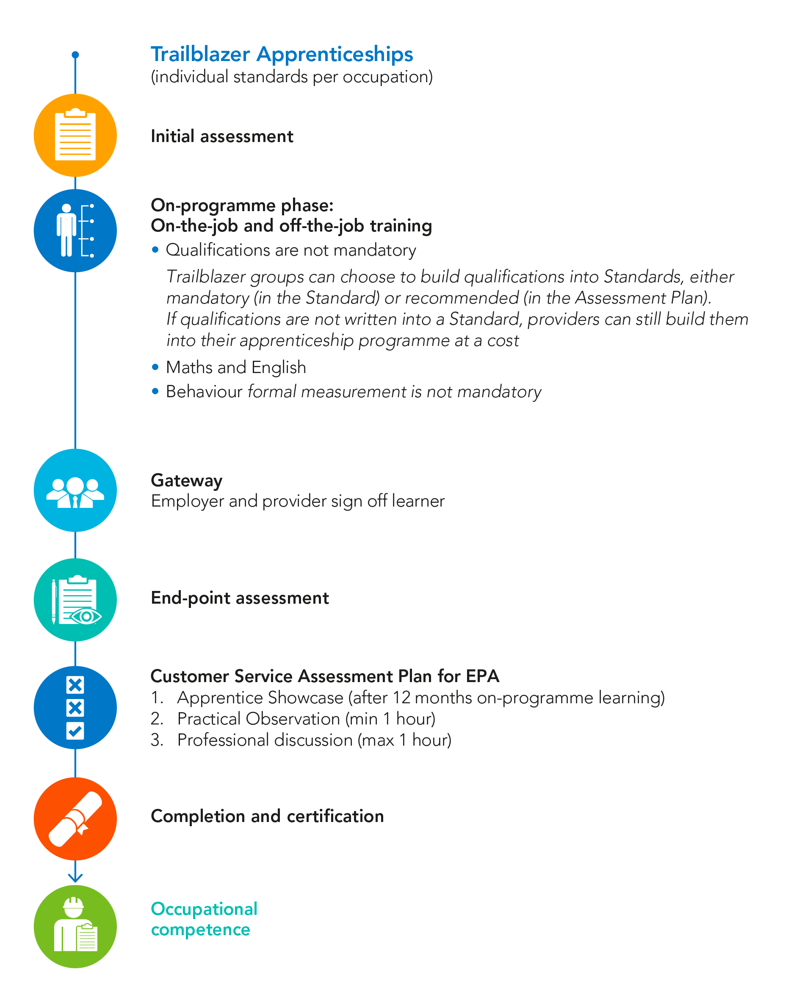
Commis chef occupation standards
Change customer service assessment plan for EPA and
Maths & English Font
Maths and English requirements
Funding is available for apprentices who have not previously attained a GCSE grade A*- C, and will support;
GCSE English Language or Maths
Functional Skills English or Maths
In exceptional circumstances SFA will fund approved stepping stone qualifications to support progression to GCSE or Functional Skills
Maths and English are funded directly to the provider, not out of the employer levy
Level 2 standards learners must achieve a level1 qualification and the have training towards a level 2.
Gateway requirements
Notes:
THESE ARE THE NOTES FROM THE CUSTOMER SERVICE WEBINAR. USE THEM AS A BASIS FOR YOUR OWN SESSION.
Go through this from the Initial Assessment onwards. Use the following as a prompt:
The period of learning, development and continuous assessment is managed by the employer, in most cases with the support of a training provider. The on-programme pace will be driven by
individuals as well as by the breadth of experience an employer can offer prior to the minimum of 12 months after which end-point assessment will take place.
Employers should work closely with any training provider to plan and deliver support and training appropriately. This working closely will add value to the employer as it centres on real work
competencies demonstrated in a real work environment.
To drive quality and consistency through on-programme learning employers may wish to consider the following:
+ Use of their normal performance management processes to monitor the progress of the apprentice, provide feedback and guide development.
+ Training providers may support ensuring the requirements of the apprenticeship standard are reflected in the above processes, and by filling any gaps through their work with apprentices.
+ Employers and training providers could carry out joint reviews of progress at regular intervals, involving apprentices, line managers and others with a direct relationship, e.g. mentors, workplace coaches, etc. They should agree how any issues are to be resolved together.
+ Apprentices may develop and maintain examples of their work throughout their apprenticeship that cover the full standard. This could be in the form of a portfolio or other tracking method to be reviewed on-programme at intervals agreed by the employer and training provider, for example at 3, 6 and 9 months.
The end-point assessment is synoptic and takes place at the end of the apprentice’s learning and development, after a minimum of 12 month’s on programme learning.
The employer, and, if appropriate in conjunction with the Training Provider, will formally sign-off that the apprentice has met the minimum requirements in regards to knowledge, skills and
behaviours within the standard and confirm they are ready to move on to the end assessment.
This will happen during a meeting involving the apprentice, their line manager and the trainer.
Explain each of those using the notes from the assessment plan as prompts only.
The apprentice showcase will be reviewed and assessed by the independent end point assessor. The evidence contained in the apprentice showcase will be assessed against the following areas of the standard as
highlighted in Appendix A:
+ Understanding the organisation + Meeting regulations and legislation
+ Systems and resources + Product and service knowledge
+ Influencing skills + Personal organisation
+ Dealing with customer conflict and challenge + Developing self
+ Being open to feedback + Team working (Appendix A in the assessment plan)
The apprentice showcase, as agreed by the employer and apprentice with the assessment organisation, can therefore be assessed face to face or remotely. It can be showcased by the learner through the delivery of a presentation or by a virtual form of assessment such as submission of a report, storyboard, journal etc to the assessment organisation.
The apprentice showcase will be assessed against an externally set brief, written by the assessment organisation, working with Employers and other stakeholders, as appropriate, to ensure consistency.
It is expected that the externally set brief will include elements such as work-based evidence, including customer feedback, recordings, manager statements, and witness statements. It will also include evidence from others, such as mid-and-end of year performance reviews, and feedback. It is important to acknowledge that the employer and training provider will work together throughout the on-programme learning, ensuring all learning is consistently applied throughout the Apprenticeship and not just at the End Point Assessment or in the Apprentice Showcase. The apprentice will then present to the Independent Assessor to provide an opportunity for them to interview the apprentice and delve deeper in to the learning and experience. This is to ensure rigor, competence and independence.
Practical Observation & Professional Discussion
The practical observation and professional discussion provides the opportunity for substantial synoptic assessment across the standard and must include customer interaction.
Practical Observation
The practical observation will be pre-planned and scheduled to when the apprentice will be in their normal place of work and will be carried out by the Independent Assessor. The observation should enable the apprentice to evidence their skills, knowledge and behaviour from across the standard to demonstrate genuine and demanding work objectives. Each situation within the observation will be different, and examples are, handling a general enquiry, dealing with a customer complaint or a need for further information or detail, but it is mandatory that the observation covers as a minimum: presentation, equality, interpersonal skills, communication and personal organisation. Those areas of the standard which are not able to be evidenced during the observation will be discussed subsequently as part of the professional discussion with the Independent Assessor.
Professional Discussion
The professional discussion will be a structured discussion between the apprentice and the Independent Assessor, following the observation, to establish the apprentice’s understanding and application of knowledge, skills and behaviours. The professional discussion will need to take place in a suitable environment and should last for a maximum of one hour. The discussion will be against set criteria in the occupational brief to ensure standardisation and consistency. It will be appropriately structured to draw out the best of the apprentice’s energy, enthusiasm, competence and excellence. Please see Appendix A at the end of this Assessment plan for the Occupational brief.
The purpose of the professional discussion is to:
+ clarify any questions the Independent Assessor has from their assessment of the learner journey and practical observation;
+ confirm and validate judgements about the quality of work;
+ explore aspects of the work, including how it was carried out, in more detail;
+ discuss how the apprentice would behave in specific scenarios, should they not have occurred within the practical observation;
+ ask questions in relation to personal development and reflection;
+ provide a basis for the Independent Assessor to make a decision about the grade to be awarded.
The Independent Assessor will plan the professional discussion in advance and in conjunction with the apprentice and employer. It will follow the occupational brief which will be subject to internal
and external quality assurance.
The professional discussion will be graded by the Independent Assessor based on the standard and grading criteria. Final judgement and the overall grade for the apprenticeship will be made by the
Independent Assessor following completion of both the practical observation and professional discussion.

Slide 21
Commis chef standard
Knowledge ‘know it’
Culinary
Food safety
Business
People
Skills ‘show it’
Culinary
Food safety
Business
People
Behaviours/Attitude ‘live it’
Culinary
Food safety
Business
People
Notes:
A commis chef is the most common starting position in many kitchens and in principal the most junior culinary role. A commis chef prepares food and carries out basic cooking tasks under the
supervision of a more senior chef. The primary objective of the commis chef is to learn and understand how to carry out the basic functions in every section of the kitchen.
There are 21 elements split into three sections covering knowledge, skills and behaviours/attitude.
The elements are found in the commis chef occupational standard which is a stand-alone document outlining each module. However more detail can be found in the assessment plan which outlines the modules, pass and distinction requirements and the method of assessment.

Slide 22
Occupational brief – Commis Chef
Grading is covered in the occupational brief and graded as below:
 | Pass | Score | Distinction | Score
On demand test | 70% | 1 | 85% | 2
Professional discussion | Competence | 1 | Excellence | 2
Practical observation | Competence | 1 | Excellence | 3
Culinary challenge | Competence | 1 | Excellence | 3
Overall grade | 4 - 8 |  | 9+

Slide 23
Team Member standards

Slide 24
Team member occupation standards
Change customer service assessment plan for EPA and
Maths & English Font
Maths and English requirements
Funding is available for apprentices who have not previously attained a GCSE grade A*- C, and will support;
GCSE English Language or Maths
Functional Skills English or Maths
In exceptional circumstances SFA will fund approved stepping stone qualifications to support progression to GCSE or Functional Skills
Maths and English are funded directly to the provider, not out of the employer levy
Level 2 standards learners must achieve a level1 qualification and the have training towards a level 2.
Gateway requirements
Notes:
THESE ARE THE NOTES FROM THE CUSTOMER SERVICE WEBINAR. USE THEM AS A BASIS FOR YOUR OWN SESSION.
Go through this from the Initial Assessment onwards. Use the following as a prompt:
The period of learning, development and continuous assessment is managed by the employer, in most cases with the support of a training provider. The on-programme pace will be driven by
individuals as well as by the breadth of experience an employer can offer prior to the minimum of 12 months after which end-point assessment will take place.
Employers should work closely with any training provider to plan and deliver support and training appropriately. This working closely will add value to the employer as it centres on real work
competencies demonstrated in a real work environment.
To drive quality and consistency through on-programme learning employers may wish to consider the following:
+ Use of their normal performance management processes to monitor the progress of the apprentice, provide feedback and guide development.
+ Training providers may support ensuring the requirements of the apprenticeship standard are reflected in the above processes, and by filling any gaps through their work with apprentices.
+ Employers and training providers could carry out joint reviews of progress at regular intervals, involving apprentices, line managers and others with a direct relationship, e.g. mentors, workplace coaches, etc. They should agree how any issues are to be resolved together.
+ Apprentices may develop and maintain examples of their work throughout their apprenticeship that cover the full standard. This could be in the form of a portfolio or other tracking method to be reviewed on-programme at intervals agreed by the employer and training provider, for example at 3, 6 and 9 months.
The end-point assessment is synoptic and takes place at the end of the apprentice’s learning and development, after a minimum of 12 month’s on programme learning.
The employer, and, if appropriate in conjunction with the Training Provider, will formally sign-off that the apprentice has met the minimum requirements in regards to knowledge, skills and
behaviours within the standard and confirm they are ready to move on to the end assessment.
This will happen during a meeting involving the apprentice, their line manager and the trainer.
Explain each of those using the notes from the assessment plan as prompts only.
The apprentice showcase will be reviewed and assessed by the independent end point assessor. The evidence contained in the apprentice showcase will be assessed against the following areas of the standard as
highlighted in Appendix A:
+ Understanding the organisation + Meeting regulations and legislation
+ Systems and resources + Product and service knowledge
+ Influencing skills + Personal organisation
+ Dealing with customer conflict and challenge + Developing self
+ Being open to feedback + Team working (Appendix A in the assessment plan)
The apprentice showcase, as agreed by the employer and apprentice with the assessment organisation, can therefore be assessed face to face or remotely. It can be showcased by the learner through the delivery of a presentation or by a virtual form of assessment such as submission of a report, storyboard, journal etc to the assessment organisation.
The apprentice showcase will be assessed against an externally set brief, written by the assessment organisation, working with Employers and other stakeholders, as appropriate, to ensure consistency.
It is expected that the externally set brief will include elements such as work-based evidence, including customer feedback, recordings, manager statements, and witness statements. It will also include evidence from others, such as mid-and-end of year performance reviews, and feedback. It is important to acknowledge that the employer and training provider will work together throughout the on-programme learning, ensuring all learning is consistently applied throughout the Apprenticeship and not just at the End Point Assessment or in the Apprentice Showcase. The apprentice will then present to the Independent Assessor to provide an opportunity for them to interview the apprentice and delve deeper in to the learning and experience. This is to ensure rigor, competence and independence.
Practical Observation & Professional Discussion
The practical observation and professional discussion provides the opportunity for substantial synoptic assessment across the standard and must include customer interaction.
Practical Observation
The practical observation will be pre-planned and scheduled to when the apprentice will be in their normal place of work and will be carried out by the Independent Assessor. The observation should enable the apprentice to evidence their skills, knowledge and behaviour from across the standard to demonstrate genuine and demanding work objectives. Each situation within the observation will be different, and examples are, handling a general enquiry, dealing with a customer complaint or a need for further information or detail, but it is mandatory that the observation covers as a minimum: presentation, equality, interpersonal skills, communication and personal organisation. Those areas of the standard which are not able to be evidenced during the observation will be discussed subsequently as part of the professional discussion with the Independent Assessor.
Professional Discussion
The professional discussion will be a structured discussion between the apprentice and the Independent Assessor, following the observation, to establish the apprentice’s understanding and application of knowledge, skills and behaviours. The professional discussion will need to take place in a suitable environment and should last for a maximum of one hour. The discussion will be against set criteria in the occupational brief to ensure standardisation and consistency. It will be appropriately structured to draw out the best of the apprentice’s energy, enthusiasm, competence and excellence. Please see Appendix A at the end of this Assessment plan for the Occupational brief.
The purpose of the professional discussion is to:
+ clarify any questions the Independent Assessor has from their assessment of the learner journey and practical observation;
+ confirm and validate judgements about the quality of work;
+ explore aspects of the work, including how it was carried out, in more detail;
+ discuss how the apprentice would behave in specific scenarios, should they not have occurred within the practical observation;
+ ask questions in relation to personal development and reflection;
+ provide a basis for the Independent Assessor to make a decision about the grade to be awarded.
The Independent Assessor will plan the professional discussion in advance and in conjunction with the apprentice and employer. It will follow the occupational brief which will be subject to internal
and external quality assurance.
The professional discussion will be graded by the Independent Assessor based on the standard and grading criteria. Final judgement and the overall grade for the apprenticeship will be made by the
Independent Assessor following completion of both the practical observation and professional discussion.

Slide 25
Team Member standard
Knowledge ‘know it’
Customer
Business
People
Routes include:
Food and beverage service
Alcoholic beverage – 3 sub routes
Barista
Food production
Concierge and guest services
Housekeeping
Reception
Reservations
Conference and events
Skills ‘show it’
Customer
Business
People
Behaviours/Attitude ‘live it’
Customer
Business
People
Notes:
A hospitality team member can work in a range of establishments, for example bars, restaurants, cafés, conference centres, banqueting venues, hotels or contract caterers. The role is very varied and
although hospitality team members tend to specialise in an area, they have to be adaptable and ready to support team members across the business is the most common starting position in many kitchens and in principal the most junior culinary role.
There are 15 elements split into three sections covering knowledge, skills and behaviours/attitude before your specialist route.
The elements are found in the commis chef occupational standard which is a stand-alone document outlining each module. However more detail can be found in the assessment plan which outlines the modules, pass and distinction requirements and the method of assessment.

Slide 26
Occupational brief
Grading is covered in the occupational brief and graded as below:
 | Pass | Score | Distinction | Score
On demand test | 70% | 1 | 85% | 2
Professional discussion | Competence | 1 | Excellence | 2
Practical observation | Competence | 1 | Excellence | 3
Business project | Competence | 1 | Excellence | 3
Overall grade | 4 - 8 |  | 9+

Slide 27
Planning your delivery
- points to consider

Slide 28
What do you need to consider?
What is the apprenticeship? Familiarise with the standards and assessment plan.
Where and how do you register your learners on the apprenticeship?
What are the timelines? How will you meet them?
What support materials will you have already or need to develop?
What staff do you need? How will they be used?
What is the end-point assessment (EPA)? How will you book it?
Who will liaise with the EPA organisation? What liaison will be required?
What do you need to organise to have an efficient EPA?
Notes:
THESE ARE THE NOTES FROM THE CUSTOMER SERVICE WEBINAR. USE THEM AS A BASIS FOR YOUR OWN SESSION.
Explain if they are employers they will either operate alone or with a training providers.
Remember your learners not only need to complete the standards through to an EPA they also may need to do maths and English.
Timelines – What initial assessment will you use, what learning and development, what on and off the job training.
Need to have people ready for the EPA and ensure you meet timelines for booking Gateway/EPA etc.
Staff – You will need to look at different roles for their staff now. You will need to make more use of employers’ staff and you need to be aware your own staff will be acting as support, preparing learners for the EPA and not assessing them.
EPA - An efficient EPA will be dependent on having learners fully prepared by the time of the booked EPA.
Efficient EPA - You will need to make sure someone is responsible for the organisation of rooms, equipment and commodities as required to meet the assessment needs.

Slide 29
How we can support you to prepare for delivery and end-point assessment

Slide 30
Preparation resources and support
Learner Journal
EPA Assessment Packs
Consultancy
Mapping to Existing Qualification
CPD Events
Accreditation
Existing Qualification
Learning Assistant
E-portfolio
Dedicated Advisor
New Qualification in Development
(100% mapped to the standards)
SmartScreen Resources
Webinars
Notes:
THESE ARE THE NOTES FROM THE CUSTOMER SERVICE WEBINAR. USE THEM AS A BASIS FOR YOUR OWN SESSION.
Here is a list of the various resources and support we can offer. We are working on these at present and the timelines showing when they will be available will be covered in a different slide. We will have SmartScreen resources as before and learning assistant. There will additionally webinars and CPD events.
At present we are developing a Learner Journal and EPA assessment packs and more information on these are on future slides. The learner Journal will also be signposted to maths and English and (differentiate between pass and distinction TBC).
One thing to note is this apprenticeship does not include a qualification. However, it has been mapped and an example is on the next slide. We will be continuing with the existing qualification for the foreseeable future. However we are developing a new qualification that will 100% cover the standards. Also support for the functional skills.

Slide 31
Commis Chef mapping
Knowledge | Apprenticeship: what is required | City & Guilds Qualification units and learning outcomes Level 2 Diploma in Professional Cookery (7132-08)
Culinary | Recognise the importance of checking food stocks and keeping the storage areas in good order, know the procedures to carry out and how to deal with identified shortages and food close to expiry date | This has only been partially met by optional units and these are not widely used and only cover food storage. Unit 271 would cover stock usage reports and temperature records Unit 203 covers first two points in Employer brief Use 203 and 271 to support this standard Know what checks need to be made on deliveries according to food safety legislation and organisational procedures and why this is important Knowledge of all types of storage conditions including temperature and conditions (chilled, frozen, ambient) Know consequences of not checking in terms of self- others and the business
Notes:
As a result we have mapped the existing standards 7132-08 to the new Commis Chef Standard.
The main feedback from employers is not to have a qualification running alongside the occupational standards and focus on preparing a learner to be fully competent and achieve EPA
We will offer this mapping to centres by the use of a password but here is an example of the mapping. You will see that there are occasions where the existing qualification does not quite map across and these gaps are mainly where the candidate needs to be aware of their own job role and their organisations.

Slide 32
Leaner Journals key features
Tasks for the learner to complete to ensure coverage of the Commis chef/team member standards.
Each one contains:
A list of key terms and their definitions.
Details on how each task relates to the standards and differentiation between pass and distinction when applicable (Individual recipes will not be provided)
Preparatory activities to check leaner understanding.
Practical tasks to allow the learner to apply their knowledge to their own role and organisation.
Reflective practice for learners to consider what they’ve learnt, what they need to improve and how to do it.
Learner journal will provide great evidence of recipe log
A progress tracker and a list of key milestones as well as information on how
to use the manual as part of the programme. It will also include signposting to Maths and English.

Slide 33
End-point assessment pack
For customers
Key document for customers for the planning and delivery of the apprenticeship.
It will include:
The standard.
Guidance on how to book EPA.
Guidance on the on demand test will take place.
Guidance on what will need to be set up for the Practical Observation in the workplace to take place and the culinary challenge (Commis) business project (Team member) observation.
Guidance on how the Professional Discussion will work.

Slide 34
End-point assessment pack
For Independent End Assessors (IEAs)
Key document for IEAs to conduct end assessment and grade candidates.
It will include:
Guidance on how to review the showcase portfolio against the relevant sections of the occupation brief.
Guidance on what they need to see as part of a valid Practical Observation – what if they don’t see the activities listed in the occupational brief?
Guidance on Professional Discussion including the questions to ask, any prompting, if necessary, how to record the discussion.

Slide 35
Timeline of events
Sept 2017
January
2018
March
2018
September 2018
Walled Garden open for Registrations
EPA Assessment Packs available
•
Learner Journal Available
EPA Booking Reservation open
Smart screen available
EPA Available
Level 2 Commis chef & Team member

Slide 36
Price and offer
A package price which will include:
On-programme delivery support and end-point assessment:
Commis Chef £1195
Team Member £995
For more information contact: apprenticeships@cityandguilds.com
Resits and fees:
We do not charge VAT so these prices are what you’ll pay

Slide 37
Approval process
If you are a new City & Guilds provider you will need to gain end-point assessment financial approval.
If you are a current City & Guilds centre you will also need to apply for end-point assessment approval for the occupation.
If you would like to deliver the qualification linked to the standard, you will need to apply for Qualification Approval (QAP).
The assessment pack will be available on the website once you have registered.
If you are delivering the qualifications you must ensure that your staff are able to demonstrate they have the occupational expertise required.

Slide 38
End-point assessment reservation
Reservation Booking –
Select Month
90 days prior to EPA
EPA Fee Charged
Date for EPA agreed with provider or employer
EPA - ESFA Data capture form issued to provider or employer
Provider or employer submits EPA-ESFA Data and Gateway declarations to City & Guilds
Register learner
On-programme & EPA

Slide 39
After successful end-point assessment
Provider or employer receive City & Guilds EPA Certificate
EPA-ESFA data form uploaded
ESFA issue certificate of apprenticeship standard achievement to employer
Grades agreed

Slide 40
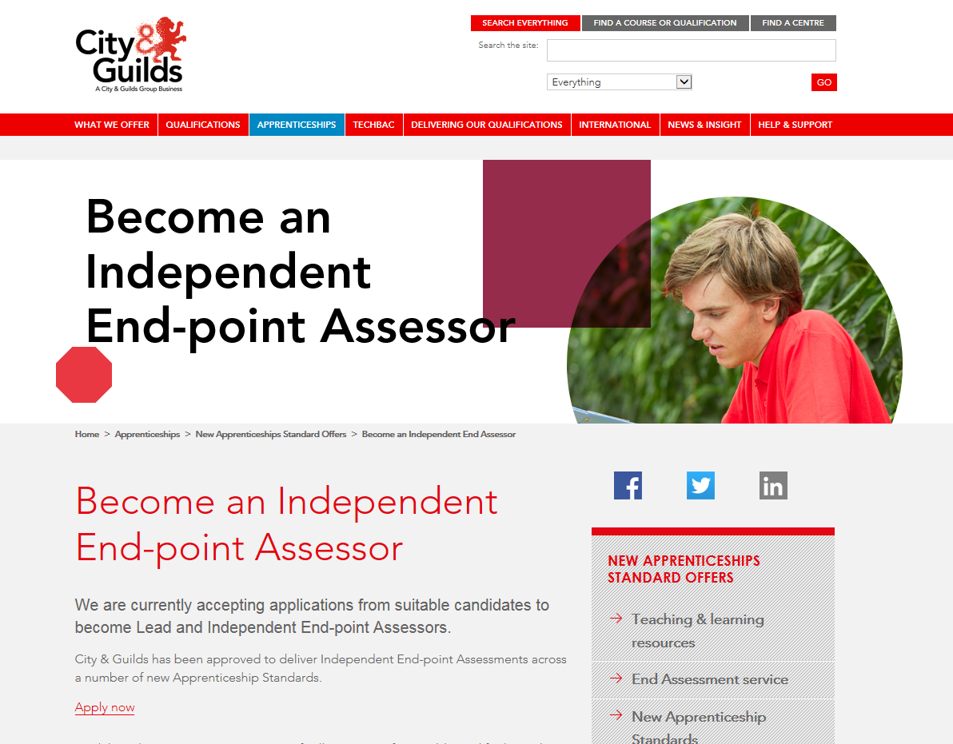
http://www.cityandguilds.com/apprenticeships/emerging-standards/independent-end-assessor

Slide 41
Next steps

Slide 42
And if you want to take things further with us
Apprenticeship
consultancy offer
Areas of apprenticeship consultancy and training
Audit your current apprenticeship strategy
A root-to-branch audit that assesses your current strategy and identifies opportunities for growth. You’ll receive an on-site consultation from a City & Guilds apprenticeship specialist who has experience in commerce and further education.
Defining your apprenticeship offer
A carefully constructed plan defining your new strategy and providing a framework for implementation. Our consultants will draw up an improved offer that takes advantages of the new opportunities for growth.
Upskill your team
Expert-led training courses that equip your staff to deliver your new apprenticeship strategy. We offer five different courses to meet your needs around commercial development, contract negotiation, apprenticeship support, funding, and trainer coaching.
Understanding
your needs
Define and
develop solutions
Implement
change
http://www.cityandguilds.com/what-we-offer/centres/consultancy-service

Slide 43
Support and resources available
Find all our past and upcoming workshops, webinars and events here.
Check our apprenticeship, consultancy and events pages on the City & Guilds website:
http://www.cityandguilds.com/apprenticeships
http://www.cityandguilds.com/what-we-offer/centres/what-is-advance
http://www.cityandguilds.com/what-we-offer/centres/improving-teaching-learning/events

Slide 44
More useful resources
Provider/ employer apprenticeship funding rules 2017/18
Apprenticeship funding policy and funding bands sheets
Register of Apprenticeship Training Providers
Apprenticeship funding from May 2017 – policy paper
Technical Funding Guidance
Apprenticeship standards
Becoming an Employer/Training Provider Guidance

Slide 45

Any questions?

Slide 46
Thank you
Keep up to date – register for email updates: http://www.cityandguilds.com/what-we-offer/centres/email-updates
To be involved in the developments of the new qualifications: businessskills@cityandguilds.com
For more information on the new standards, our learning resources (including demos), and how we can support your business: directsales@cityandguilds.com
For additional information on end-point assessment: endpointassessment@cityandguilds.com

