Slide 1
How to use the Submit
Evidence Button
Version 1
4th December 2020

Slide 2
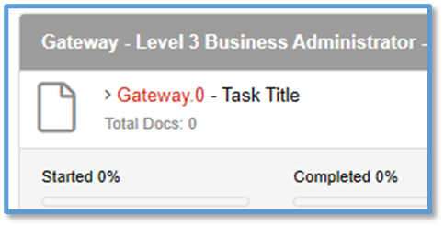
Uploading Gateway Evidence
Step 1:
Search the Apprentice name in the Learner box
When the apprentice has been found, the details will show below.
Click on their name (in red) and a new window will launch.
Step 2:
In the ‘Course’ tab, click on Gateway (in red).
Look to the right and click on ‘Evidence Wizard’

Slide 3
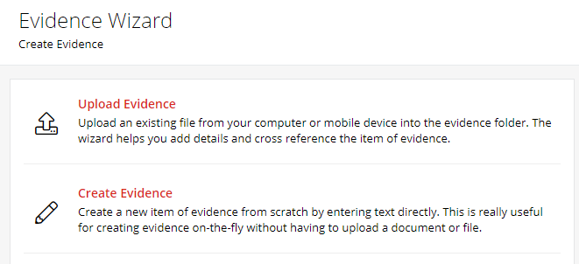
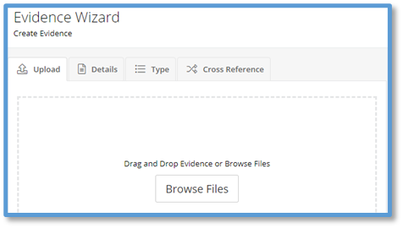
Uploading Gateway Evidence
Step 3:
Evidence Wizard will launch a new window.
Click on ‘Upload Evidence’
Click on ‘Browse Files’
Select the relevant Gateway files from your PC

Slide 4
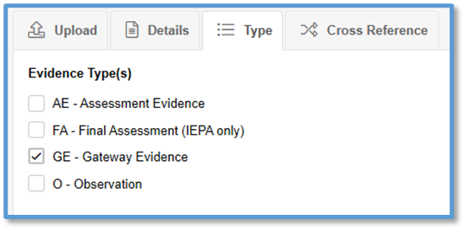
Uploading Gateway Evidence
Step 4:
Under ‘Uploaded Files’, you will see the file uploaded.
If this is the wrong file, then click on the bin icon to delete.
Step 5:
Click ‘Type’ tab.
Tick ‘GE- Gateway Evidence’.
Click ‘Cross Reference’ tab.
Click on ‘Gateway’ to open and tick ‘Gateway’.

Slide 5
Important Note!
On the next slide we will show you how to submit the evidence.
Only ‘Submit Evidence’ when all Gateway Evidence is uploaded.
Always double check that everything is correct before submitting the evidence.
And remember, the gateway component will be locked once you press submit!

Slide 6
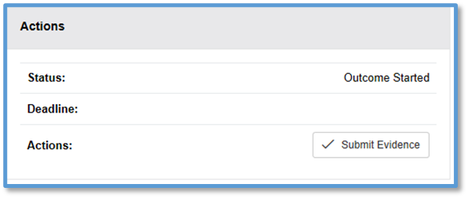
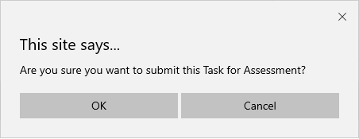
Uploading Gateway Evidence
Step 6 – The Final Step:
Select ‘Choose Evidence’
Tick the boxes beside the evidence you wish to submit.
Only after this is done will the Submit Evidence button appear on the right of the screen.
Click ‘Submit Evidence’ in the Actions box
A new window will open to reconfirm that you want to submit the Gateway Evidence.
If yes, then click ‘OK’.

Slide 7
How do I know it’s been accepted?
Once the evidence has been submitted, the Gateway file is locked and cannot be amended
And that’s all you need to do!
There isn’t a requirement to email us; the system informs us you have done this.
Our Gateway team will review the evidence within three working days. If the evidence is accepted the Gateway component will turn green in the EPA Portal
If the evidence has to be returned, the Centre Contact will receive an email within three working days.

Slide 8
We do not receive a notification when you upload evidence. If you are unable to use the Button you should email the EPA Gateway Team to request a gateway check.
Additionally, if you have any further questions, please do get in touch with our EPA Gateway Team.
EPA.Gateway@cityandguilds.com

